Slide 1
Normal School of Preschool Education
CAMBRIDGE LMS -UNIT 10 REPORT
Teacher: Brenda Bollain y Goytia de la Peña
Name: Maria Guadalupe Morales Mendoza

Slide 2
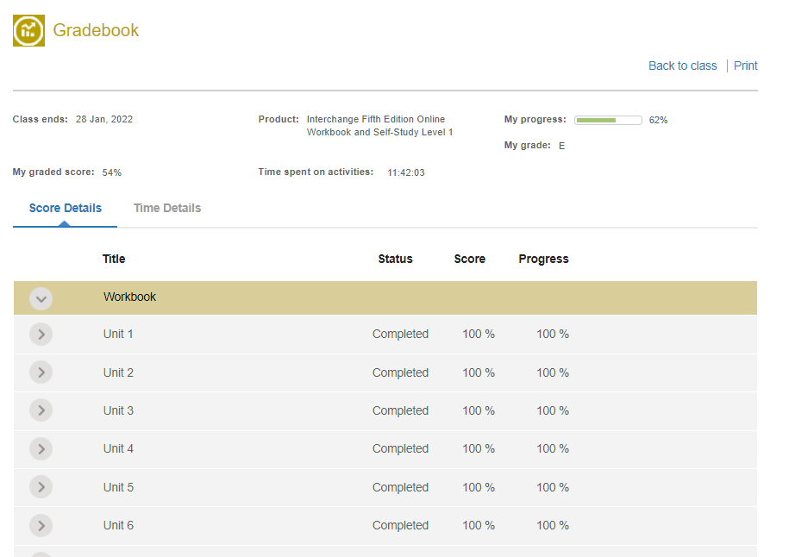
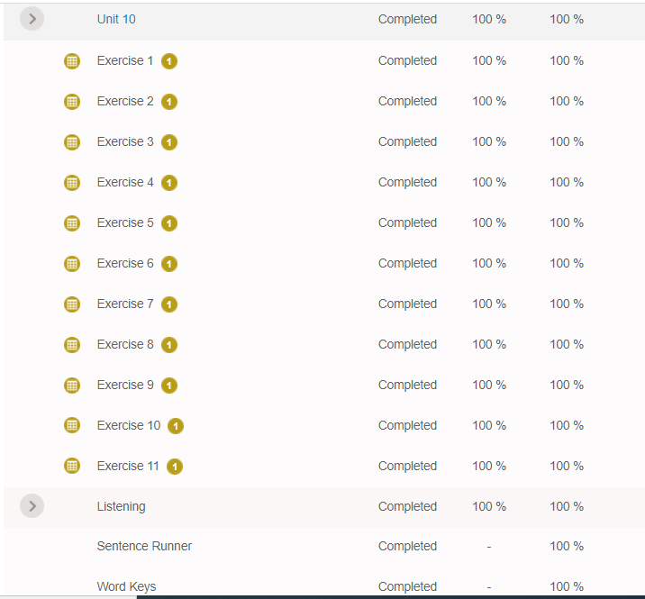
Maria Morales Mendoza
Maria Morales Mendoza

