Slide 1
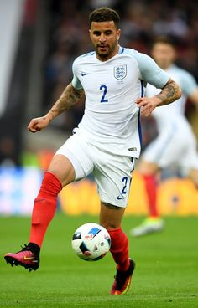
UNIT 10 Lesson 1: Speaking Avtivity
Aim:
Give Ss practice in making wh questions
Plan:
Ss read the following article about a day in life of David Johnson, then Ss will answer the given questions.
Ss. In pairs will roleplay a convertsation using the questions to talk about a day in the life of David Johnson (both ss participate equally)
Ss will record their voices making and answering the questions.
Presentation:
Ss upload the following activity with their recorded answers individually in escuela en red.
A day in the life of David Johnson
My name is David Johnson and I´m from England. I´m a footballer and I play for Manchester United in the English premiere league. In England, football matches are usually on Saturday.
On Saturday, I get up at half past seven and have breakfast at nine o´clock. I sometimes have bacon and eggs for breakfast.
In the morning, I often watch TV with my children and read the newspaper. I go to the stadium at half past eleven and have lunch with the other players at quarter past twelve.
For lunch, we usually have fish and vegetables, we hardly ever eat junk food. The match starts at three o´clock and finishes at quarter to five.
In the evening I usually go to a restaurant with my wife. When I get home, I watch a movie on TV. and go to bed very late.

Slide 2
Answer the following questions | Write COMPLETE statements
1.- What is his name? | Eg. His name is David Johnson
2.- Where is he from? | He is from England
3.- What does he do? | He is a footballer
4.- Where does he work? | He Works in Manchester United in the English premiere league
5.- What time does he have breakfast? | He has breakfast at nine o’clock
6.- How often does he have eggs and bacon for breakfast? | He sometimes has eggs and bacon for brakefast
7.- What does he do in the morning? | He often watches TV with his children and reads the newspaper.
8.- Who does he watch TV. With? | With his children
9.- What time does he go to the stadium? | He goes at half past eleven
10.- How often does he eat junk food ? | He hardly ever eats junk food.
11.- What time does he have lunch? | He has lunch at quarter past twelve.
12.- Who does he have lunch with? | With the other players
13.- What does he have for lunch? | He usually has fish and vegetables
14.- Where does he go in the evening? | He usually goes to a restaurant with his wife.
15.- Who does he go to the restaurant with? | With his wife
Insert here your audio with your conversation (make and answer the given questions)

