Slide 1

Escuela Normal de Educación Preescolar
Licenciatura en educación preescolar
Ciclo escolar 2020 – 2021
INGLES A1.2
2° semestre
MAESTRO: Máyela Alejandra del Carmen Gaona García
María de los Ángeles Guevara Ramírez
Natalia Elizabeth Ramirez Hernández
What can you do?
COURSE COMPETENCES
The students will develop their ability to use English in personal and social communications, to develop relationships, complete transactions and meet every day needs.
The students will increase their engagement with cultural and intercultural activities in English, in order to develop a better understanding of their own culture as well as other cultures around the world
The students will develop their ability to teach in a school environment where English is an important aspect of the school approach. Schools are expected to use English increasingly for various teaching and learning activities, and future teachers need to be confident in using English in the school environment

Slide 2
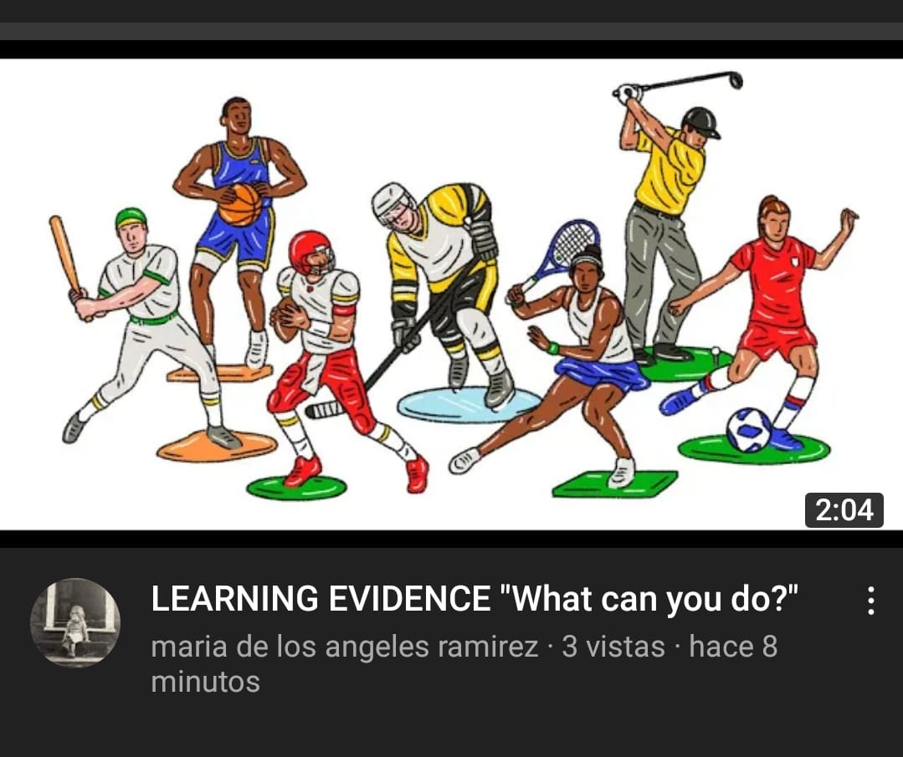
Video
https://www.youtube.com/watch?v=QiSHZI5E84I
María de los Ángeles Guevara Ramírez
Natalia Elizabeth Ramirez Hernández

Slide 3
Conversation
Do you like sports in your free time?
Of corse I do. I love sports!
So do I! What sports do you like?
I like soccer, basketball and volleyball
I prefer swimming, but I like to watch tennis on T.V.
What sports do you play?
Well, I like swim, but I can't do other sports very well
Who do you practice with?
I practice with my friends
Where do you practice?
I practice in the Olympic pool or I can also practice in the swimming school pool
How often do you practice?
I practice two hours a day
When do you play?
I practice Thursday and Sundays
What time do you play?
I practice in the mornings
What can you do?
I can play soccer but I can't skate
Can you ride a hourse?
Yes I can and I can play basketball
Can your Father play soccer?
No he can't but he can play volleyball

Slide 4
ESCUELA NORMAL DE EDUCACION PREESCOLAR
ENGLISH A1.2
TEACHER: MAYELA LAEJANDRA DEL CARMEN GAONA GARCIA
LEARNING EVIDENCE RUBRICS
General requirement format (+20pts) | Points | Total pts.
Vocabulary of sports (sports with play and go), free time activities, abilities and talents from the unit 10 (+5) | 5
Use grammar structures, simple present wh questions (+8) | 10
Use grammar structures, modal can in affirmative and negative statements (+3) Use connectors as and, but ,or or. | 3
Use grammar structures, modal can in questions (+2) | 2
Total: | 20
General requirement format (+5 pts) | Good (1) | Average (.5) | Weak (0)
Does the student correctly apply in context the new functions and grammar from the module?
Does the student correctly apply in context the vocabulary from the module?
Does the student express himself or herself clearly and fluently?
The task is creative.
The task fulfill all the elements of the required format
Total:

