Slide 1
ESCUELA NORMAL DE EDUCACIÓN PREESCOLAR
Licenciatura en educación preescolar
Ciclo escolar 2020-2021
Segundo Semestre
“Learning Evidence Unit 10”
Curso:
Inglés A1.2
Aim:
Give Ss practice in talking about sports and hidden talents using simple present Wh-questions and modal can to describe some of their abilities.
Alumnas:
Mariel Resendiz Villarreal
Daniela Lizeth Trujillo Morales
Maestra:
Mayela Alejandra del Carmen Gaona García
Saltillo, Coahuila. A 27 de junio de 2021.

Slide 2
ESCUELA NORMAL DE EDUCACION PREESCOLAR
ENGLISH A1.2
TEACHER: MAYELA LAEJANDRA DEL CARMEN GAONA GARCIA
LEARNING EVIDENCE UNIT 10
Project: Conversation
Aim:
Give Ss practice in talking about sports and hidden talents using simple present Wh-questions and modal can to describe some of their abilities.
Preparation:
Ss. will roleplay a casual convertsation talking about their likes and dislikes about sports or any other free time activities, they will mention some abilities or hidden talents they may have.
Materials:
Video of the conversation.
Plan:
Ss work in pairs.
Ss roleplay a casual conversation (both ss participate equally)
Ss talk about their likes and dislikes in sports or any other free time activity. Each of them mention the sport(s) or activity(es) that he /she practices.
In order to obtain specific information, the student make some Wh questions to his/her partner about the sport or activity he/she practices.
Ss also talk about their hidden talents of special abilities they may have. They will use the modal can and some connectors as and, but, or or
The student make some questions to his partner using modal can.
Variant: Ss can also talk about a member of his/her family
Present
Ss upload their video individually in escuela en red.

Slide 3
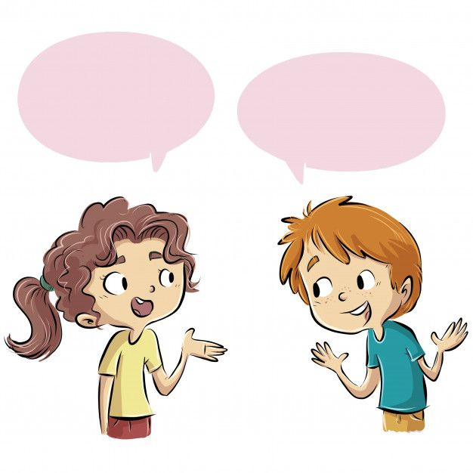
Example of questions ss can use to roleplay a conversation
Do you like sports? (you can use any verb to make your questions)
What sports do you like?
What sports do you play?
Who do/does………………..with?
Where do/does……………….. ?
How often do/does …………..?
When do/does…………….?
What time do/does …………….?
What can you do?
Can you ..............................? (+ and – answer using connectors and, but, or)
Can your sister do a hand stand?
Example 1
Example 2
What sports do you play?
I play soccer
How often do you go bike riding?
I go bike riding twice a week
Example 3
Example 4
What can you do?
I can sing very well
Can your brother cook?
No, he can´t but he can play the violin

Slide 4
CONVERSATION
Mariel: Hi, how are you?
Daniela: Fine thanks and you?
Mariel: Good thanks, hey I wanted to ask you something
Daniela: Sure, tell me.
Do you like sports? (you can use any verb to make your questions) Yes, I do.
What sports do you like? I like volleyball and hiking.
What sports do you play? I don’t play any sport, but I practice folk dance.
Who do you practice with? I practice with my friends.
Where do you practice? I practice at Ignacio Zaragoza School.
How often do you practice? I practice two times a week.
When do you practice? I practice on Tuesdays and Fridays.
What time do you practice? I practice at 11:00 a.m.
What can you do? I can edit a video and I can do math in my head.
Can you sing or draw? (+ and – answer using connectors and, but, or) No, I can’t. But I can paint, I like it very much.
Who can run a marathon in your family? My sister can run a marathon
And Do you like sports? Yes, I do
What sports do you like? I like swimming and football
What sports do you play? I go running
Who do you practice with? I practice with my sister
Where do you practice? I practice in the park
How often do you practice? I practice five times a week
When do you practice? I practice from Monday to Friday
What time do you practice? I practice at 5:00 p.m.
What can you do? I can ride a horse and paint
Can you play chess or cook? No, I can´t play chess, but I can cook
Who can sing in your family? My sister can sing
Daniela: Our talk was very interesting, but I have to go.
Mariel: Sure, see you another day.

Slide 5
https://www.youtube.com/watch?v=8xNNB9I3gy0
VIDEO

Slide 6
ESCUELA NORMAL DE EDUCACION PREESCOLAR
ENGLISH A1.2
TEACHER: MAYELA LAEJANDRA DEL CARMEN GAONA GARCIA
LEARNING EVIDENCE RUBRICS
General requirement format (+20pts) | Points | Total pts.
Vocabulary of sports (sports with play and go), free time activities, abilities and talents from the unit 10 (+5) | 5
Use grammar structures, simple present wh questions (+8) | 10
Use grammar structures, modal can in affirmative and negative statements (+3) Use connectors as and, but ,or or. | 3
Use grammar structures, modal can in questions (+2) | 2
Total: | 20
General requirement format (+5 pts) | Good (1) | Average (.5) | Weak (0)
Does the student correctly apply in context the new functions and grammar from the module?
Does the student correctly apply in context the vocabulary from the module?
Does the student express himself or herself clearly and fluently?
The task is creative.
The task fulfill all the elements of the required format
Total:

