Slide 2
Escuela Normal de Preescolar English III. Sharing information and ideas CEFR Level A2.2
Teacher: Beatriz Eugenia Valdés Rodríguez
Term I
Number of hours/ Credits: 6/ 6.75
Class schedule: 3 sessions of 2 hours each weekly

Slide 3
Course purpose
The English Language Course for Escuelas Normales is designed to develop students’ ability to communicate effectively in English contexts that will be important for them. As future teachers in a society where English is increasingly important for engaging successfully with professional and social activities, it is essential that all students develop a good level of proficiency in English.

Slide 4
English is growing in importance for accessing information, making useful contacts, understanding other cultures and participating in cultural activities.
As UNESCO has said: Linguistic competencies are fundamental for the empowerment of the individual in democratic and plural societies, as they condition school achievement, promote access to other cultures and encourage openness to cultural exchanges (UNESCO 2007:13). English is particularly important for students because of its role un multinational communicative settings (Hyland 2011).

Slide 5
Course Progression
Previous course
Subsequent course

Slide 7
Common European Framework of Reference (CEFR)
BASIC USER

Slide 8
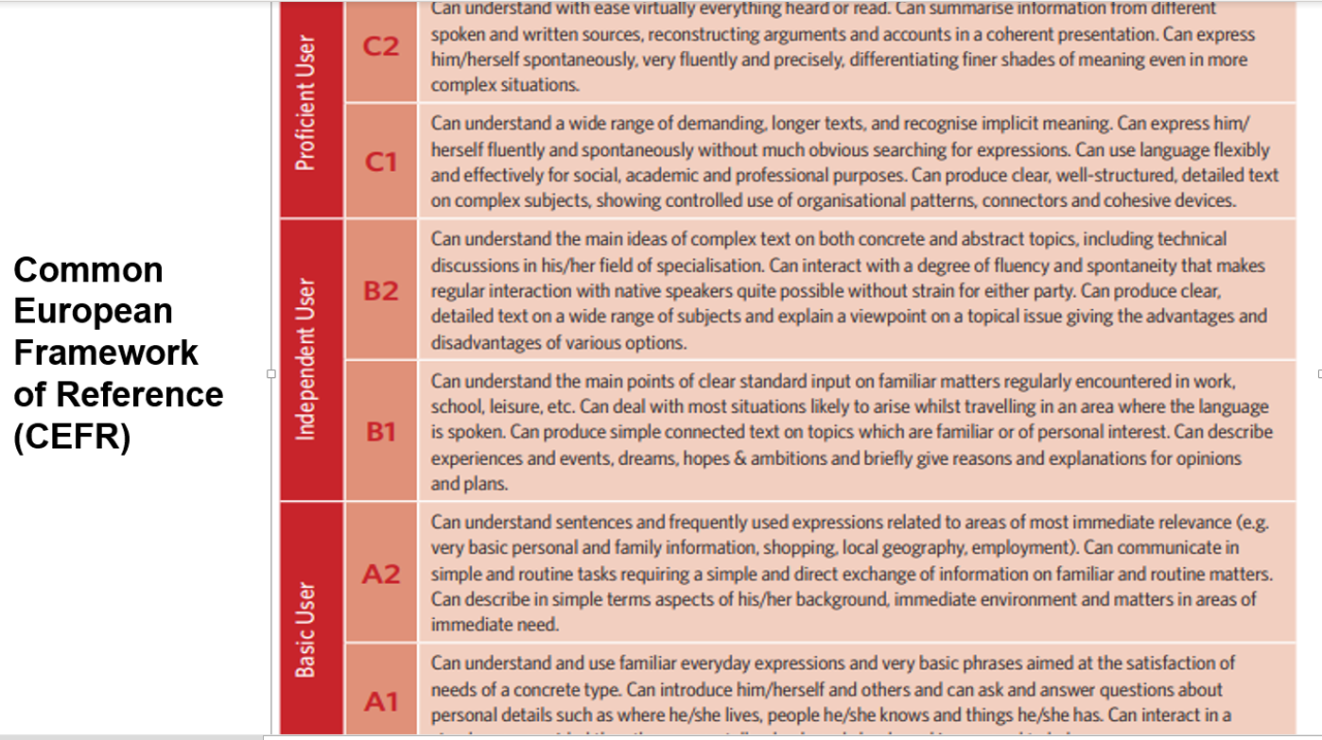

Slide 9
The course has three main objectives:
Develop their ability to use English in personal and social communications, to develop relationships, complete transactions and meet everyday needs.
Increase their engagement with cultural and intercultural activities in English, in order to develop a better understanding of their own culture as well as other cultures around the world.
Develop their ability to teach in a school environment where English is an important aspect of the school’s approach. Schools are expected to use English increasingly for various teaching and learning activities, and future teachers need to be confident in using English in the school environment.

Slide 11
Course Description
The English language course is based on the communicative approach to language learning in line with the Common European Framework of Reference form the Council of Europe. More specifically, there are five main principles of language learning that underpin this curriculum:
Focus on meaningful communication
Teach authentic English.
Students learn most effectively through doing.
Students lean best when motivated and engaged
Differentiate the teaching according to different interests and needs among each group of students.

Slide 12
Competences of the degree profile developed by the course
GENERIC
Use critical and creative thought for solving problems and taking decisions.
Learn in an autonomous way and demonstrate initiative for self-regulation and strengthen her /his personal development.
Cooperate to bring about innovative projects having a social impact.
Act within an ethical way by interiorizing social rules and principles needed for a better coexistence.
Use ICT as well as other languages for understanding, explaining and offering alternative solutions to the problems encountered.

Slide 14
Competences of the degree profile developed by the course
SUBJECT-SPECIFIC
Describe ways of living from different cultures to appreciate their diversity.
Use language to establish harmonious and responsible relationships when exercising citizenship.
Reflect on one´s own learning process to act consciously in communicative exchanges.
Understand and produce texts to participate in a variety of everyday and concrete situations.
Exchange basic information about personal and professional experiences.
Recognize cultural differences when participating in brief and common exchanges.

Slide 15
Course structure
PERIOD | BOOK UNITS | CONTENTS | LEARNING EVIDENCES
1 | Unit 7- We went dancing! | Free-time and weekend activities | Project 7-Wish you were here! Design a postcard from the place you are visiting and say what activities you have done there- Express it orally in Flipgrid or Vocaroo App.
 | Unit 8- How´s the neighborhood? | Stores and places in a city; neighborhoods; houses and apartments | Project 8 The perfect neighborhood, write a poem about it. Delivery date Apr 30th
2 | Unit 9.What does she look like? | Appearance and dress; clothing and clothing styles; people. | Project 9: What should I wear? Ss create an online catalog of clothing items they want to sell according to their favorite clothing style.
 | Unit 10. Have you ever been there? | Past experiences; unusual activities | Project 10:What have they done? Ss choose a historical character and research their biography and then represent him/her using the present perfect and the simple past. Delivery grades June 11th.
3 | Prepare for cross evaluation Question bank with contents from units 1 to 10 Results in cross evaluation

Slide 16
Assessment Criteria
EVALUATION OF EACH LEARNING UNIT (1-3)
Exam | 30%
Projects (4) (portfolio included) | 30%
Classwork, homework, platforms | 30%
Participation | 10%
Attendance, punctuality, attitude, complete materials, respect, and classwork
EVALUATION OF THE SEMESTER
AVERAGE OF LEARNING UNITS | 50%
FINAL EVIDENCE (INTERVIEW) | 50%

Slide 17
Global Evaluation
NOTE:
In order to have two opportunities to regularize your status you must attend 85% of class hours.
50%
50%
Average of learning units 1-3
Final Evidence
(Speaking)

Slide 18
NOTA IMPORTANTE
El estudiante acreditará el curso cuando obtenga como mínimo en la evaluación global del nivel de desempeño, su equivalencia numérica de 6.
El estudiante acreditará el nivel una vez que evidencie el desarrollo de las habilidades propias del nivel de inglés con base en el CEFR mediante una entrevista realizada al final del ciclo escolar.
En caso de que el estudiante no logre el desarrollo de las habilidades necesarias para obtener el nivel de inglés que esté cursando, se evaluará con base en el desempeño del estudiante, sin embargo, tendrá que cursar nuevamente el nivel.

Slide 19
Course policies
Course Materials: Failure to bring the book results in losing points per day.
Homework: There will be regular online homework tasks, as well as homework related to textbook material. If you are absent for any reason, it is your responsibility to find out the homework assigned.
Late homework: It is your responsibility to turn in homework assignments on time. In case you present homework assignments or projects after the stablished due date, The maximum grade will be 70
Grading: Your course grade will depend on performance on tests, speeches given, and participation. Satisfactory participation means completing the tasks assigned in class and interacting with your classmates in English at all times. Quizzes, tests, speeches, and other presentations cannot be made up unless the student has an excuse absence by ENRE. This means that if a student is not in class for this work, he or she will receive a grade of 0 for the missed work.

Slide 21
Policies about being late and being absent.
In accordance to ENEP‘s policies, you must attend 85% of class time hours.
Class participation grade will be affected if you:
Arrive late or leave early.
Miss class.
Sleep during a class.
Read anything during class which is not related to class activities.
Speak Spanish in class.
Disrespect teacher or classmates during the class or in social media such as whatsapp.
Please turn off cell phones during class!
Cell phones should be turned on in class; no texting may be done in class. In addition, students may not use electronic devices with earphones in class nor may they do recreational activities on computers. Electronic dictionaries may be used in class but not during tests.

Slide 24
Golden rule: Treat others as you want to be treated.
BE….
Respectful
Honest
Patient Neat
Tolerant
Participative
Receptive
Confident
Positive
INTERESTED

Slide 26
Additional online references and resources
Learning English. http://www.bbc.co.uk/learningenglish
Teaching adults. https://www.teachingenglish.org.uk/teaching-adults
Adult learners. https://elt.oup.com/learning_resources/courses/adultlearners/?cc=mx&selLanguage=en
Learning English. https://www.cambridgeenglish.org/learning-english/
Teacher’s corner. https://americanenglish.state.gov/teachers-corner
Classroom resources. Pearson. https://www.pearsonelt.com/professional-development/resources.html
Teaching adults. Oxford. https://elt.oup.com/teachersclub/courses/teachingadults/?cc=mx&selLanguage=en
For teachers. BBC. http://www.bbc.co.uk/worldservice/learningenglish/teach/
Onestop English. http://www.onestopenglish.com/
The digital teacher. https://thedigitalteacher.com/
https://visuwords.com/
https://www.eslvideo.com/
https://es.lyricstraining.com/
https://www.busuu.com/es
http://intermediatelow.blogspot.com/
https://www.englishclub.com/
http://www.topics-mag.com/
http://www.readableblog.com/
https://dictionary.cambridge.org/es/
http://www.bbc.co.uk/learningenglish
https://www.tefl.net/
http://www.elllo.org/

