Slide 1
Possesives and vocabulary practice.
Write at least (3) sentences to answer the model questions on each picture of the slides
Model questions:
What is he/she wearing? Or What are they/we wearing?
What color is/ are his/her ..(clothing)..? Or What color is/ are their/our ..(clothing)..?

Slide 2
What is he wearing?
What is she wearing?
What color is/are her….?
What color is/are his….?
Dan
May

Slide 3
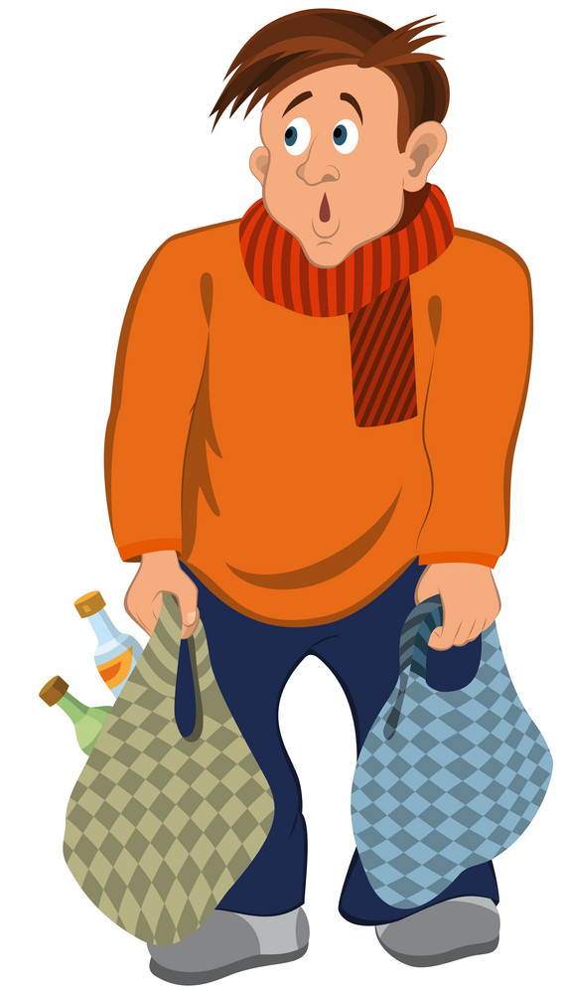
David

Slide 4
Mary

Slide 5
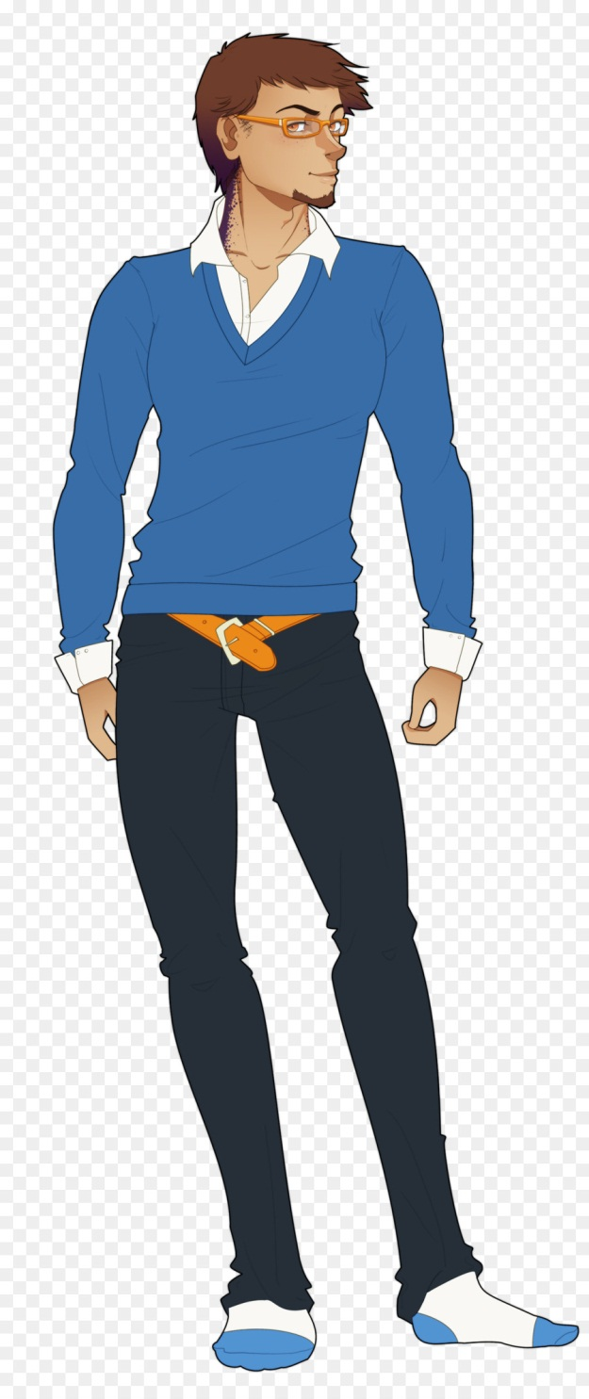
Carl

Slide 6
Cesar

Slide 7
Ary

Slide 8
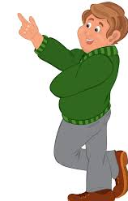
They
Roger
George

Slide 9
Me
My friend

Slide 10
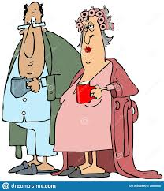
They
Mr. Smith
Mrs. Smith

