Slide 1
Only Time will Tell
Good afternoon!
November 13th 2018

Slide 2
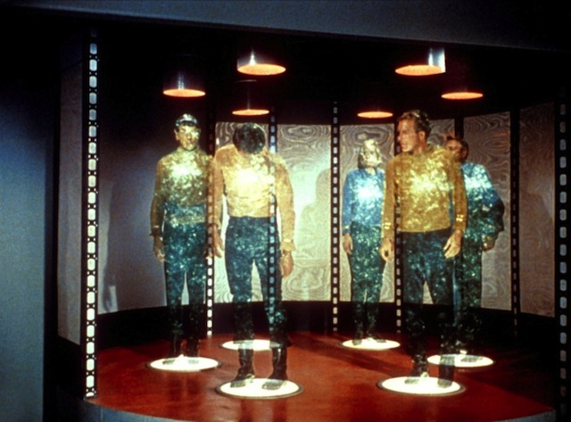
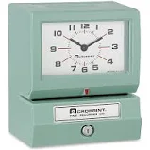
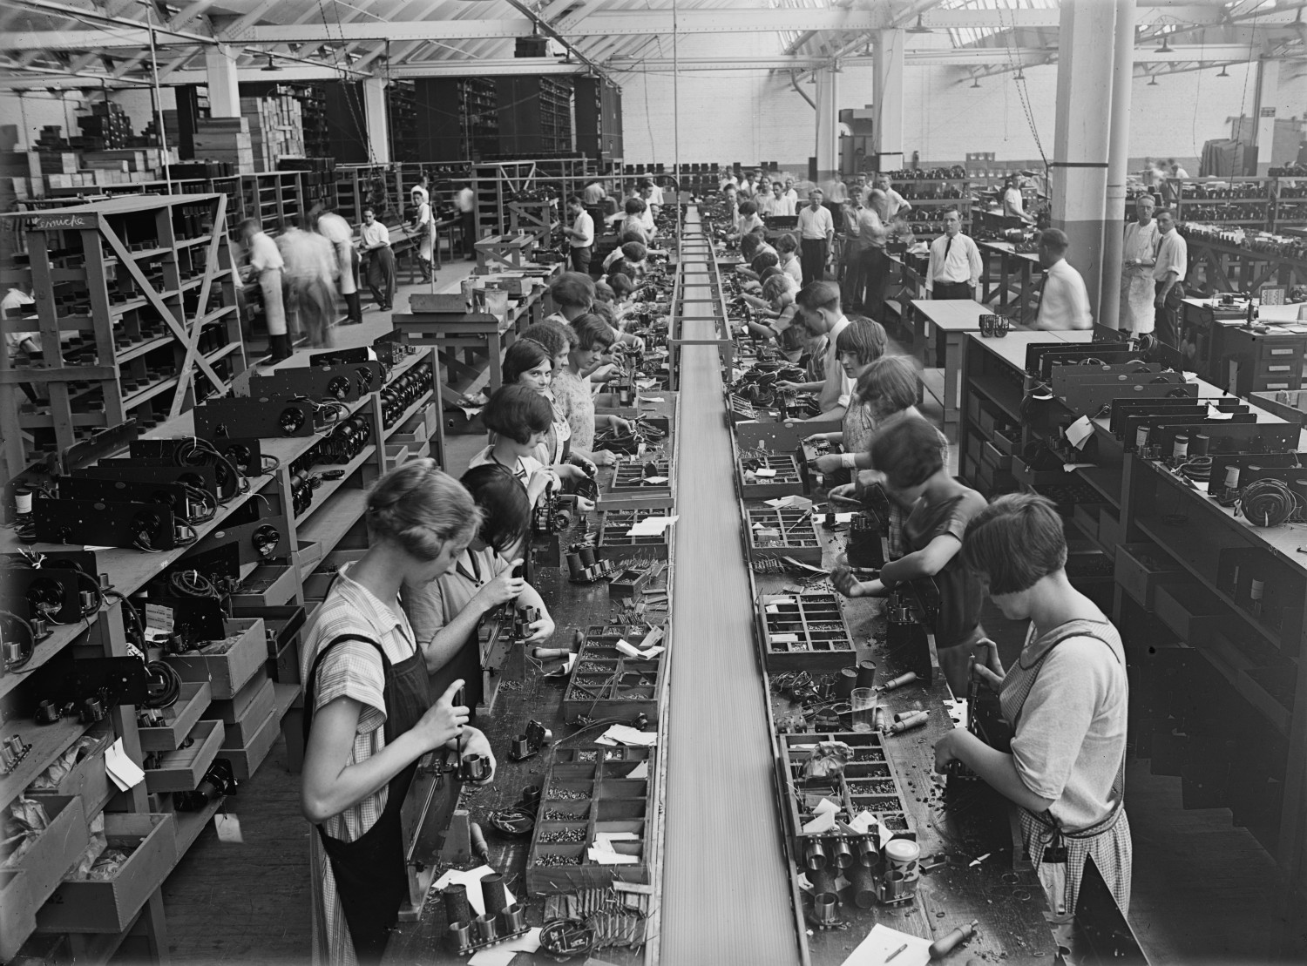
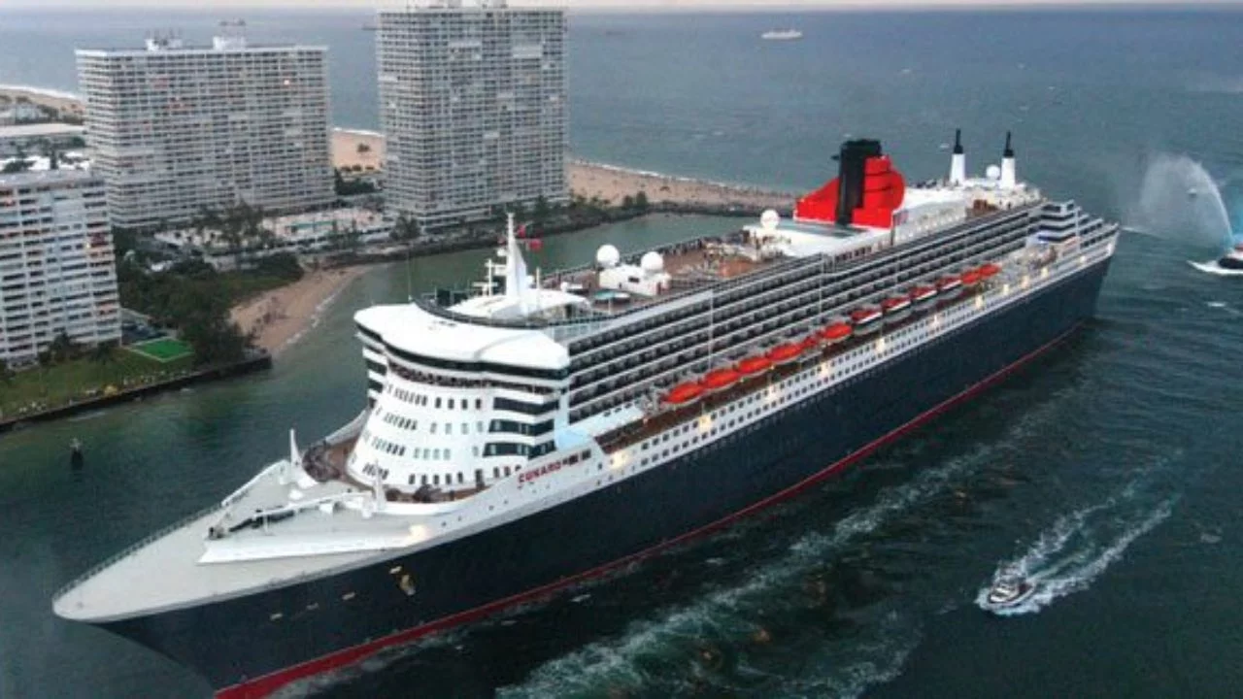
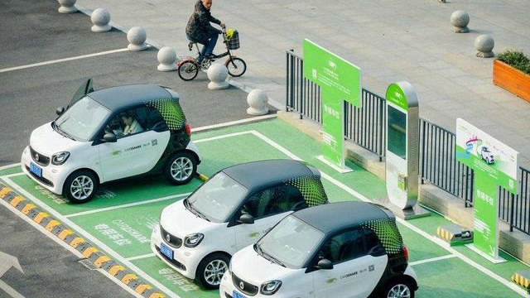
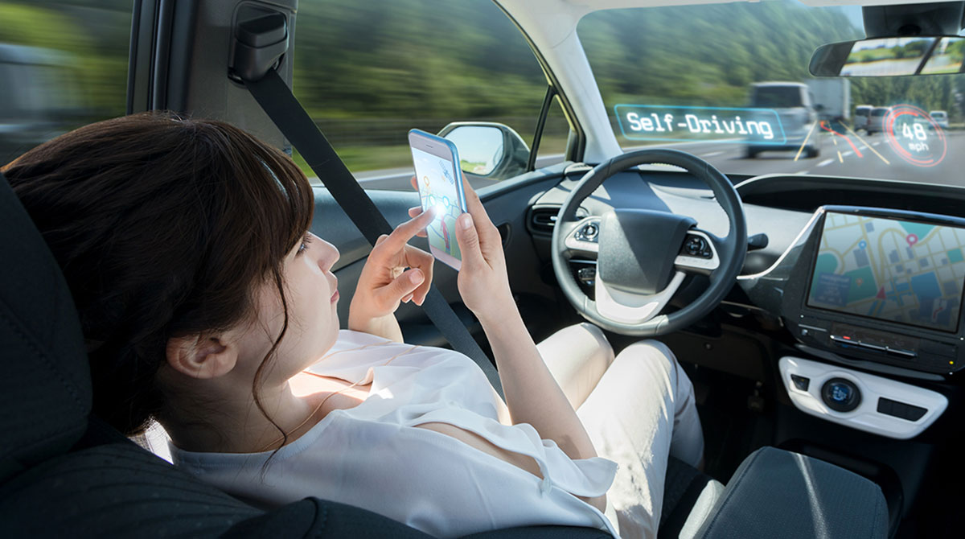
SNAPSHOT
Can you think of some ways life 100 years ago was different form life today in these categories?
How do you think it will be different in the next 50 years?
Education
Work
Transportation

Slide 3
Conversation
What kinds of buildings can you see?
How old are the people?
Why do you think they look surprised?
---------------------------------------------------------------------------------------------------------------------
Have things changed a little or a lot?
Have things changed for the better or for the worse?
In the past | Now
There were houses. | They’re
There was a burger restaurant. | It’s an
There was a high school. | They’re
People hung out with friends after school. | They

Slide 4
Time expressions
Which are the tenses used for referring to the three different time periods presented in this lesson?
Which expressions could we use with each tense?
Past
Present
future

Slide 5
“Making the big bucks”
Who wants to make a lot of money?
Why?
Teams of four people
Think about these to complete the mind map:
How will your life change for the better?
How will your life change for the worse?
If I get a high-paying job

Slide 6
Book page 33. Perspectives
Did you mention any of these consequences?
Which are advantages of getting a high-paying job?
Which are disadvantages of getting a high-paying job?
Why?

Slide 7
Possible situation
(it may happen)
Consequence
If you get a high-paying job,
Your friends might ask you for a loan
your friends might ask you for a loan.
if you get a high-paying job.

Slide 8
Grammar focus Which structures do you see?
Typical
To show the consequence is less likely
Possibility
Necessity
If + simple present, subject + will/won’t
If you eat candy, you’ll gain weight.
If + simple present, subject + may/might
If you eat candy, you may gain weight.
If + simple present, subject Will + be able to/ will + have to
If you save money, you’ll be able to travel.
If you travel abroad, you’ll have to get a visa.

Slide 9
Chain game
T: If I have time this weekend, I’ll go to the movies.
Ss: If I go to the movies this weekend, I’ll…
T: If she finishes her homework early, she’ll go out for a ride in her bike.
Ss: If she goes out for a ride in her bike, she’ll…

Slide 10
Book page 91. Interchange 9
Pair work.
Compare your opinions.
T: I don’t really agree. If a woman works outside the home, she’ll bring money to the house and she will feel fulfilled, so she will feel happy.

Slide 11
Domino game
Create a domino using collocations and conditional sentences with if clauses.
…I will earn respect from others.
If I behave with honesty, …
If I get sick…

Slide 12
Homework
As self study, complete the grammar plus activity
Complete work book pages from Unit 9.

