Slide 1
Unit 4
Do you play the guitar?
Aims:
Discuss entertainment likes and dislikes
Make, accept, and decline invitations

Slide 2
Objective questions
What kinds of music do you like? Do you like [type of music]?
Who’s your favorite musician? What musical instrument does he/she play?
Do you play a musical instrument? What instrument do you play? Do you play the piano/guitar?
What kinds of TV programs do you like? Do you like [type of TV show]?
What kinds of movies do you like? Do you like [type of movie]?
Do you play video games? What’s your favorite video game?
Would you like to go to [event] this weekend? Why or why not?
Would you like to [activity] this weekend?
Ask me about music/TV shows/movies. or Ask [classmate] about music/TV shows/movies.

Slide 3
READ.
THINK.

Slide 4
PRACTICE: categorize types of movies, TV shows and music

Slide 5
PRACTICE: scan a time line for details; read a biography of an entertainer; develop skills in sequencing events
C.
1. Who is your favorite musician?
A=
2. What do you know about his or her life?
A=

Slide 6
PRACTICE: use yes/no and Wh-questions with do in a conversation about entertainment likes and dislikes
B.
1. What do you think of Tylor Swift?
A=
2. What do you think of Drake?
A=
C. Listen to the rest of the conversation.
1. Who is Seth’s favorite band?
A=
2. Does Leanne like them?
A=

Slide 7
PRACTICE: ask and answer yes/no and Wh-questions with do to discuss entertainment likes and dislikes
A. Find three questions with do or does in the Conversation.
1 | 2 | 3 | 4 | 5
 | Does | she | play | the violin?
 | Doesn’t | Drake | play | the guitar?
What kind of music | do | you | like?
B. What is the rule for forming questions with do or does?
A= Wh-questions+do/does+subject+ verb+complement.
C. Write three questions with do and does.
1 | 2 | 3 | 4 | 5
I live in Saltillo -verb
I listen to live music - adjective

Slide 8
D. Find and circle the example of an object pronoun in the Conversation.
1. What does her refer to?
. A=Taylor Swift.

Slide 9
Pronouns are used to avoid repetition.
Subject pronouns are those pronouns that perform the action in a sentence.
Object pronouns are those pronouns that receive the action in a sentence.
Example: I give them cookies every week.
E. PRACTICE.
https://agendaweb.org/exercises/grammar/pronouns/object-3
https://agendaweb.org/exercises/grammar/pronouns/object-4
For extra practice:
Object Pronouns
https://www.englisch-hilfen.de/en/exercises/pronouns/personal_pronouns3.htm

Slide 10
F. PAIR WORK PRACTICE. Find a classmate partner. Recreate the conversation. Fill in the gaps with new information. Listen to the original audio and practice your new conversation in pairs. Record your voices.

Slide 11
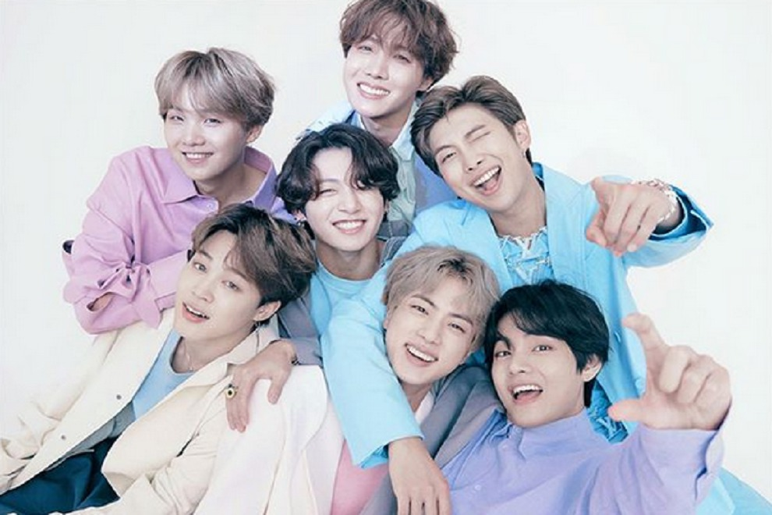
G. PRACTICE. Find and circle the example of an object pronoun in the grammar box.
H. PRACTICE. Complete the blank spaces and answer the questions.
Do you like classical music?
Do you like Hip-Hop music?
Do you like Pop music?
What kind of music do Karina and Rose like?
A= I really like pop and electronic.
What kind of music does Nayeli like?
A= She really likes pop music.
Do you play the Ukulele?
A=No, I don’t. I don’t know how.
Does Yaneth play the Ukulele?
A=No, she doesn’t. She doesn’t play and instrument.
Who plays a musical instrument?
What do you play?
A= I play the accordion.
What does she play?
A= She plays the accordion.
Do you like BTS band? Lucy, Cristy
Do they like BTS band?
A=No, they don’t. They don’t like them at all.
Do you play the guitar?
A=No, I don’t. I don’t know how.
Does Fatima play the guitar?
A=Yes, she does. She plays very well.
Do you like Taylor Swift? Yesi, Luz
Do your friends like Taylor Swift?
A=Yes. They do. They like them a lot.
Who do you like?
A= I like Morat.
Who does Paola like?
A= She likes Matiz.

Slide 12
I. Play the audio and practice your pronunciation.
J. PRACTICE. Complete these conversations.
For extra practice:
Wh-questions with do
http://www.learnenglish-online.com/grammar/exercises/yesnoquestionsexercise
Simple Present
https://www.ego4u.com/en/cram-up/tests/simple-present-1
SELF-CHECK

Slide 13
K. PRACTICE.
WHAT DO THEY LIKE?
Complete the conversations with yes, no, do, don’t, does, or doesn’t. Use information from the chart.
 | Kinds of movies they like | Kinds of TV shows they like
Samantha | comedies | game shows
Howard | science fiction, comedies | talk shows, game shows
1. | A: | Does Samantha like comedies?
 | B: | Yes , she does . She loves to laugh.
2. | A: | _________ Howard like comedies?
 | B: | Yes, he _________.
3. | A: | _________ Samantha and Howard like game shows?
 | B: | _________, they _________. They like them a lot.
4. | A: | _________ they like soap operas?
 | B: | _________, they _________.
5. | A: | _________ Samantha like talk shows?
 | B: | _________, she _________. She can’t stand them.

Slide 14
PRACTICE: sound more natural by using intonation when asking questions.
B. Practice these questions and record your voice.
Place your audio recording here.

Slide 15
PRACTICE: listen for details about people’s likes and dislikes
B. Who do you think is the best date for Alexis? Why?
A=
SELF-CHECK

Slide 16
PRACTICE: discuss entertainment likes and dislikes
Guide (model)
Write five questions about entertainment and entertainers.
1.
2.
3.
4.
5.

Slide 17
One of my favorites
Why Is Music Helpful for English as a Second Language (ESL) Students?
Music is a language in itself, and experts are now making the case that language is developed as a type of music. Both rely on the use of sounds to express thoughts and emotions, and both require timing, pitch and proper emphasis. Because many of the same skills are used in music and speech, experts argue that language and music acquisition occur side by side, and language acquisition is aided through music.
Task: Song report.
Choose a song.
Title of the song: | Singer: | Genre:
What’s the song about?
Why do you like this song?
How does the song make you feel when you listen to it?
New vocabulary | Meaning

