Slide 1




Slide 2

Escuela Normal de Educación Preescolar
English B1.2.2
Becoming Independent Communicators
Number of hours/ Credits: 6/ 6.75
Term: March – July 2021
Teacher: Cristina Aracely Alvarado Chavarría

Slide 3
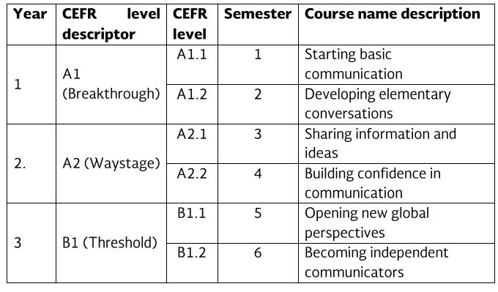
Course Progression

Slide 4
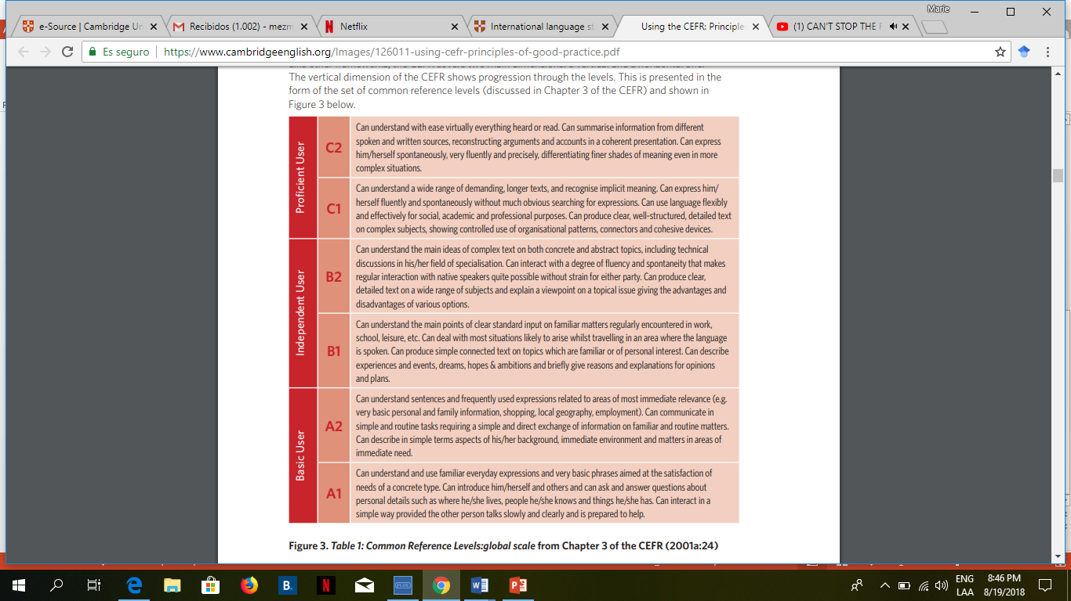

Slide 5





Course Purpose

Slide 6
This course has three main objectives:
The students will develop their ability to use English in personal and social communications, to develop relationships, complete transactions and carry out every day needs.
The students will increase their engagement with cultural and intercultural activities in English, in order to develop a better understanding of their own cultures as well as other cultures around the world.
The students will develop their ability to teach in a school environment where English is an important aspect of the school´s approach.

Slide 7
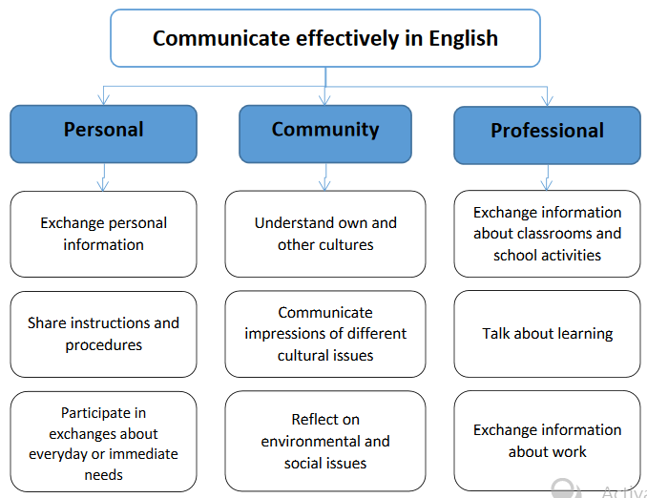

Slide 8
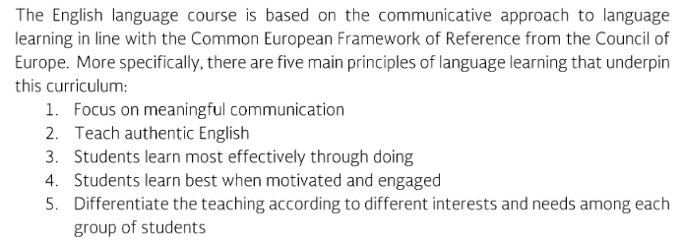
Course Description

Slide 9
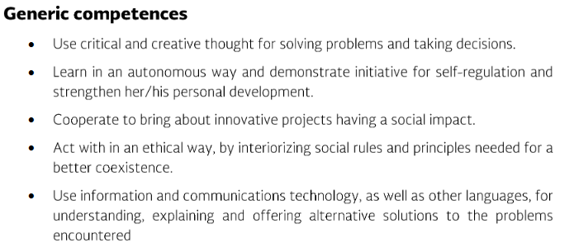
Competences of the degree profile developed by the course

Slide 10
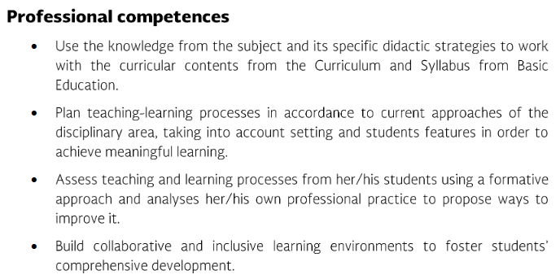
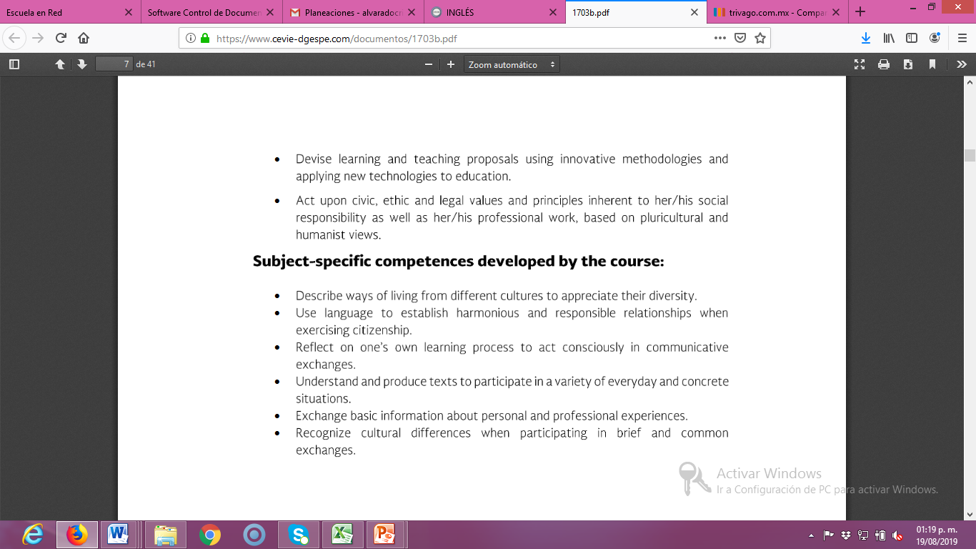

Slide 12
Course structure
PERIOD | BOOK UNITS | CONTENTS | LEARNING EVIDENCES
1 | What happened? Expanding your horizons That needs fixing | The media; news stories; exceptional events. Cultural comparisons and culture shock; moving abroad; emotions; customs; tourism and travel abroad. Consumer complaints; everyday problems; problems with electronics; repairs. | Project 1 Project 2
2 | What can we do? Never stop learning Getting things done | The environment; global challenges; current issues. Education; learners choices; strategies for learning and life skills. Everyday services; recommendations; self-improvement | Project 3 Project 4
3 | A matter of time Rites of passage Keys to success | Historic events and people; biography; the future. Milestones and turning points; behaviour and personality; regrets. Qualities for success; successful businesses; advertising. | Project 5 Project 6

Slide 13
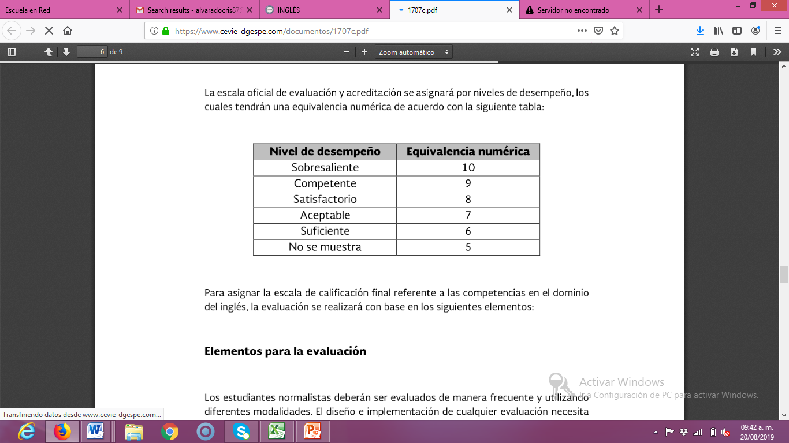
Assessment Criteria for E-learning
EVALUATION OF EACH LEARNING UNIT (1-3)
Classwork / Homework Todas las actividades asignadas en escuela en red y participación en sesiones virtuales. | 40%
Projects (2) | 20%
Exam | 20%
Platform | 20%
Attendance (camera on), punctuality, attitude, participation, respect, and classwork.
EVALUATION OF THE SEMESTER
AVERAGE OF LEARNING UNITS | 50%
FINAL EVIDENCE (INTERVIEW) | 50%

Slide 14


Global Evaluation
NOTE:
In case you fail one of the learning units, you will not be allowed to present the final evidence losing 50% of your global evaluation. In which case, you will have to present the extraordinary exam.
50%
50%
Average of learning units 1-3
Final Evidence
(Speaking)

Slide 15
NOTA IMPORTANTE
En caso de que el estudiante no logre el desarrollo de las habilidades necesarias para obtener el nivel de inglés que esté cursando, se evaluará con base en el desempeño del estudiante, sin embargo, tendrá que cursar nuevamente el nivel.
El estudiante acreditará el curso cuando obtenga como mínimo en la evaluación global del nivel de desempeño su equivalencia numérica de 6.
El estudiante acreditará el nivel una vez que evidencie el desarrollo de las habilidades propias del nivel de inglés con base en el CEFR mediante una entrevista realizada al final del ciclo escolar.

Slide 16
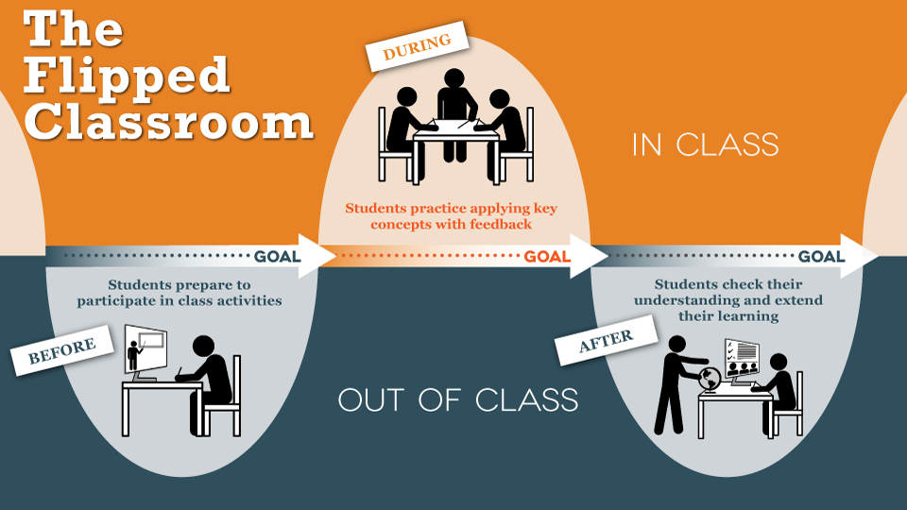

Slide 17



LA NETIQUETA. GUIA PARA TUS CLASES EN LINEA.
NETTIQUETE. GUIDE FOR ONLINE CLASSES.
Connect 5 minutes before the class starts / Conectarse 5 min antes de la clase
Have all your materials ready, camera on and microphone off, you will turn it on when teacher asks your participation (camera must be on all class) / Tener su material de clase listo, cámara encendida, micrófono apagado, solo encenderlo cuando se pida tu participación (La cámara debe estar activada durante toda la clase). EL CELULAR SE PUEDE UTILIZAR SOLAMENTE PARA FINES DE CLASE DURANTE LA SESION.
Have a good presentation, wear your uniform, sit in a quiet and appropriate place to do all activities (not in bed)/Estar Presentable con el uniforme escolar (o ropa en colores similares), sentado en un lugar tranquilo y adecuado para realizar las actividades (no en la cama).

Slide 18



No eating during class /No comer durante la clase
Participate during class raising your hand. Respect your classmates´participation without interrupting/Participar durante la clase levantando la mano y respetando la participación de los compañeros sin interrumpir.
If for some reason you are not able to join the class, send a message immediately to your teacher, get informed and do all the activities given that day/Si por algún motivo no puedes enlazarte a la clase, envía mensaje a tu maestro, infórmate y realiza todas las actividades que se siguieron en clase.

Slide 19
Course Policies
Homework: There will be regular online homework tasks, as well as homework related to textbook material.
Late homework: It is your responsibility to turn in homework assignments on time. In case you present homework assignments or projects after the stablished due date, the maximum passing grade will be 7.

Slide 20
Class participation grade will be affected if you:
Arrive late or leave early.
Miss class.
The camera is turned off during the class.
Disrespect teacher or classmates during the class.
Please turn off cell phones during class!
Cell phones should be turned off in class; no texting may be done in class. In addition, students may not use electronic devices with earphones in class nor may they do recreational activities on computers. Electronic dictionaries may be used in class.
Policies about being late and being absent
In accordance to ENEP ‘s policies, you must attend 85% of class time hours.

Slide 21
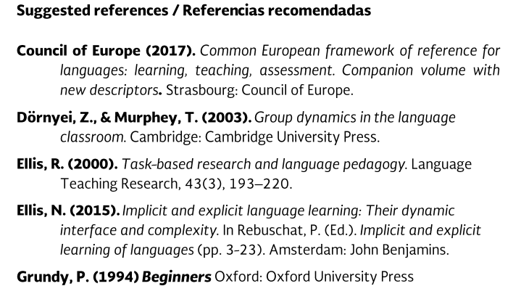
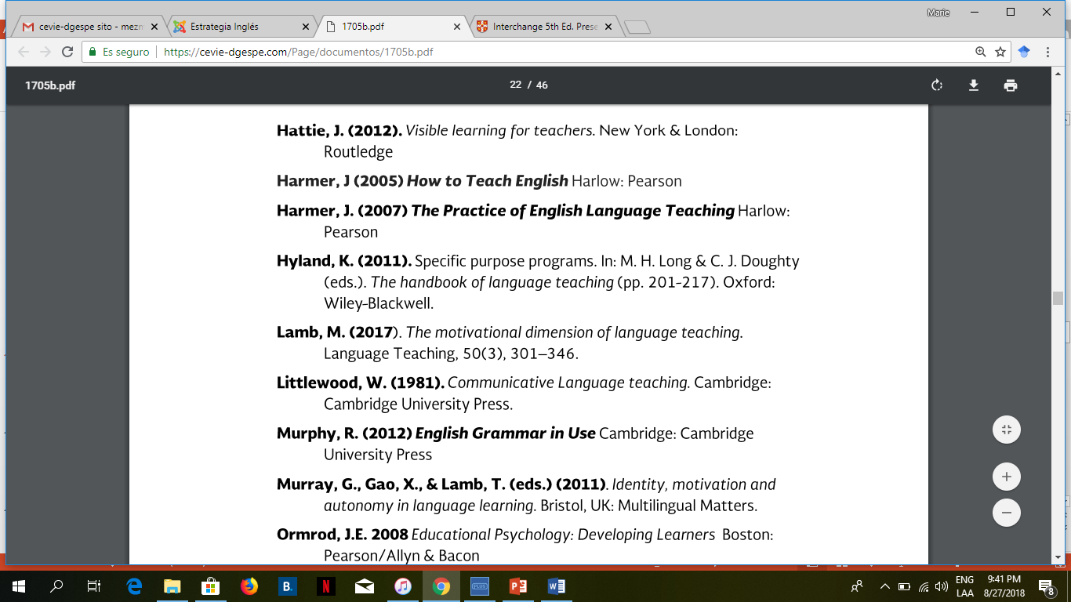
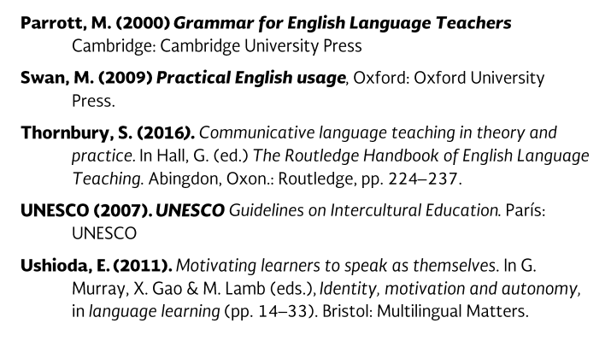

Slide 22
Additional online references and resources
Learning English. http://www.bbc.co.uk/learningenglish
Teaching adults. https://www.teachingenglish.org.uk/teaching-adults
Adult learners. https://elt.oup.com/learning_resources/courses/adultlearners/?cc=mx&selLanguage=en
Learning English. https://www.cambridgeenglish.org/learning-english/
Teacher’s corner. https://americanenglish.state.gov/teachers-corner
Classroom resources. Pearson. https://www.pearsonelt.com/professional-development/resources.html
Teaching adults. Oxford. https://elt.oup.com/teachersclub/courses/teachingadults/?cc=mx&selLanguage=en
For teachers. BBC. http://www.bbc.co.uk/worldservice/learningenglish/teach/
Onestop English. http://www.onestopenglish.com/
The digital teacher. https://thedigitalteacher.com/
https://visuwords.com/
https://www.eslvideo.com/
https://es.lyricstraining.com/
https://www.busuu.com/es
http://intermediatelow.blogspot.com/
https://www.englishclub.com/
http://www.topics-mag.com/
http://www.readableblog.com/
https://dictionary.cambridge.org/es/
http://www.bbc.co.uk/learningenglish
https://www.tefl.net/
http://www.elllo.org/

