Slide 2
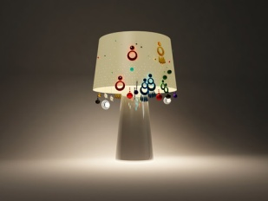
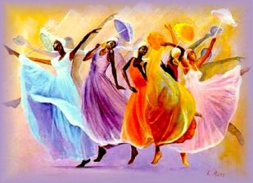
Qualifiers / intensifiers are words like very, too, so, quite, rather.
Qualifiers are function parts of speech. They do not add inflectional morphemes, and they do not have synonyms. Their sole purpose is to "qualify" or "intensify" an adjective or an adverb. Qualifiers / intensifiers modify adjectives or adverbs, telling to what degree.
Example of intensifiers/qualifiers
This painting is too coloured
This lamp is not light enough

Slide 3
GRAMMAR FOCUS / TOO AND ENOUGH
+ SATISFACTORY |  | - NOT SATISFACTORY
+ ADJECTIVE + ENOUGH SWEET ENOUGH |  | TOO + ADJECTIVE TOO SWEET
NOT + TOO + ADJECTIVE NOT TOO SWEET |  | NOT+ ADJECTIVE + ENOUGH NOT SWEET ENOUGH
REALLY + ADJECTIVE REALLY SWEET
VERY + ADJECTIVE VERY SWEET

Slide 4
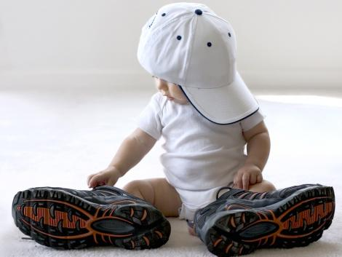
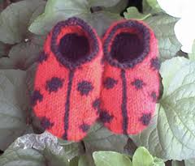
These shoes are too big for me
These shoes are too small for me

Slide 5
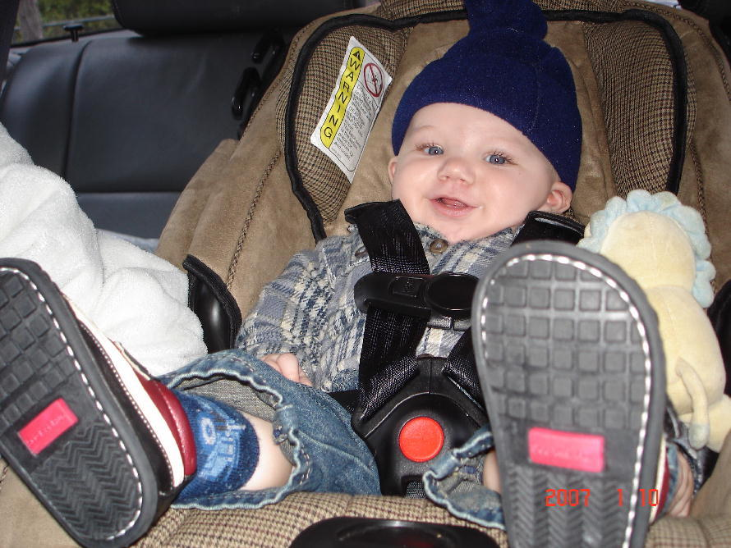
These shoes are big enough for me

Slide 6
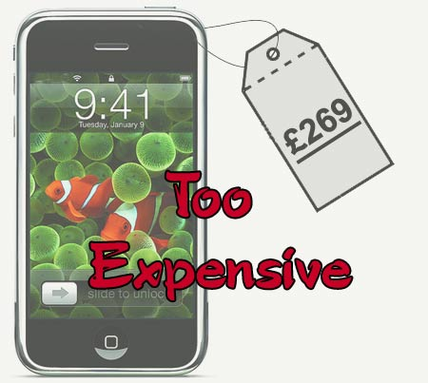
This cell is too expensive
This painting is too coloured

Slide 7
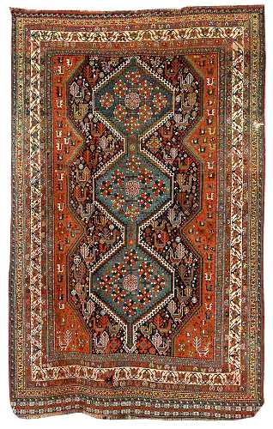
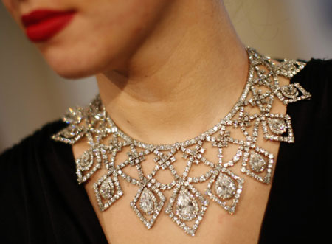
This rug is too old
This necklace is
beautiful enough for me

Slide 8
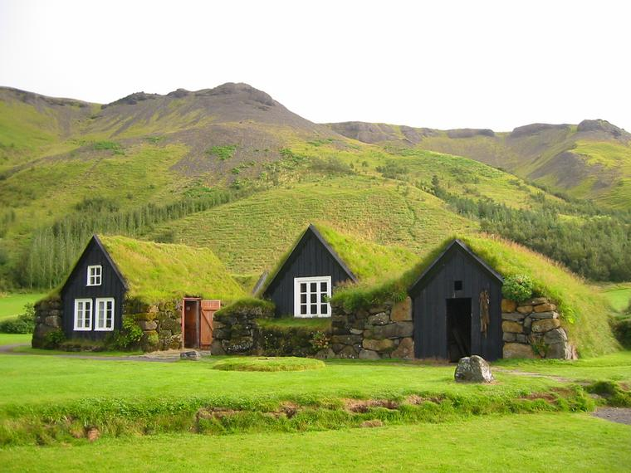
This lamp is not light enough
This place is quiet enough for me
This place is too quiet for me

Slide 9
Answer correctly use the cues from the word bank
1. This computer is _________ to do this calculation.
2. It isn't ___________ to sunbathe.
3. Are you ___________ to reach that shelf?
4. You're ________ to drive.
5. That sweater is big, it's ___________ for you.
6. The garden isn't ____________to play football.
Bigh enough Too big Tall enough
too slow Too young Sunny enough

Slide 10
Underline the correct answer
1-I didn't have ......... to finish the test
time enough enough time
2- He didn't do ......... to pass the course
enough work work enough
3 - There just aren't ......... in the day to get everything done
hours enough enough hours
4 - His work wasn't .........
enough good good enough
5- He didn't try .........
enough hard hard enough
6- She doesn't speak French .......... for the job
enough well well enough
7- He didn't run ....... to catch the bus
quickly enough enough quickly
8- The weather wasn't ....... for a picnic
enough nice nice enough

Slide 11
UNDERLINE THE CORRECT ANSWER THAT COMPLETES THE SENTENCE
Q1 - It was _____ so we didn't get it.
expensive enough too expensive enough expensive
Q2 - It's ___ to read; I don't understand it at all.
enough difficult too difficult difficult enough
Q3 - It's not ____ to go to the cinema.
enough late late enough too late
Q4 - It's ____ to pass.
enough difficult too difficult
Q5 - He ate ____ and felt ill.
enough much much enough too much

Slide 12
Fill in the blanks use too or enough on each sentence using the cues on brackets
1) I can't work today. It's ______________. (hot) 2) Tom didn't win the race because his car wasn't ______________. (fast) 3) I'll have to finish it on Friday because I don't have ______________.(time) 4) I can't do this exercise because it's ______________. (too) 5) It's impossible to study in my house because it's ______________. (noisy) 6) Have you got ______________ to buy a new car? (money) 7) I can't drink this coffee because it's ______________ for me. (strong) 8) Have we got ______________ in the fridge? (milk)

Slide 13
ANSWER THE FOLLOWING EXERCISE USING TOO AND ENOUGH 1. This computer is (slow) _________________to do this calculation. 2. Elaine is (old) __________________to enter here. 3. This suitcase is (heavy) __________________to carry. 4. It isn't (sunny) ____________________to sunbathe. 5. Are you (tall) __________________to reach that shelf? 6. You're (young) _____________________to drive. 7. You aren't (old) ____________________to drive. 8. That sweater is big, it's (big) ___________________for you. 9. The garden isn't (big) ___________________to play football. 10. This coffee is (strong) __________________________for me.

Slide 14
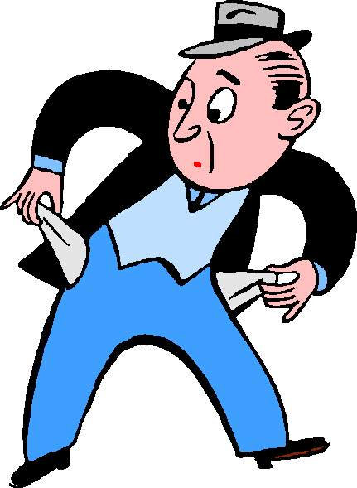
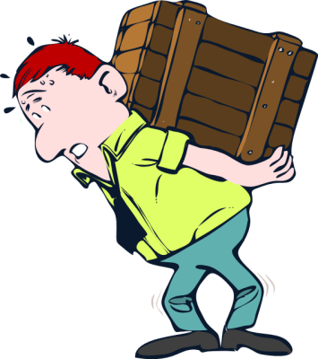
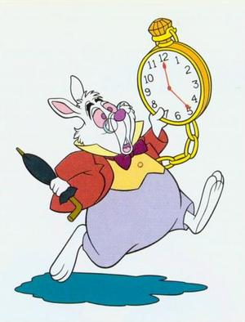
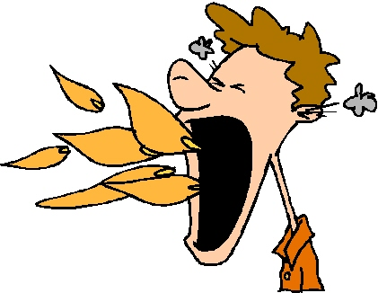
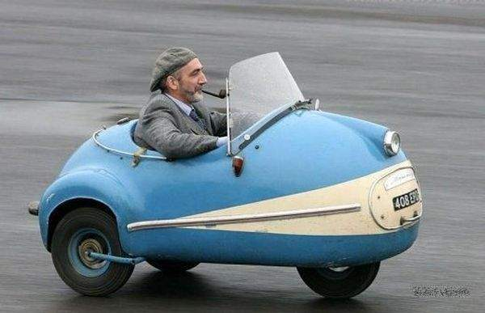
Write sentences using too and enough for each picture
___________________
___________________
___________________
___________________
___________________
___________________
___________________
___________________
___________________
___________________
___________________
___________________
___________________
___________________
___________________
___________________
___________________
___________________

