Slide 1
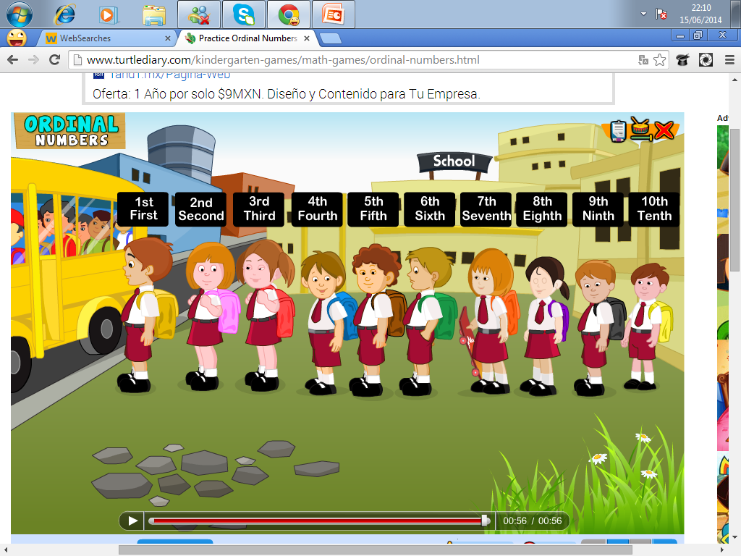
Ordinal NUMBERS
Ordinal numbers refer to a number indicating the position in a serie
http://www.turtlediary.com/kindergarten-games/math-games/ordinal-numbers.html

Slide 2
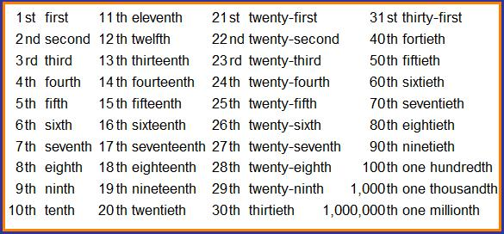

Slide 3
