Slide 4
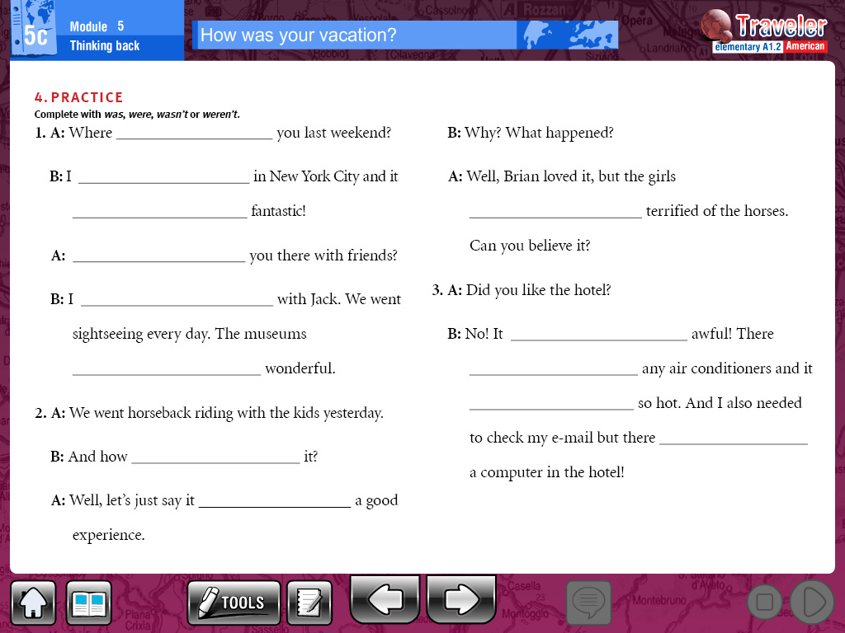

Slide 5
_____________________________________________________________________________________________________________________________________________________________________________________________________________________________________________________________________________________________________________________________________________________________________

