Slide 1
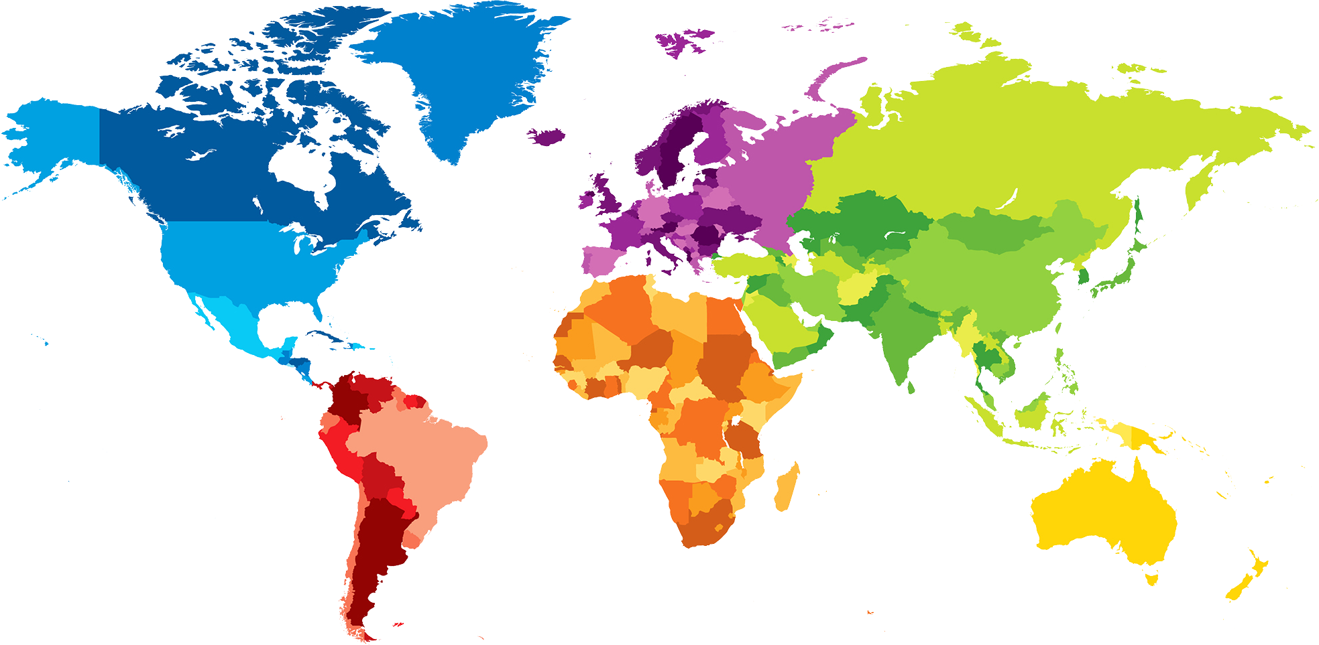
ENGLISH A2.1
UNIT 1 “WHERE ARE YOU FROM?”
SEPTEMBER 8TH

Slide 2
OBJECTIVES
To use be and possessive adjectives in a conversation about people meeting for the first time.
To make statements/contractions with be; use possessive adjectives to describe oneself and others; ask and answer Wh-questions with be

Slide 4
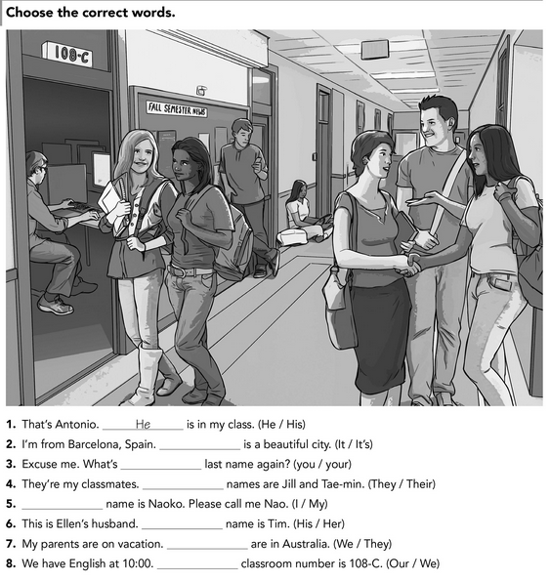
It
your
Their
My
His
They
We

Slide 5
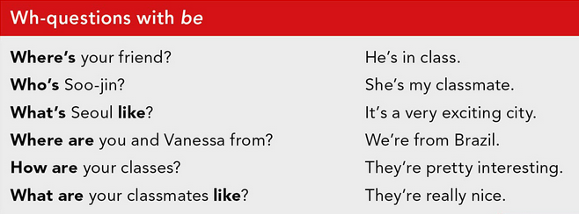
WH- WORD +. VERB BE (AM, IS, ARE) + COMPLEMENT?

Slide 6
VERB BE (AM, IS, ARE) + SUBJECT + COMPLEMENT?

Slide 7
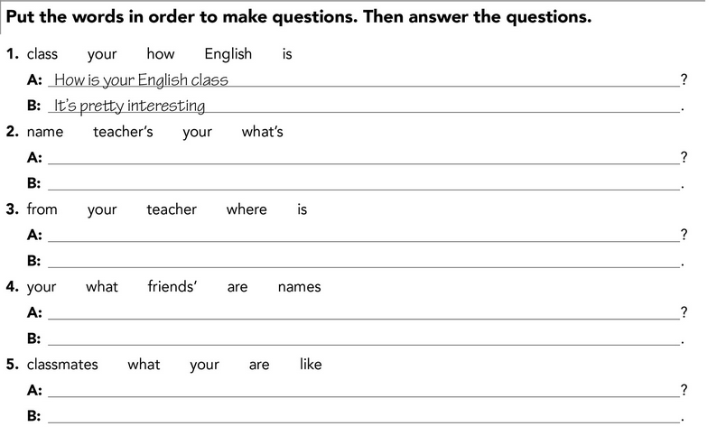
Whats your name teachers
CRISTINA ARACELY ALVARADO CHAVARRIA
Where is your from
Saltillo
What are you Friends names
My Friends are called Gisell y cesar
What you like are classmates
They are nice

Slide 8
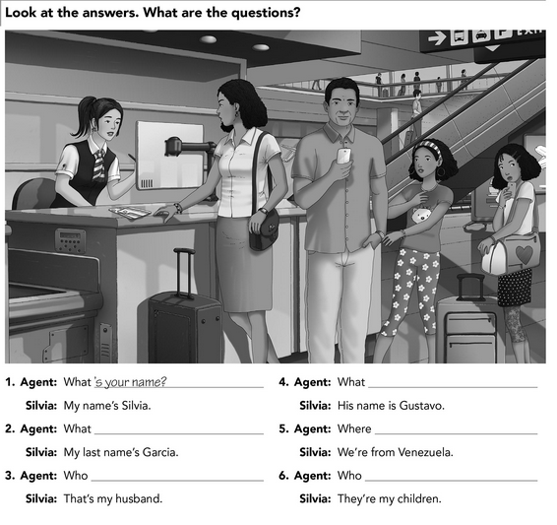
her name?
is you last name?
they live?
Is your husband?
are you daughters?

Slide 9
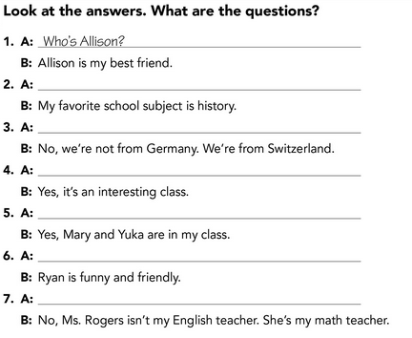
Which is your favorite subject?
You are from Germany?
Is english class interesting?
Mara and Yuka are in your class?
How is Ryan?
Is Ms Rogers your english teacher?

