Slide 1
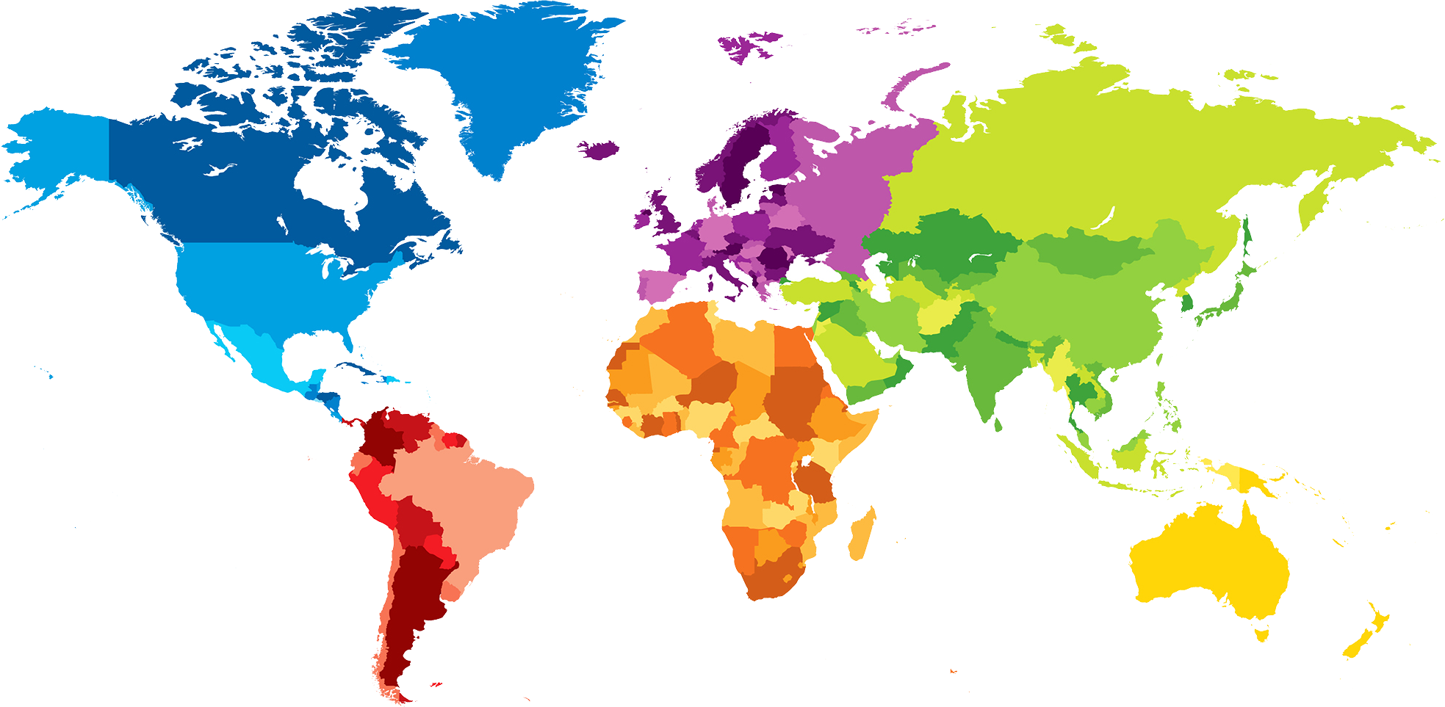
ENGLISH A2.1
UNIT 1 “WHERE ARE YOU FROM?”
SEPTEMBER 10TH
ALUMNA: MÓNICA GUADALUPE CÁRDENAS TOVAR

Slide 2
OBJECTIVES
To use be and possessive adjectives in a conversation about people meeting for the first time.
To make statements/contractions with be; use possessive adjectives to describe oneself and others; ask and answer Wh-questions with be

Slide 4
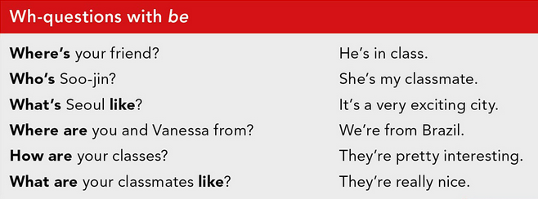

Slide 6
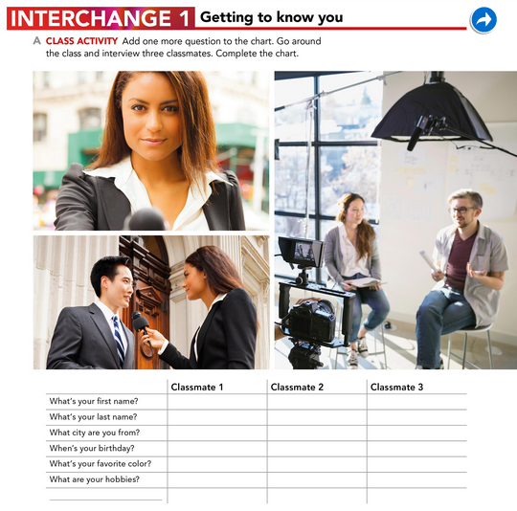
Alondra
Victoria
Diana
Huerta
Monreal
De la Cruz
Saltillo
Saltillo
Saltillo
JUANUARY 24
MARCH 4
AGUST 6
PINK
PINK
PURPLE
PINK
LISTEN MUSIC
LISTEN MUSIC
COOKIE
Tierra de osos
Shrek

Slide 7
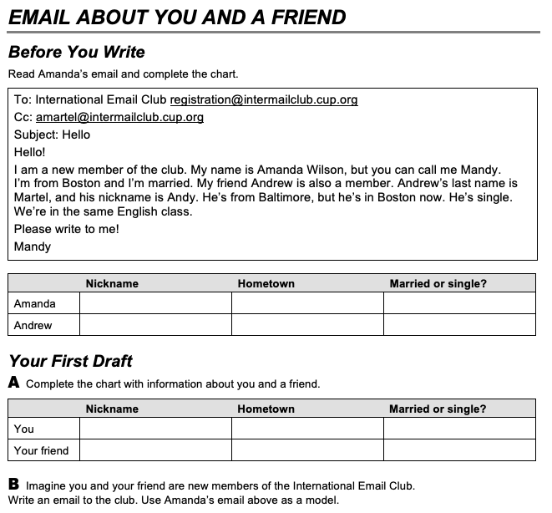
Mandy
Boston
Married
Andy
Baltimore
Single
Moni
Saltillo
Single
Sandy
México
Single

Slide 8
Hello, I am new member of the club. My name is Mónica Cárdenas, but you call me Moni. I´m from Saltillo and I´m single. My friend Sandra is also a member. Sandra´s last name is Rodrígue, and her nickname is Sandy. She´s from México. She´s single.
We´re in the same English class.
Please write to me.

Slide 9
PROJECT UNIT 1
IT’S A REALLY NICE CITY!
THE PROJECT WILL BE DONE INDIVIDUALLY.
WORK IN YOUR PROJECT ON MONDAY.
TASK:
Choose one person who is special for you (classmate, friend, relative).
Answer the following questions: What’s his/her name? What’s his/her last name? Where’s he/she from? When’s his/her birthday? What’s his/her favorite color/food/sport/music/hobbie?
Design a presentation/poster with pictures and tell your classmates about this special person. You will present on Monday.
PRODUCTS: Document in Escuela en Red/Presentation/Speaking performance

