Slide 1
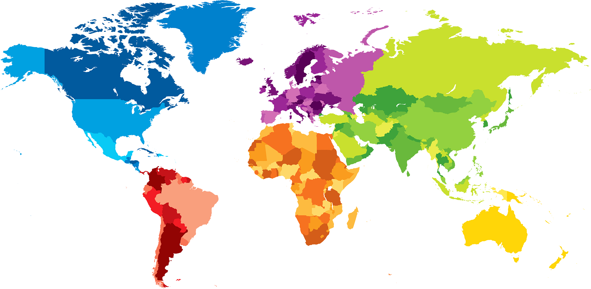
ENGLISH A2.1
UNIT 1 “WHERE ARE YOU FROM?”
SEPTEMBER 10TH
Student: Adamary Sarahi Arizpe Alvarez

Slide 2
OBJECTIVES
To use be and possessive adjectives in a conversation about people meeting for the first time.
To make statements/contractions with be; use possessive adjectives to describe oneself and others; ask and answer Wh-questions with be

Slide 4
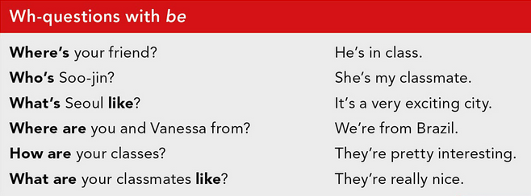

Slide 6
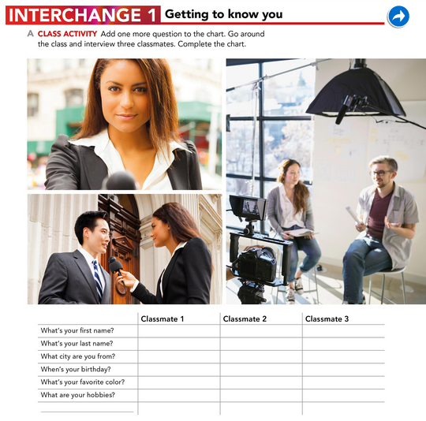
Andrea Sara Pamela
Guerrero Gomez Avila
Saltillo, Coahuila Saltillo, Coahuila Saltillo, Coahuila
22th, September April 19 November, 27
Purple Blue and red Blue
Watch series, spend Out with my Friends, Watch movies
Money and slepp. listen to music and spend
time with my family.

Slide 7
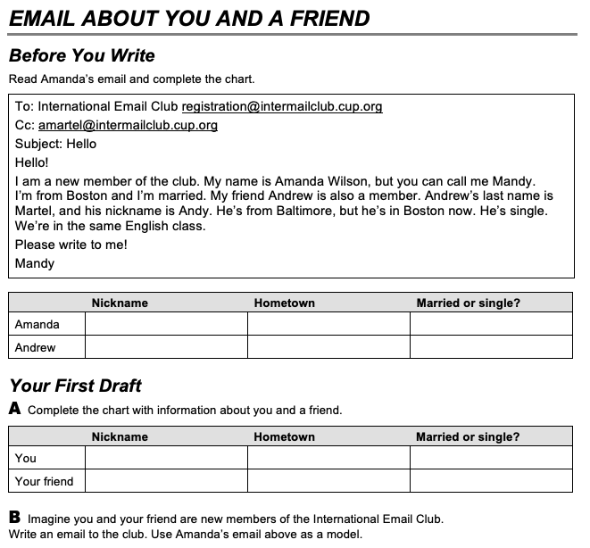
Mandy Boston Married
Andy Boston Single
Ada Saltillo, Coahuila Single
Dani Saltillo, Coahuila Married

Slide 8
Email:
To: International Email Club registration@intermailclub.cup.org
Cc: amartel@intermailclub.cup.org
Subject: Hello
Hello!
I am a new member of the club. My name is Adamary Arizpe, but you can call me Ada. I’m from Saltillo Coahuila and I’m single. My friend Danitza is also a member. Danitza’s last name is Hernandez, and her nickname is Dani. She’s from Monclova, but she’s in Saltillo Coahuila now. She’s married.
We’re in the same English class.
Please write to me!
Ada.

Slide 9
PROJECT UNIT 1
IT’S A REALLY NICE CITY!
THE PROJECT WILL BE DONE INDIVIDUALLY.
WORK IN YOUR PROJECT ON MONDAY.
TASK:
Choose one person who is special for you (classmate, friend, relative).
Answer the following questions: What’s his/her name? What’s his/her last name? Where’s he/she from? When’s his/her birthday? What’s his/her favorite color/food/sport/music/hobbie?
Design a presentation/poster with pictures and tell your classmates about this special person. You will present on Monday.
PRODUCTS: Document in Escuela en Red/Presentation/Speaking performance

