Slide 1
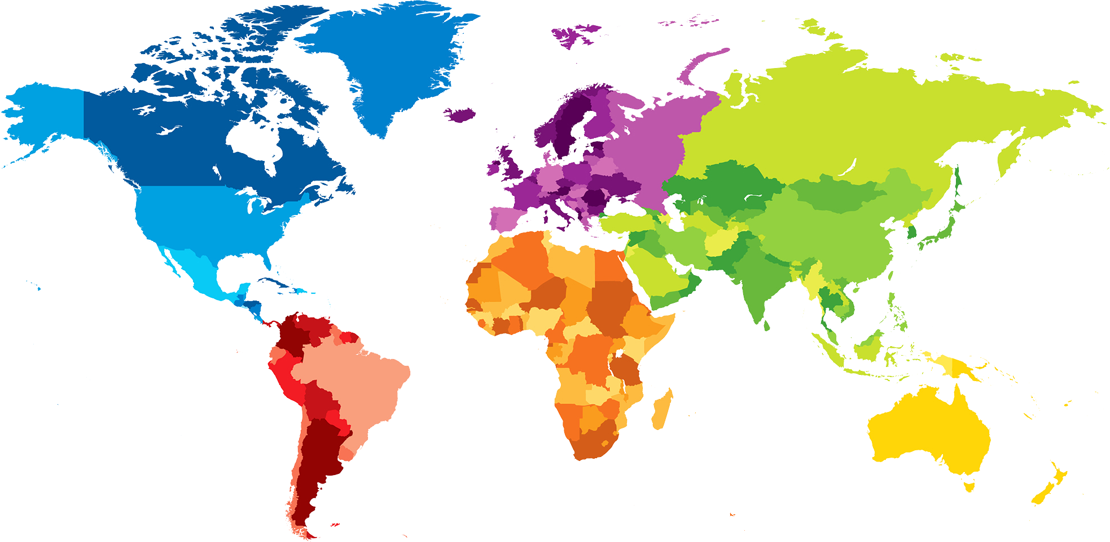
ENGLISH A2.1
UNIT 1 “WHERE ARE YOU FROM?”
SEPTEMBER 10TH
Andrea García García

Slide 2
OBJECTIVES
To use be and possessive adjectives in a conversation about people meeting for the first time.
To make statements/contractions with be; use possessive adjectives to describe oneself and others; ask and answer Wh-questions with be

Slide 4
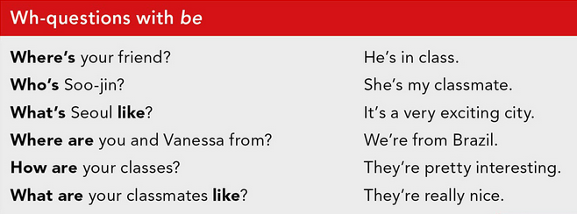

Slide 6
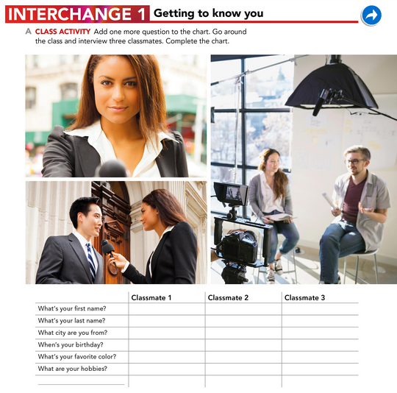
Ilse
Jonathan
Garcia
Saltillo
June 27th
Blue
Play baseball
Fernando
Delgado
Saltillo
November 16th
Red
Play soccer
Carranza
Saltillo
October 4th
Pink
Dancing

Slide 7
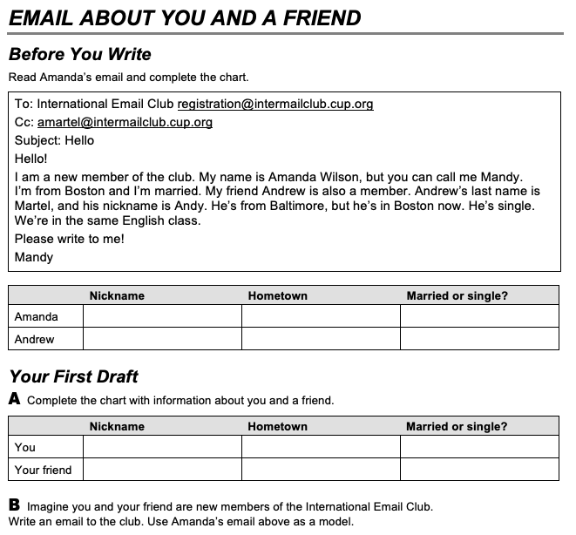
Mandy Boston Married
Andy Baltimore Single
Andy Saltillo Single
Mar Saltillo Single

Slide 8
Andrea García
Andy
saltillo
single
mar
Mar´s
Duarte
her
mar
She´s
Saltillo
She´s
california
She´s
Andy

Slide 9
PROJECT UNIT 1
IT’S A REALLY NICE CITY!
THE PROJECT WILL BE DONE INDIVIDUALLY.
WORK IN YOUR PROJECT ON MONDAY.
TASK:
Choose one person who is special for you (classmate, friend, relative).
Answer the following questions: What’s his/her name? What’s his/her last name? Where’s he/she from? When’s his/her birthday? What’s his/her favorite color/food/sport/music/hobbie?
Design a presentation/poster with pictures and tell your classmates about this special person. You will present on Monday.
PRODUCTS: Document in Escuela en Red/Presentation/Speaking performance

