Slide 1
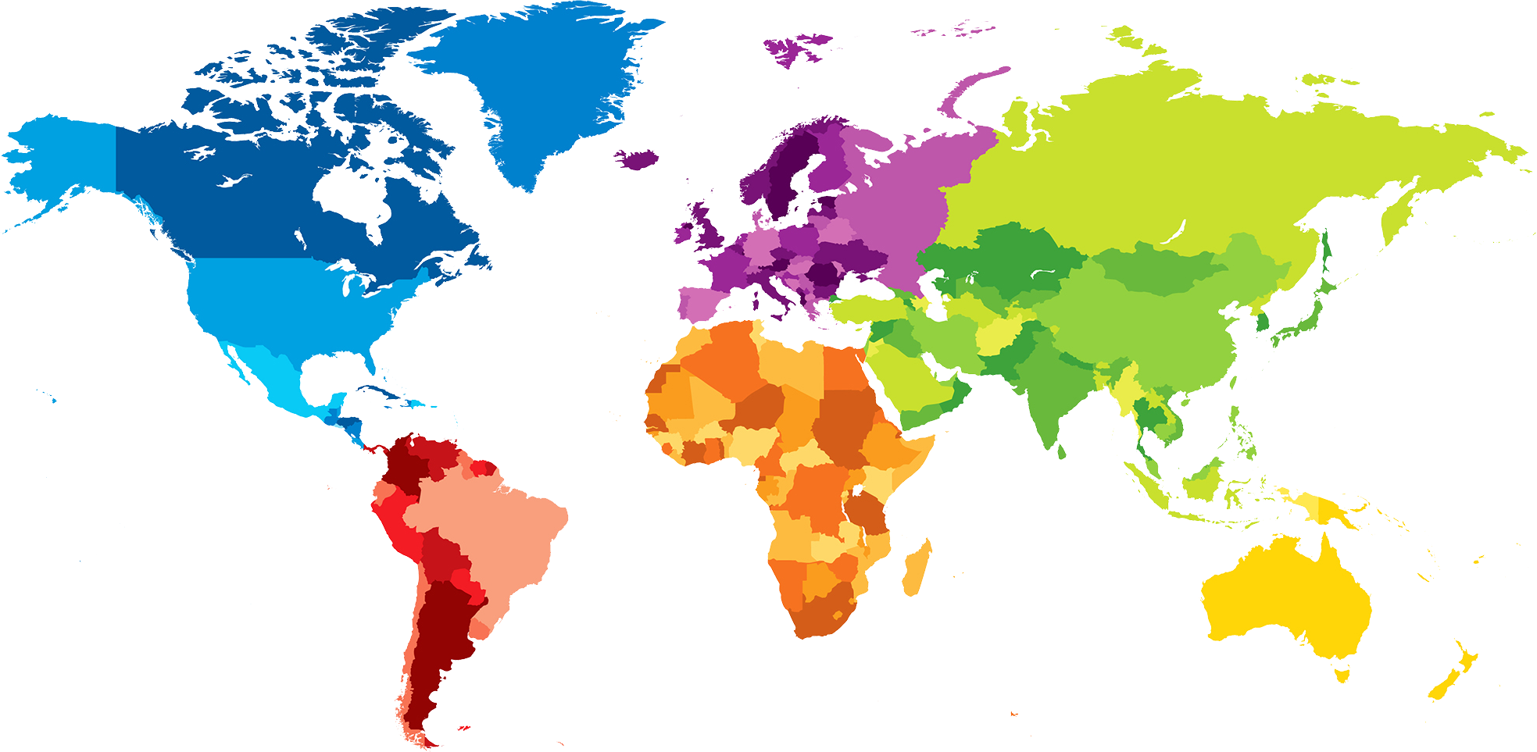
ENGLISH A2.1
UNIT 1 “WHERE ARE YOU FROM?”
SEPTEMBER 10TH

Slide 2
OBJECTIVES
To use be and possessive adjectives in a conversation about people meeting for the first time.
To make statements/contractions with be; use possessive adjectives to describe oneself and others; ask and answer Wh-questions with be

Slide 3
Davis
Chicago
History
Josefina
México
Bisness
Park
Corea
Math

Slide 4
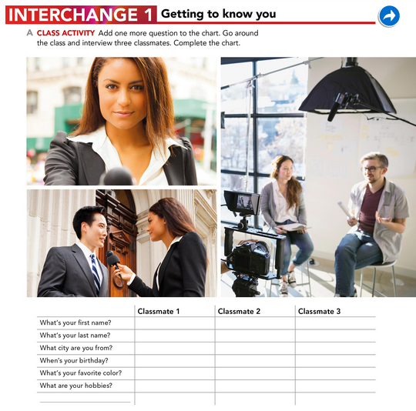
Nancy
Covarrubias
Saltillo
July 6th
Blue
Look the movies and listening music
Jimena
Gaytan
Saltillo
Novembre 3th
Green
Pintar y leer
Mayra
Gaona
Saltillo
Enero 21
Yellow
Listening music

Slide 5
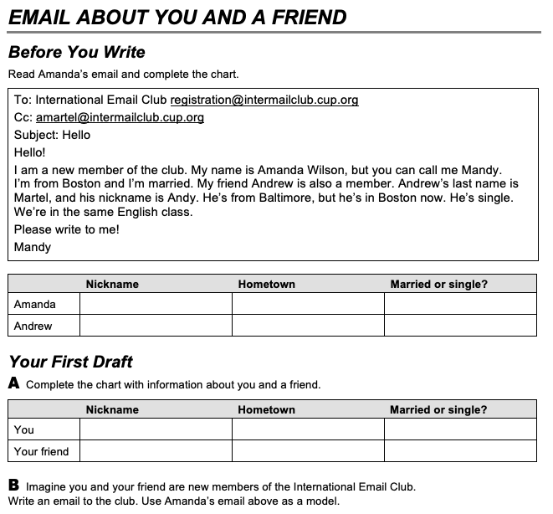
Mandy
Andy
Boston
Baltimore
Married
Single
Mery
Dianita
Saltillo
Saltillo
Single
Single

