Slide 1
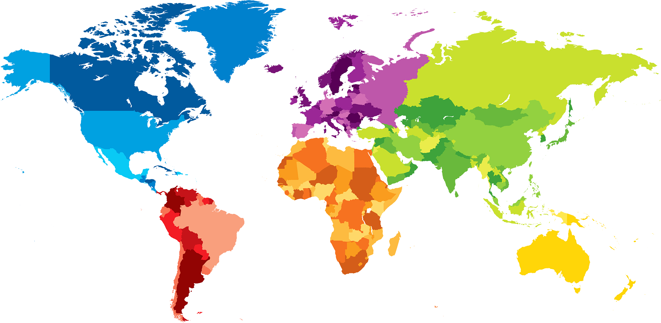
ENGLISH A2.1
UNIT 1 “WHERE ARE YOU FROM?”
SEPTEMBER 10TH

Slide 2
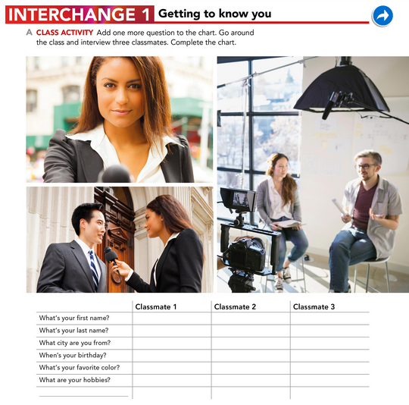
Sofia
Mascorro
Monterrey Nuevo leon
November 26
Pinck
Chat and have fun
Melissa
Martinez
Saltillo Coahuila
Octuber 15
pink
Whatch movies
Alondra
Cortez
Saltillo
September 15
Black
With my dog

Slide 3
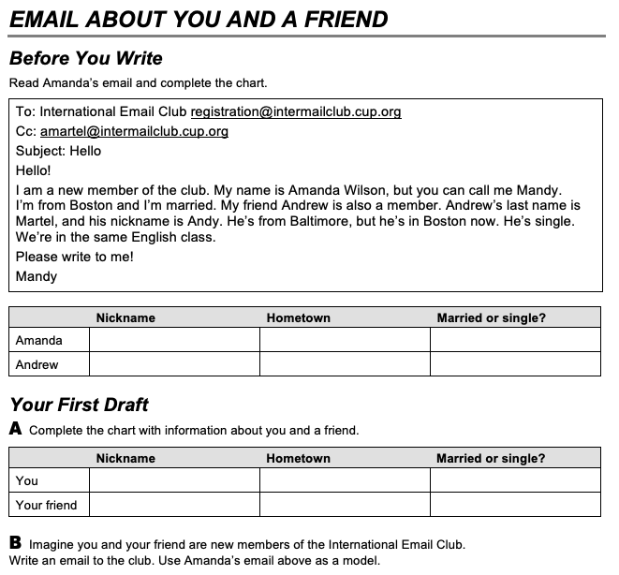
Mandy
Andy
Boston
Boston
Married
Single
Camila
Yamileth
Mexico
Mexico
Single
Single

Slide 4
To:International Email Club registration@intermailclub.cup.org
Cc: amartel@intermailclubcup.org
Subject: Hello
Hello!
I am a new member of the club. My name is Camila Moncada,but you can call me Cami.
I´m fro Mexico and I´m single.My friend is Yamileth is also a member. Yamileth´s last name is Cazarez,and his nickname is Yami. She´s from Mexico.She´s single.
We´re in the same English class.
Please write to me!
Cami.

