Slide 1
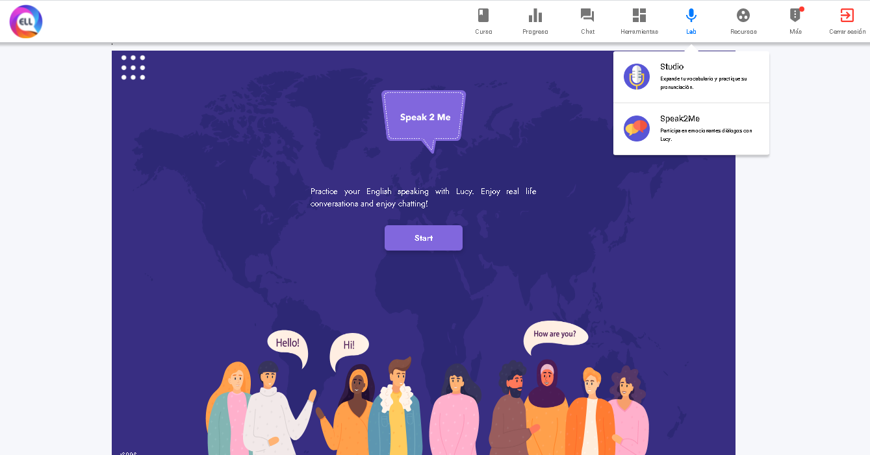
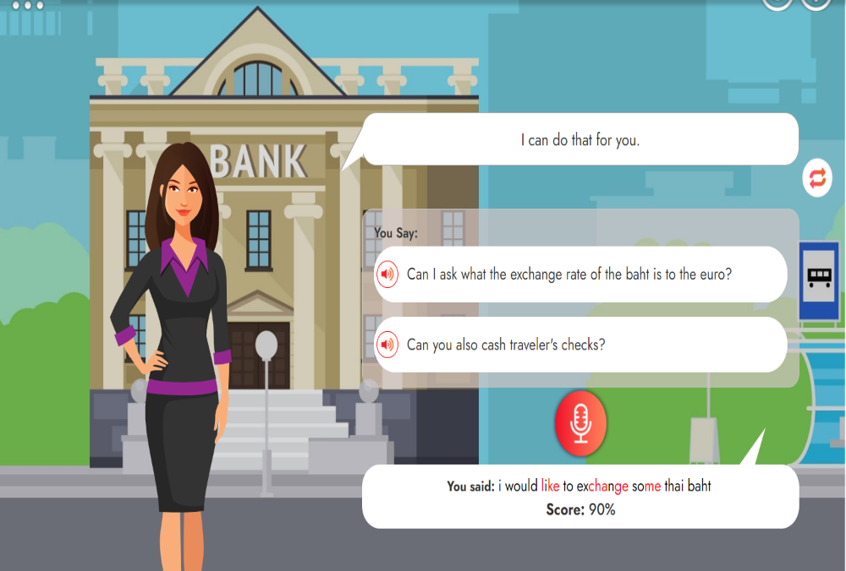
Speaking task “Speak2Me”
Practice your english speaking with real conversations in “Speak2Me” (choose Intermediate Level, conversation with the title “There was an earthquake this morning”
Select intermediate level and the lesson
Click here to check practice Speak2Me
Yor results are given in each practice, (not in reports, look the following example)

Slide 2
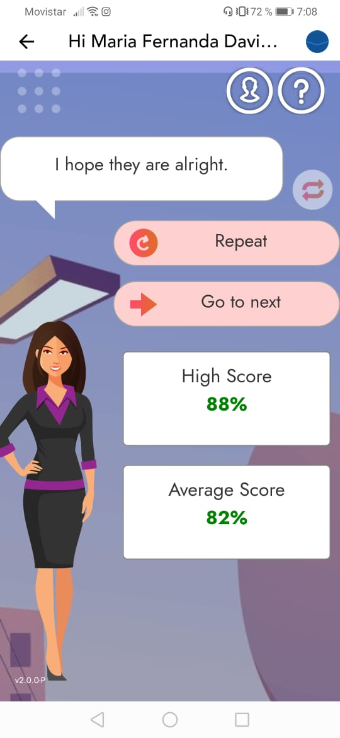
Fill the blanks
Student: María Fernanda Dávila Bustos
Title of the pratice: There was an earthquake this morning
Here your results with your speaking practice in Speak2Me

