Slide 1
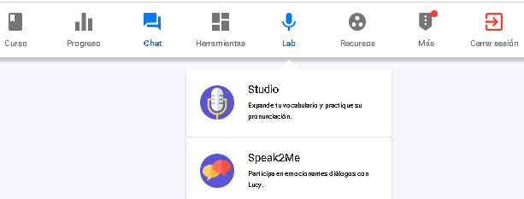
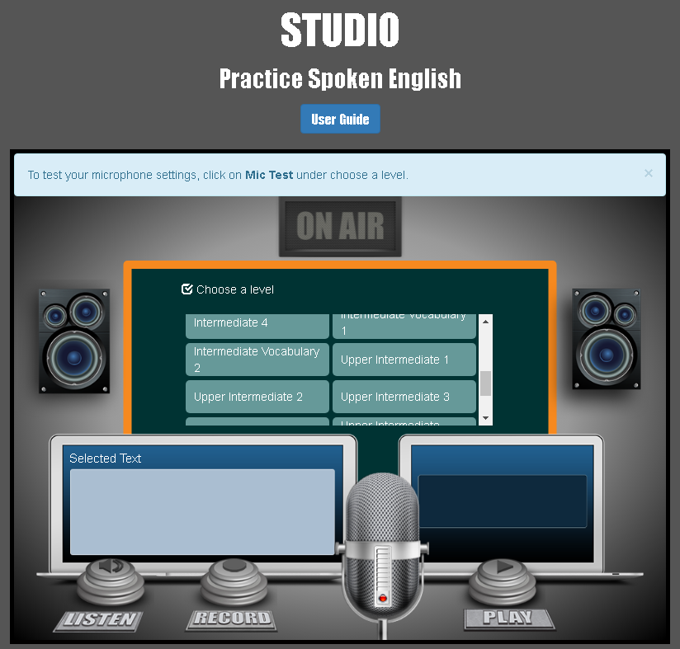
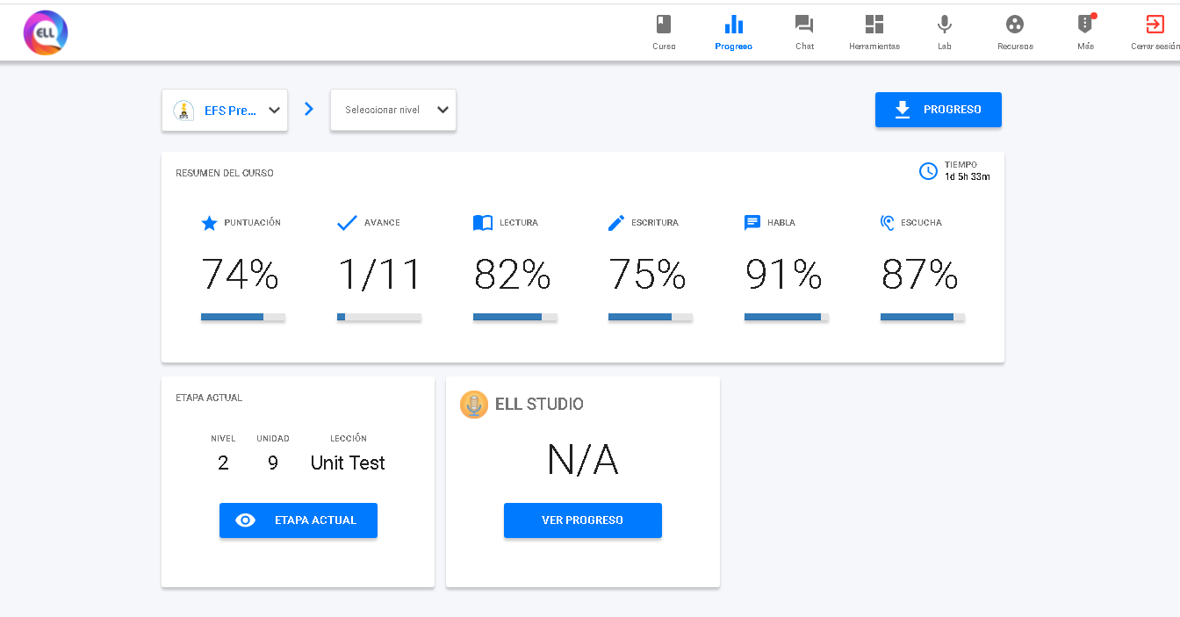
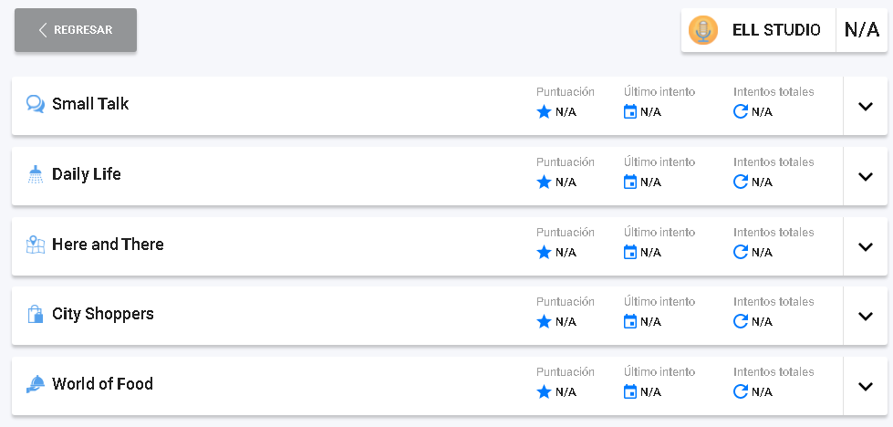
Speaking task “ELL studio”
Record, review and improve your pronunciation practicing with the speaking activities in “ELL studio” (choose activities of Upper intermediate 1 phrases included in the title
”TRAVEL THE PLANET” (Here is a guide to select the title)
Click here to in “Studio”
Select the level and the title of your practice
Check your practice results (look the following example)
Click here to check your speaking report in the “practice of Studio”
Display the results of each phrase
Look for your practice and print screen
Print screenwith your results and paste in the following slide

Slide 2
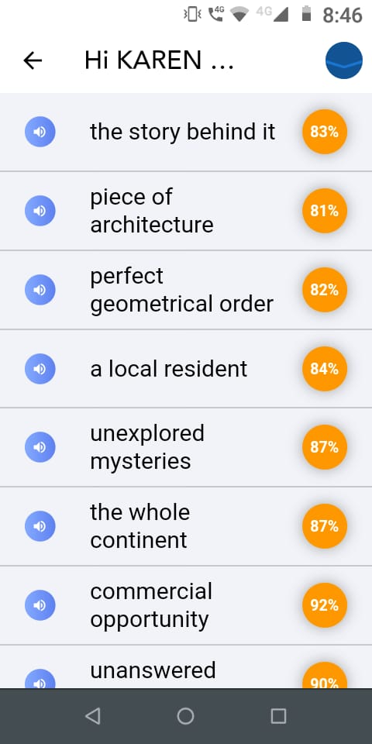
Fill the blanks
Student: Karen Lucero Muñiz Torres.
Title of the pratice: ”TRAVEL THE PLANET”
Here your results with your speaking practice in ELL Studio

Slide 3
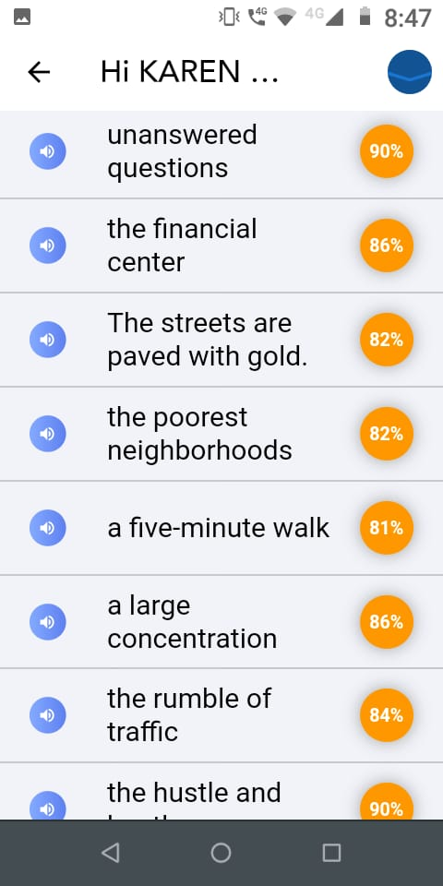

Slide 4
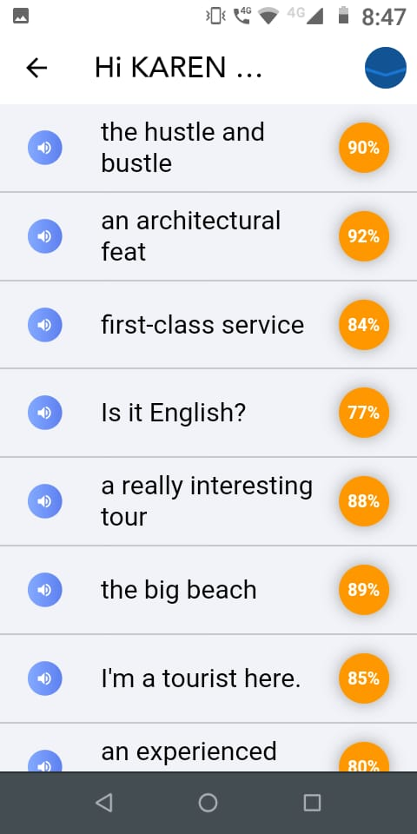

Slide 5
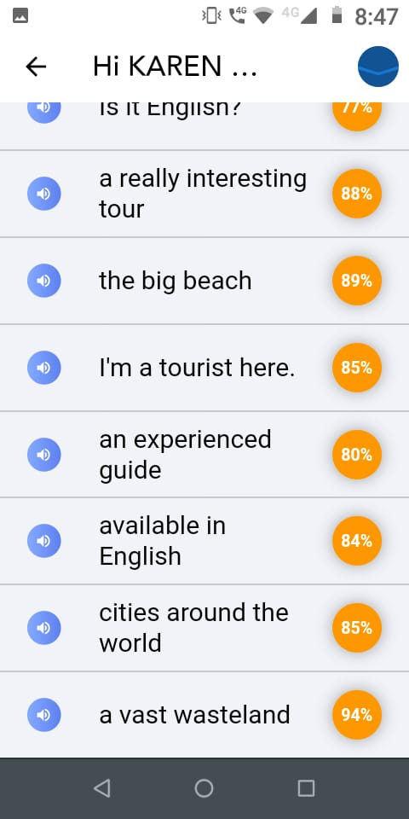

Slide 6
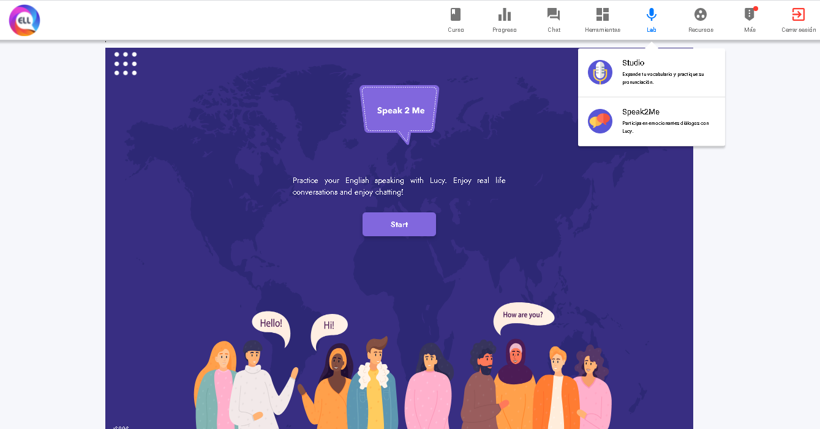
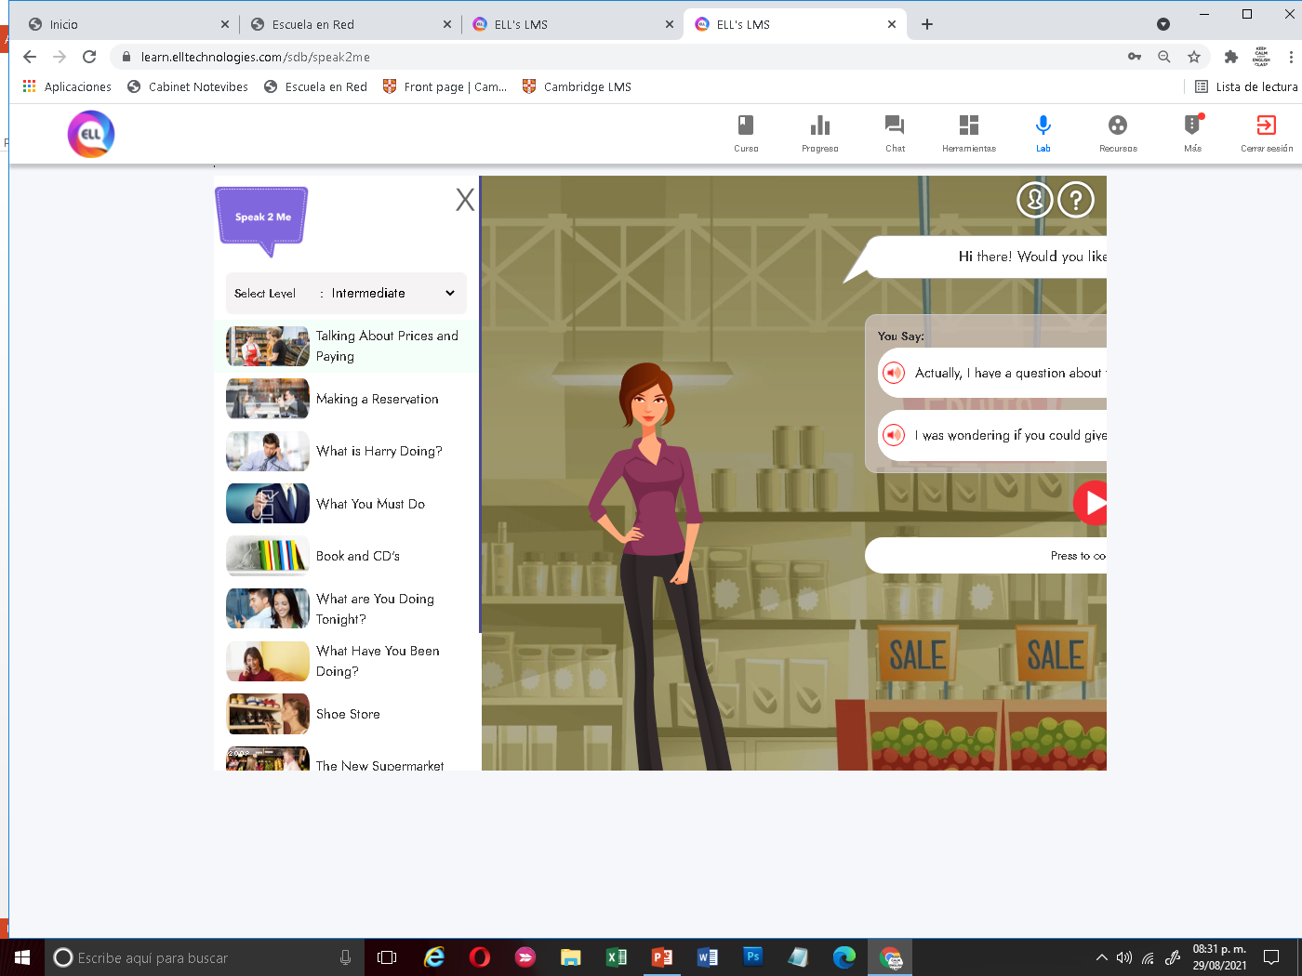
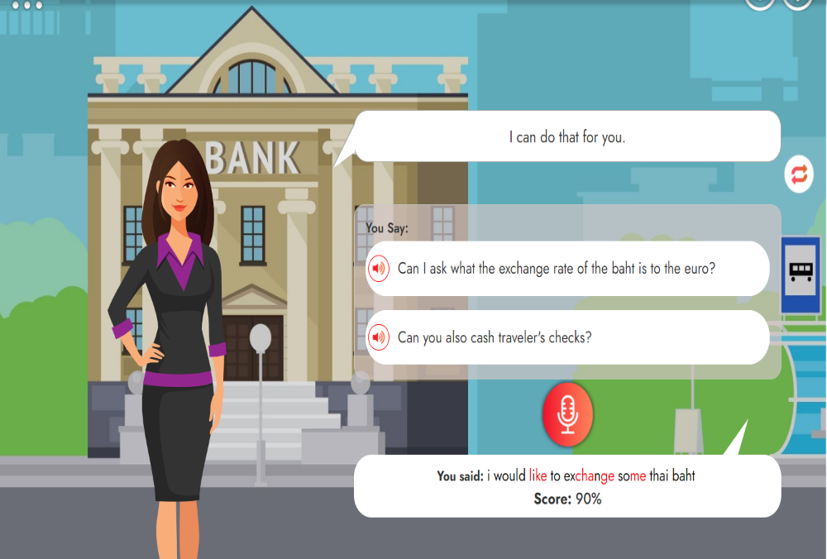
Speaking task “Speak2Me”
Practice your english speaking with real conversations in “Speak2Me” (choose Intermediate Level, conversation with the title “There was an earthquake this morning”
Select intermediate level and the lesson
Click here to check practice Speak2Me
Yor results are given in each practice, (not in reports, look the following example)

Slide 7
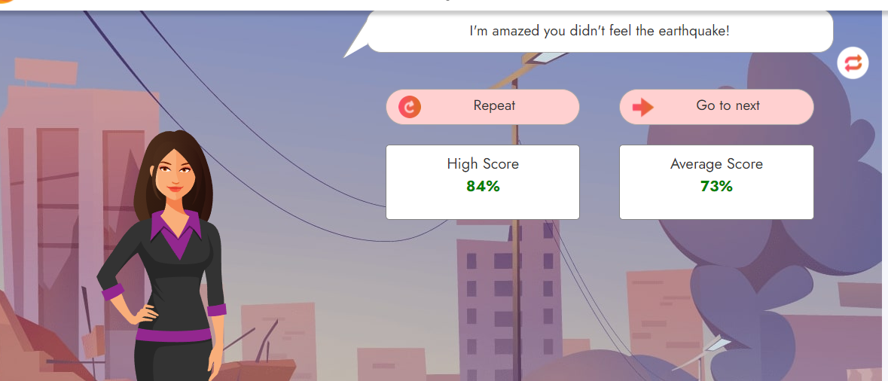
Fill the blanks
Student: Karen Lucero Muñiz Torres.
Title of the pratice: “There was an earthquake this morning”
Here your results with your speaking practice in Speak2Me

