Slide 1
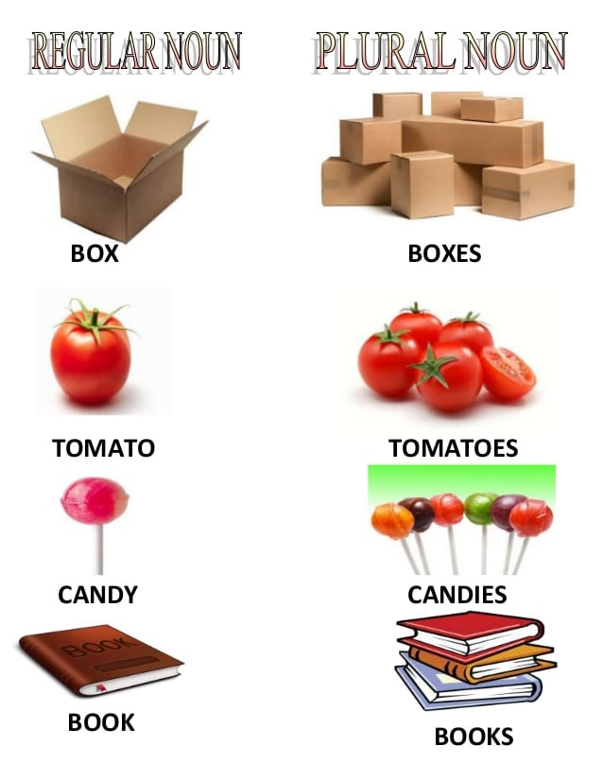
UNIT 2
Lesson 2 “plurals”
Learning objective:
Identify the spelling rules of plural
Practice the pronunciation of plural words

Slide 2





GRAMMAR “Words in plural”
A plural noun is a word that indicates that there is more than one person, animal place or thing.
When you write about more than one of anything, you usually use the same word, adding s, es, or ies to the end.
box
boxes
clip
clips
Some nouns are always plural
Algunos sustantivos son siempre plurales
glasses
headphones

Slide 3
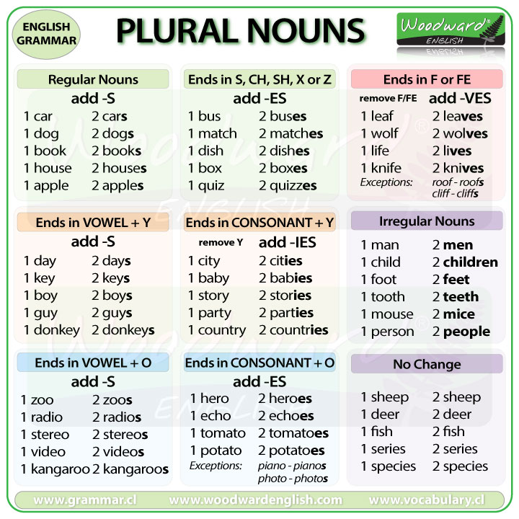
Plural Spelling rules

Slide 4
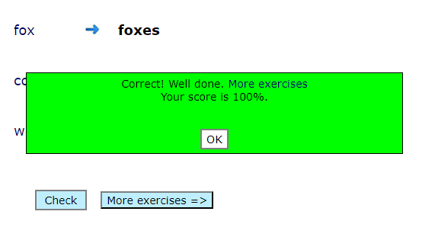

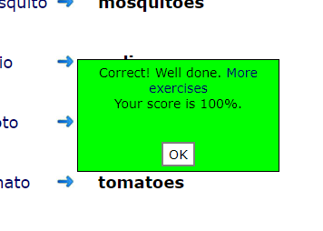
Practice plural spelling rules with the following online activities.
Print screen with your score and insert here
https://agendaweb.org/exercises/grammar/plural/singular-plural-1
https://agendaweb.org/exercises/grammar/plural/plural-y
https://agendaweb.org/exercises/grammar/plural/plural-o

Slide 5
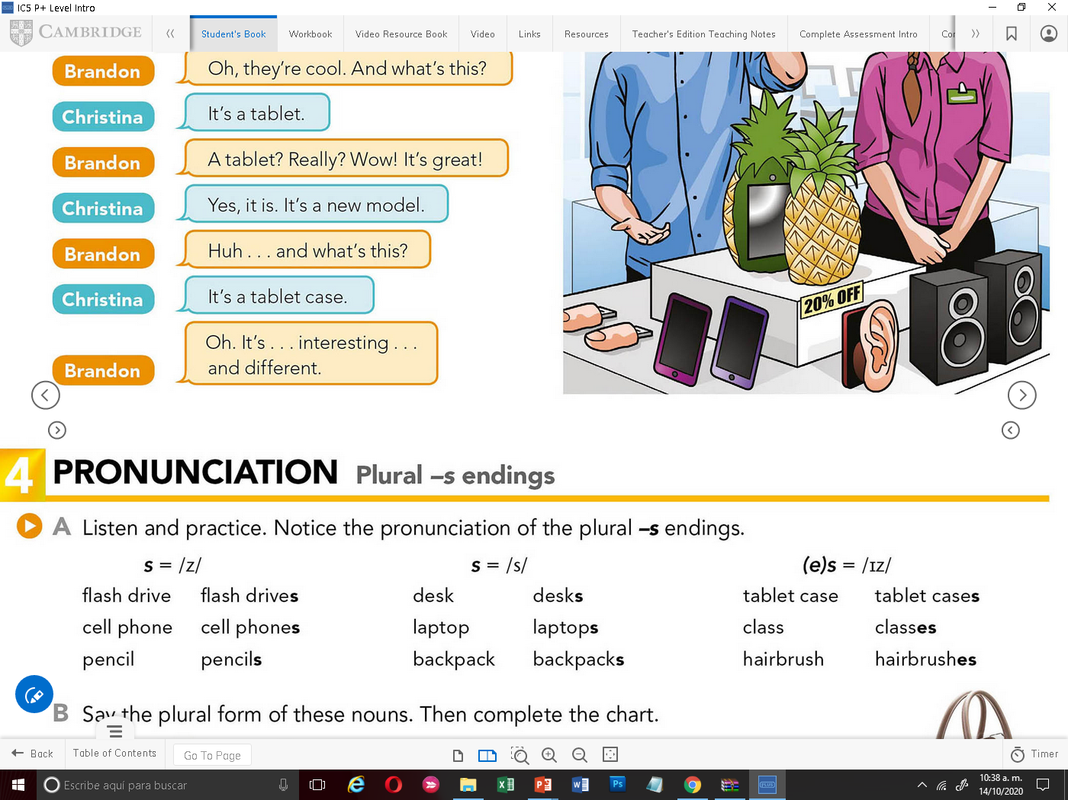

Nouns end in vowel sound or voiced consonant ( eg. /n/l/r)
Nouns end in voiceless consonant sound ( eg. /p/t/k/)
Nouns end in sibilant consonant sound (eg. /s/sh)
S = /Z/
Singular | Plural
S = /s/
Singular | Plural
(e)s = /IZ/
Singular | Plural

Slide 6
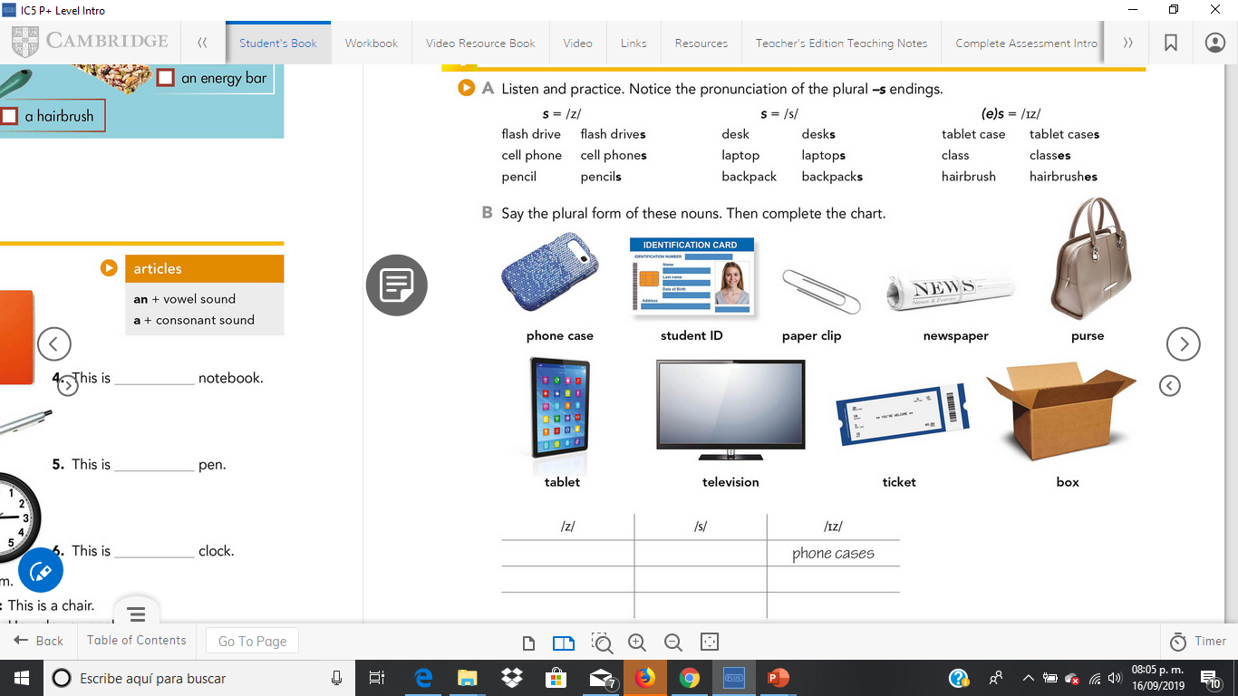
Record your voice practicing the plural form of these nouns,
Graba tu voz con la práctica del plural de cada uno de estos sustantivos
Complete the following chart with the plural form of these nouns,
Completa la siguiente gráfica con el plural de estos sustantivos
/Z/ | /S/ | /IZ/
Student ids | Tickets | Phone cases
Televisions | Tablets | Purses
Paper clips | New papers | Boxes

Slide 7
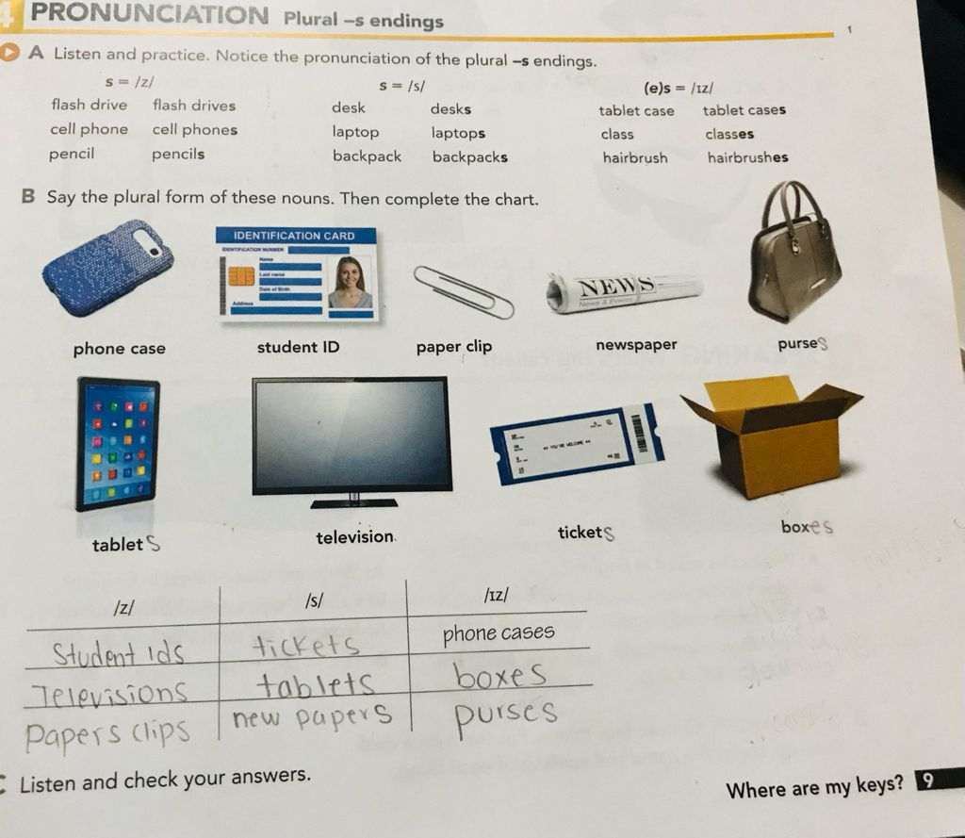
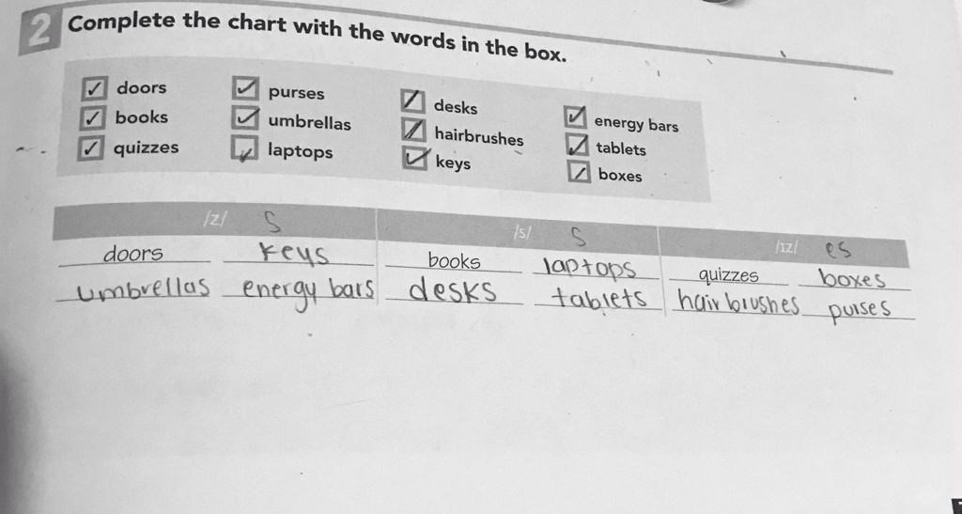
Practice the pronunciation of plurals is studentbook pg 9 ex. 4 and workbook pg7 ex 2.
Print screen tour answered practice and insert here

