Slide 3
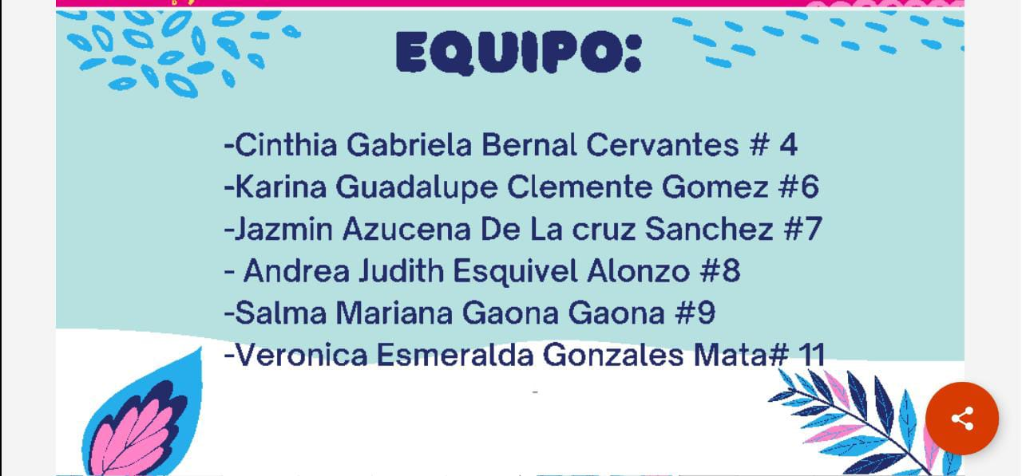

Slide 6
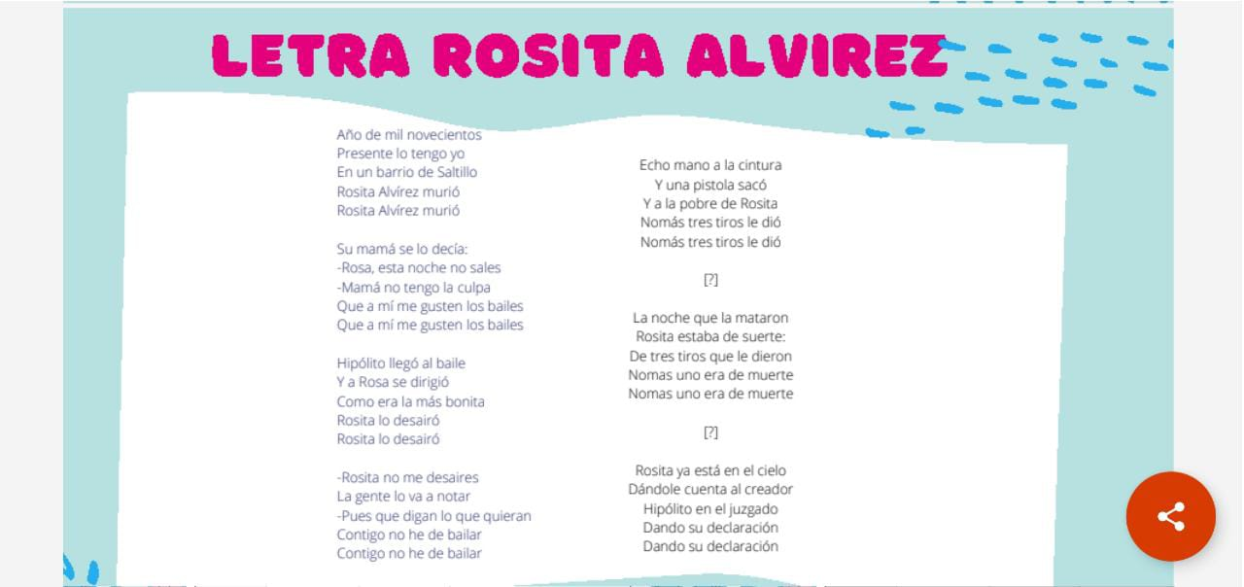

Slide 9
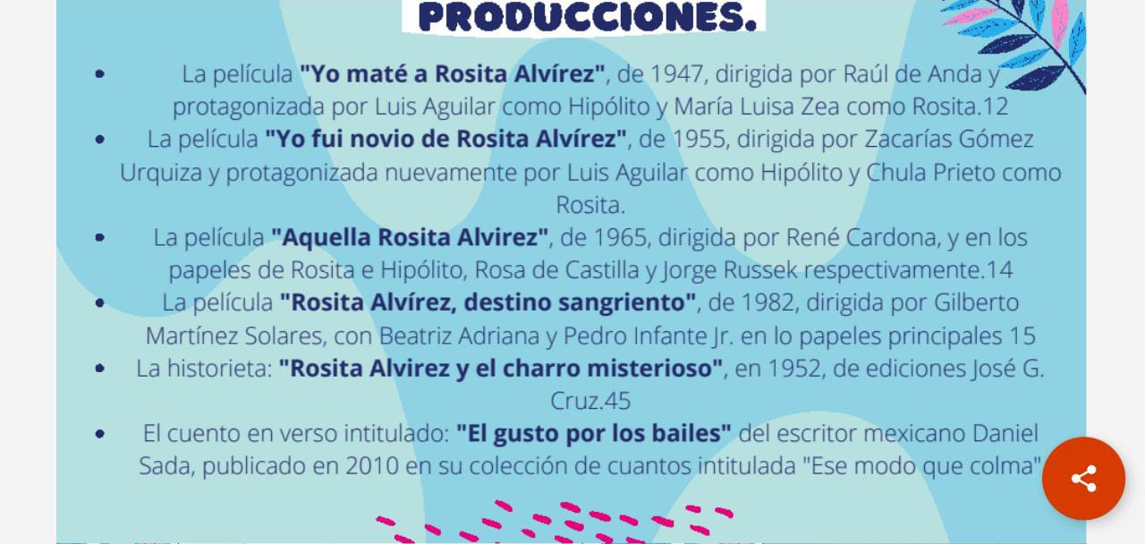

Slide 10
https://drive.google.com/file/d/1Pr9ADXp_CFC8g7vMW9vAxEJMqEKQG3Dg/view?usp=sharing

Slide 11
