Slide 1
MATERIAL DIDACTICO

Slide 2
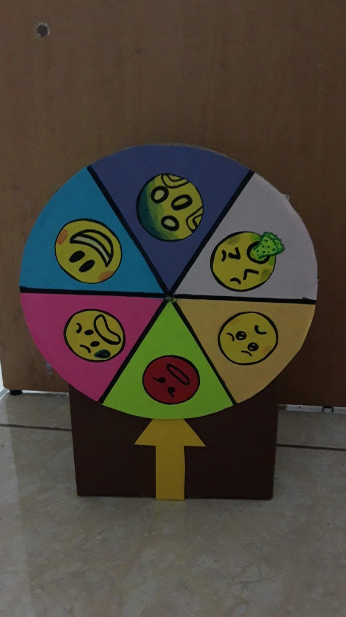
RULETA

