Slide 1


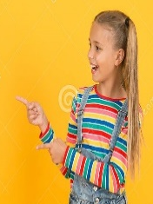


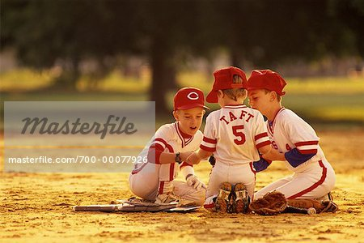
UNIT 4
Lesson 3 Possessive Adjectives
We use possessive adjectives to express who owns (or ‘possesses’) something. A possessive adjective is used in front of a noun (a thing). For example: My computer, Your pen, his name, her nickname
My cap is red
Your cap is orange
Her cap is red
His cap is red
Their caps are red
Our caps are nice

Slide 2
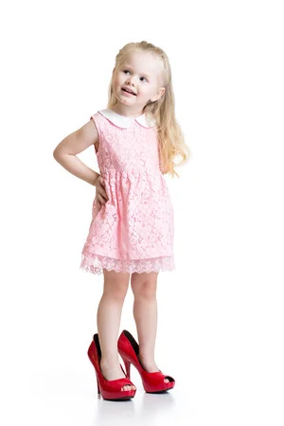
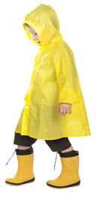


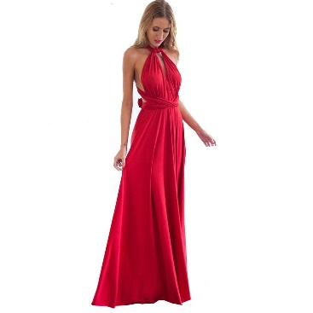
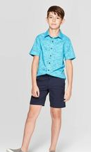
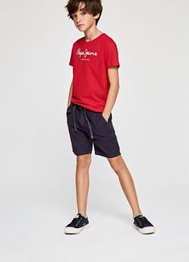
Use possessive adjectives and verb to be to complete the following statements write the missing word (s)
Her higheels are big.
His raincoat is yellow.
Their car is new.
Her eyes are blue.
Her dress is red.
Their shorts are dark blue.

Slide 3
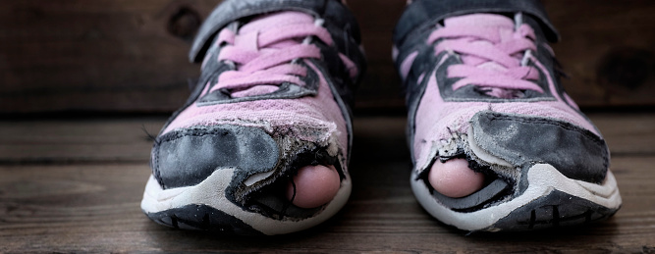
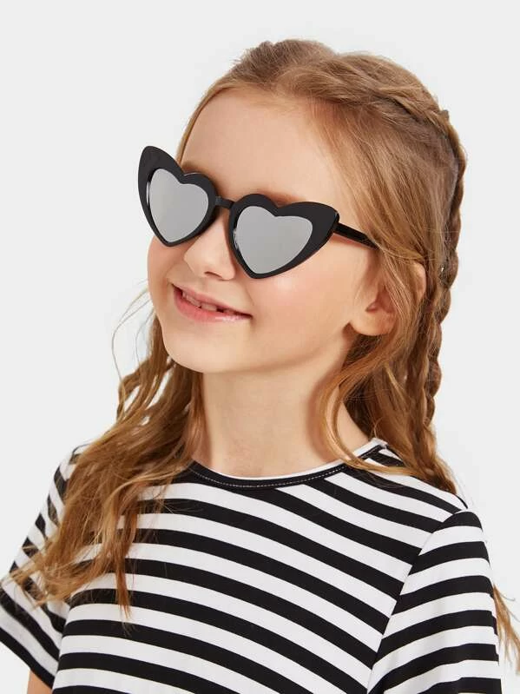
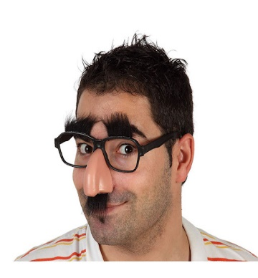




Complete the following statements write the missing word.
Her sneakers are old.
_Her_ sun glasses are cool.
His face is funny.
Her books are heavy.
_Her_ laptop is new.
Their backpacks _are_ big.

