Slide 1
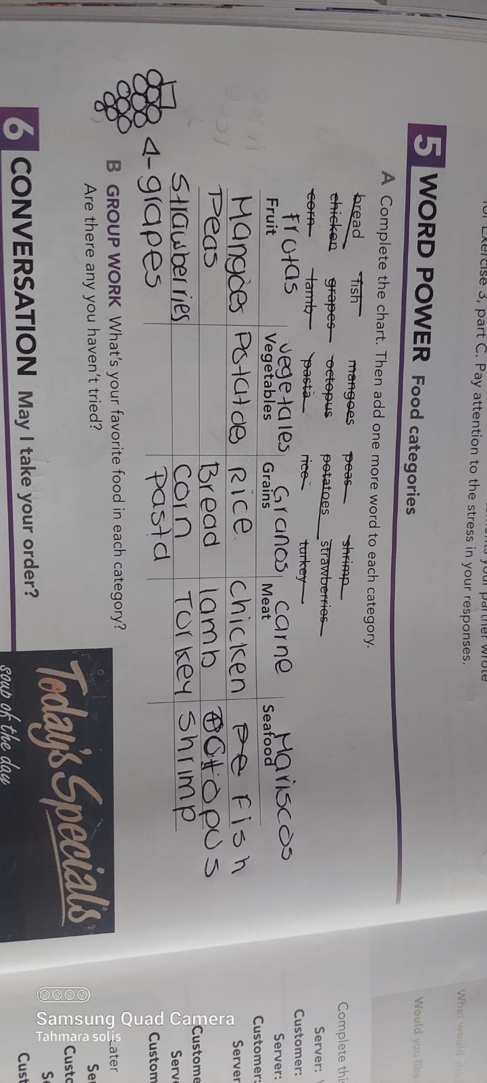

Slide 2
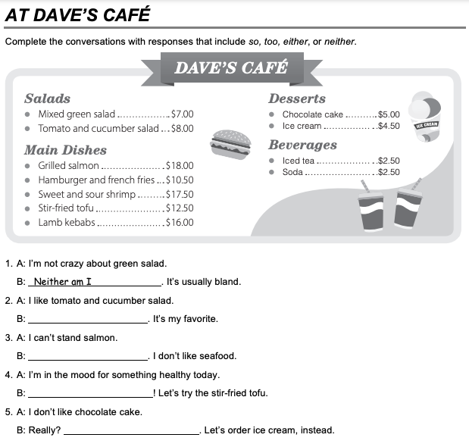
I am , too
Neither am i
Soo, i am
I don’t either

Slide 3
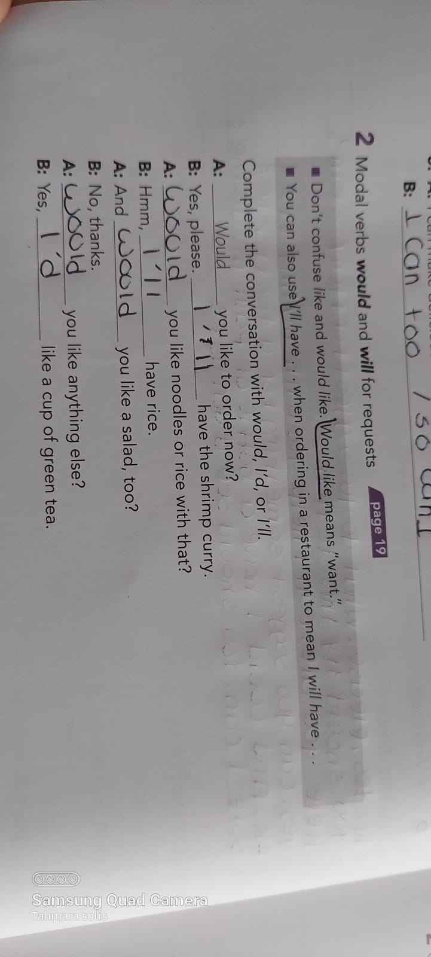

Slide 4
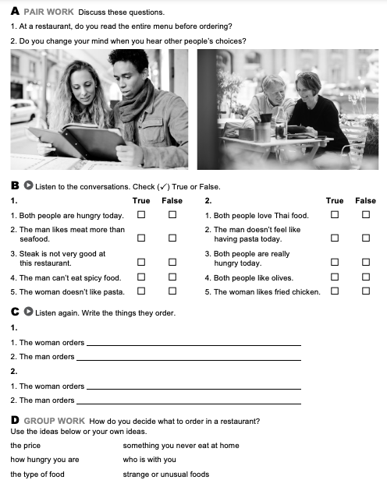
i woman order a salad and fries
i man order spinach pasta with tomato and cheese
Green salads
Chicken
-the Price
-how hungry you are
Something you never eat at home

