Slide 1
MARIA GUADALUPE MORALES MENDOZA

Slide 2
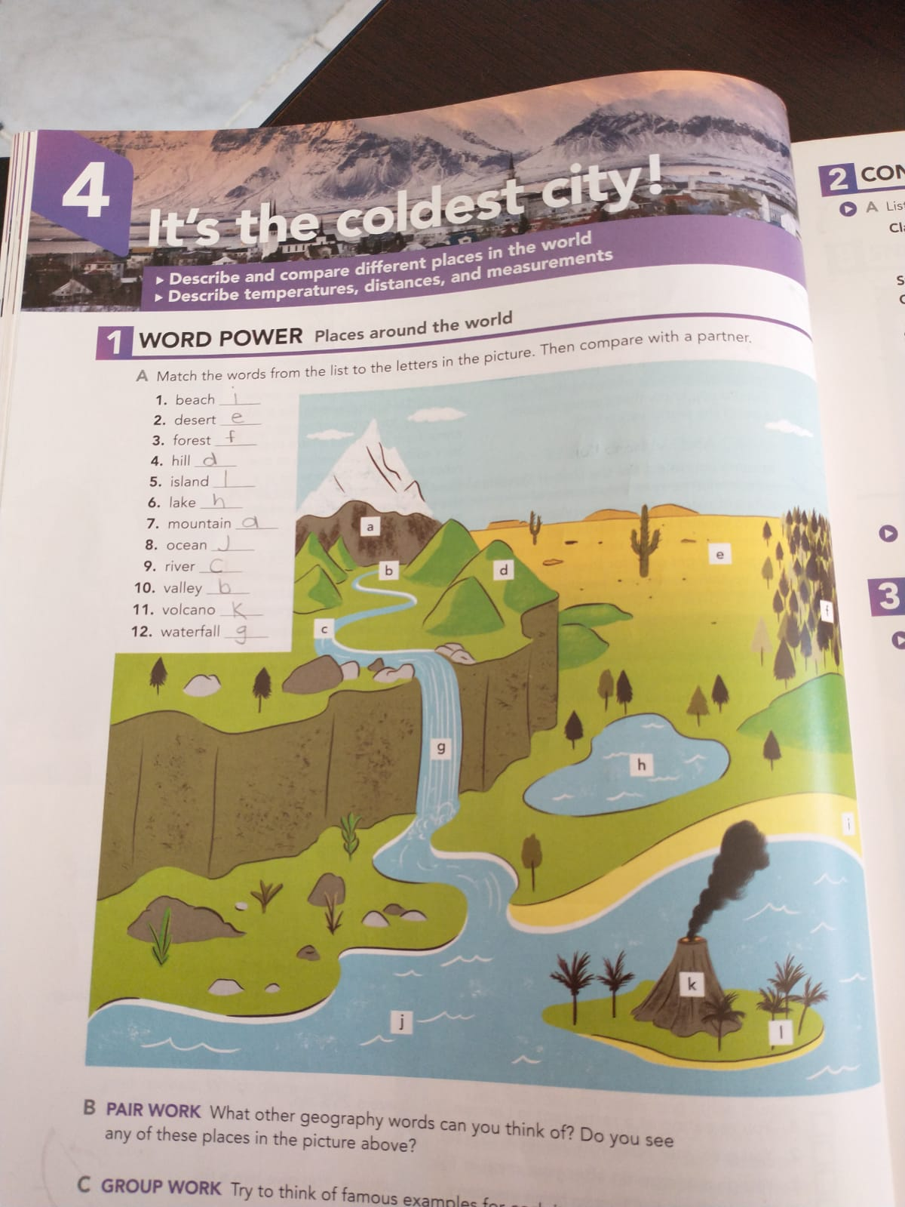

Slide 3
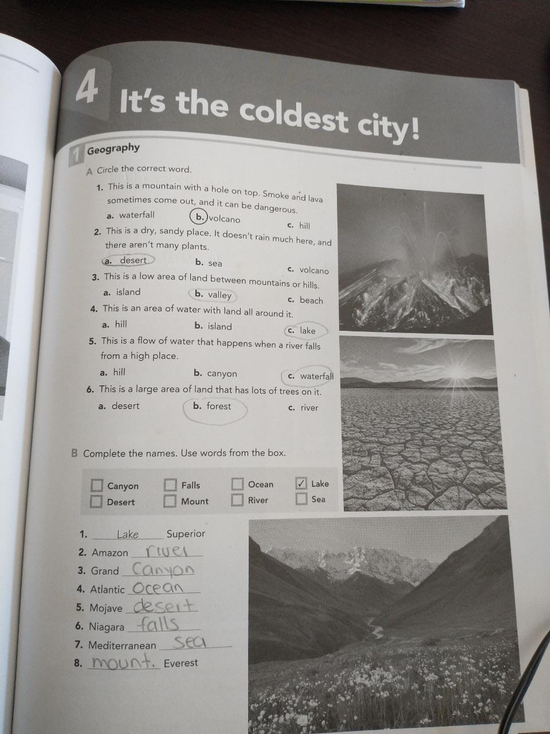

Slide 4
