Slide 1
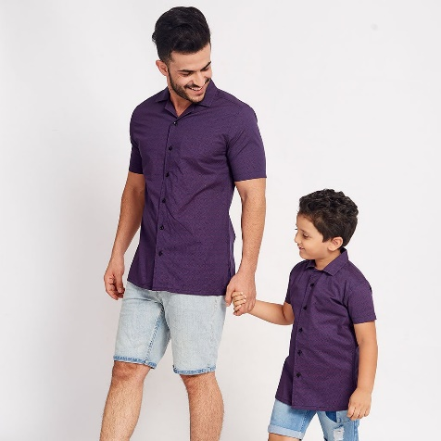
LESSON 10
“Present continuous Questions”
To be + subject + verb(ing) + complement
Are they wearing shorts?
Yes, they are
No, they´re not. / No, they aren´t
Unit objectives:
Identify and use present continuous questions

Slide 2
Vocabulary practice
Practice on studentbook pg 26 ex B.
Insert here your practice
B

Slide 3
C
‘s not
Are you wearing hig heles?
‘re not
Are you weating a sweater
am
Is it raining?
is

Slide 4
Listening practice
A. Listen. What are their names? Write the names Brittany, Ryan, Jhon, Robert, Kayla and Amber in the correct boxes
Jhon
Amber
Robert
Ryan
Brittany

Slide 5
B. Ask and answer five questions about the people in the picture.
Write them and record your voice with your practice. Follow the example.
1.Is kayla wearing a dress yellow? | No,she’s not
2.Are britanny wearing a high heels dark? | No, she’s not
3. Is robert wearing a tie red? | Yes, he is
4. Are Ryan wearing a jeans gray? | Yes ,he are
5. Is amber wearing blouse orange? | Yes she is

Slide 6
