Slide 1
ESCUELA NORMAL DE EDUCACIÓN PREESCOLAR DEL ESTADO DE COAHUILA.
Licenciatura en Educación Preescolar.
Ciclo escolar 2021-2022.
INGLÉS B2 ONLINE
Teacher’s Name: Mayela Alejandra Del Carmen Gaona García.
Student name:
María Paula Gonzalez Valdez. #4
January 10, 2022.

Slide 2
ESCUELA NORMAL DE EDUCACION PREESCOLAR
INGLES B2+ UNIT 15 RUBRICS FOR SPEAKING PRACTICE
TEACHER: MAYELA ALEJANDRA DEL CARMEN GAONA GARCIA
Aim:
Students will talk and write about social activities. Ss will find out how to discuss ways of preparing food, ways to cook, and to give advice on cooking. Ss will also explore ways to talk about local and international news.
Preparation:
Student will work individually
Student will elaborate a video following instructions included in the rubric.
Ss will give apply content learned on unit 15, ss will answer some questions stated in unit 15.
Ss support their speech with the grammar included in the unit 15 and (at least 5 gramar structures)
vocabulary of the unit 15. (at least 4 words of the vocabulary given in the unit)
Upload the video ( Video with audio)
Insert the link of the video (make sure it works perfectly before upload your activity)
Materials: creative video with all elements of the rubric.

Slide 3
Speaking Assignment | Give answers to the following questions to nurture the structure of your speech. Support your answer with grammar, vocabulary and expressions of unit 15 Imagine you´re a chef. You own a cooking show on TV and you´re giving a show today. Introduce your name and the name of your show. Start your video with the following information. What type of rice dishes do you enjoy? How often do you eat rice? What different dishes do you have with rice? Are they always hot dishes or are they sometimes cold? How many different types of rice have you tried? How many types are available in your local supermarket? Give a foreing recipe of a rice dish you would like to try. (mention where is it from and a short piece of it´s culture) Mention the ingredients and the different kitchen appliances or gadgets to cook the dish. (Is there a special ingredient which you should not miss? What kitchen gadget will you buy to make your cooking easier? Do you use a special gadget to cook rice? Is it maybe your grandma´s pot?) Mention the steps of the récipe. While you prepare your dish you can give some important information about the dish preparation , eg tips for a faster cooking,, a better flavour, prevent rice for sticking, etc ) Make an invitation (Will you cook the dish for a fríend or for a group of people? Will you cook it in a special date?) Don´t forget creativity to make your cook show sparkle
Due date | January 10th

Slide 4
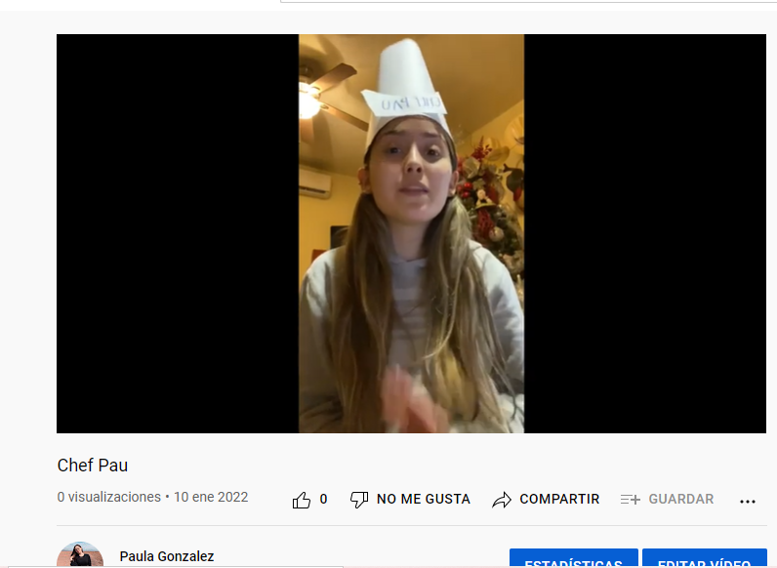
Your Video here: (share your link here)
https://www.youtube.com/watch?v=Hpr05ZowE54
Note: Before sharing, make sure your video runs perfectly.

Slide 5
General Requiriment format (20pts) | Excellent (4) | Good(3) | Satisfactory (2) | Poor (1)
The task (video with converation) fullfills all elements of the unit 10 content (gramar and functions at least 5structure) Present perfect tense Present perfect continuous Since, for and In to state duration Subject and object relative clauses. Can/ could modals to ask for adivce Fisrt conditional(cause and effect) Future will, going to and present continuous. Phrasal verbs.
The task (video) fullfills all elements of the unit 15 content (vocabulary 4 words min)
Uses relevant information, includes details to support ideas which are in context.
The student express himself/herself clearly and fluenty
The task is creative
TOTAL

