Slide 1
In order to the students participate and practice orally the contents of unit 1 and 2, they have to:
Pass to the front in pairs (conversation pairs)
Introduce your self individually (with your tabloid presentation)
Then, act your introduction and greeting conversation (unit 1)
Teacher choses one of the student´s presentation (unit 2), and each student has to make questions and give answers about it
The teacher will assess with a rubric, the clear and fluent performance of the student, as well as the use of the vocabulary, functions and grammar from the unit 1 and 2

Slide 2
Introduce your self individually include basic information as name (first and last), nickname, spell your phone number and e-mail.
Hello!
My name is….. My last name is:
My Friends call me…..
My pone mumber is…..
My e mail is……

Slide 3
In pairs act your introduction and greeting conversation
Hello! My name is ….
Nice to meet you…….
Can you spell your name?
What is your last name again? …….
What is your pone number?
Whats your e-mail?
Good bye.... / see you son……

Slide 4
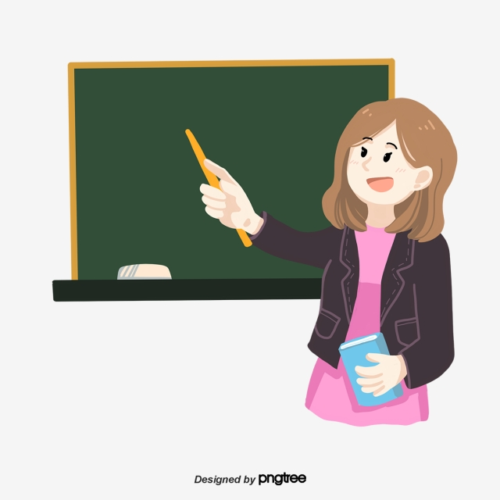
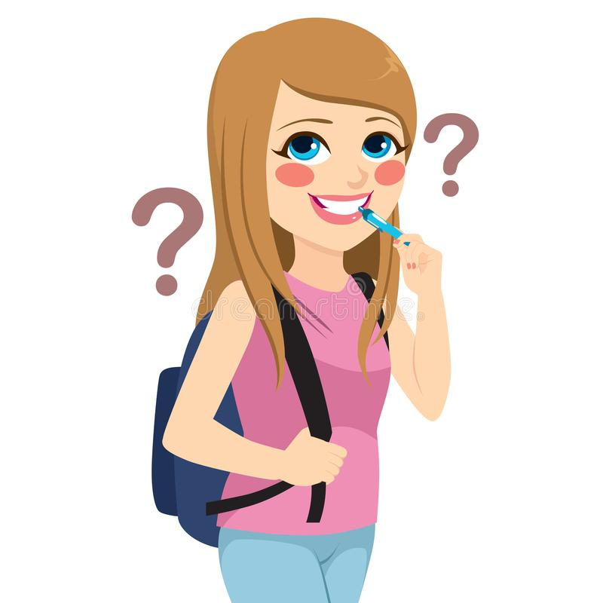
Students present slides of Project unit 2 (in pairs) each student has to make questions and give answers about it

Slide 5
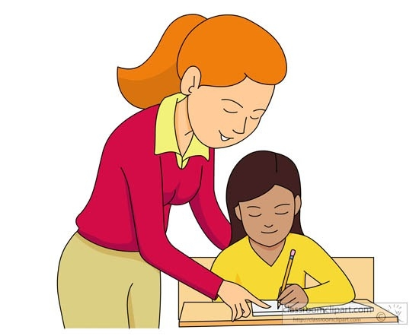
The teacher will assess with a rubric, the clear and fluent performance of the student, as well as the use of the vocabulary, functions and grammar from the unit 1 and 2

