Slide 1
Welcome to the QR codes Activity Album!

Slide 2
Instructions
Download the QR lector App in your smarphone (Escaner de código QR)
Choose the topic or grammar you want to work with
Place the scanner in front of the QR code (Acerca el lector al código en la presentación de Power Point)
Work on the activity clicking on the audio, then you can see the script, the grammar and then complete the quiz.

Slide 3
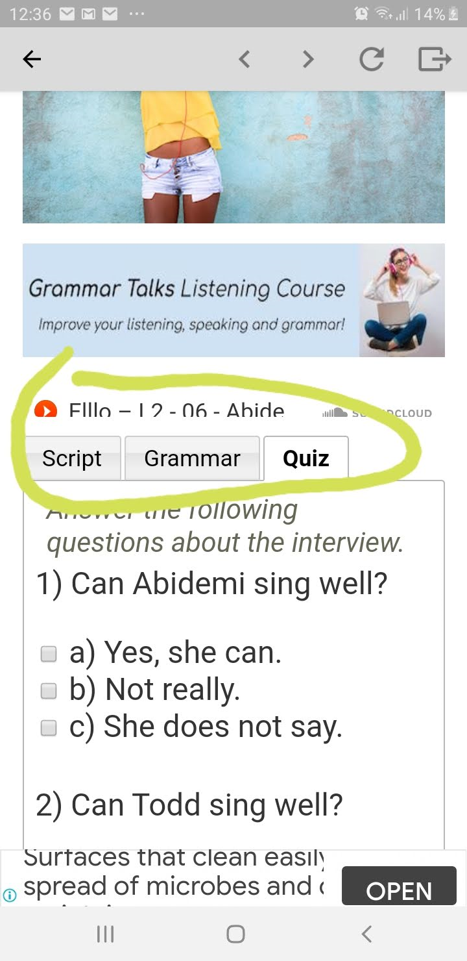

Slide 4
Simple present questions

Slide 5
Can and Can’t for ability

Slide 6
Subject-verb agreement singular/pluralnoncount

