Slide 1
Lemon Tree by Fool's Garden
I wonder how, I wonder why
Yesterday you told me 'bout the
Blue, blue sky
And all that I can see
Is just a yellow lemon tree
I'm turning my head up and down
I'm turning, turning, turning, turning
Turning around
And all that I can see
Is just another lemon tree
Sing dah
Dah-dah-dah-dam, dee-dab-dah
Dah-dah-dah-dam, dee-dab-dah
Dab-deedly dah
I'm sitting here in a boring room
It's just another rainy Sunday afternoon
I'm wasting my time I got nothing to do
I'm hanging around I'm waiting for you
But nothing ever happens
And I wonder
I'm driving around in my car
I'm driving too fast, I'm driving too far
I'd like to change my point of view
I feel so lonely, I'm waiting for you
But nothing ever happens
And I wonder

Slide 2
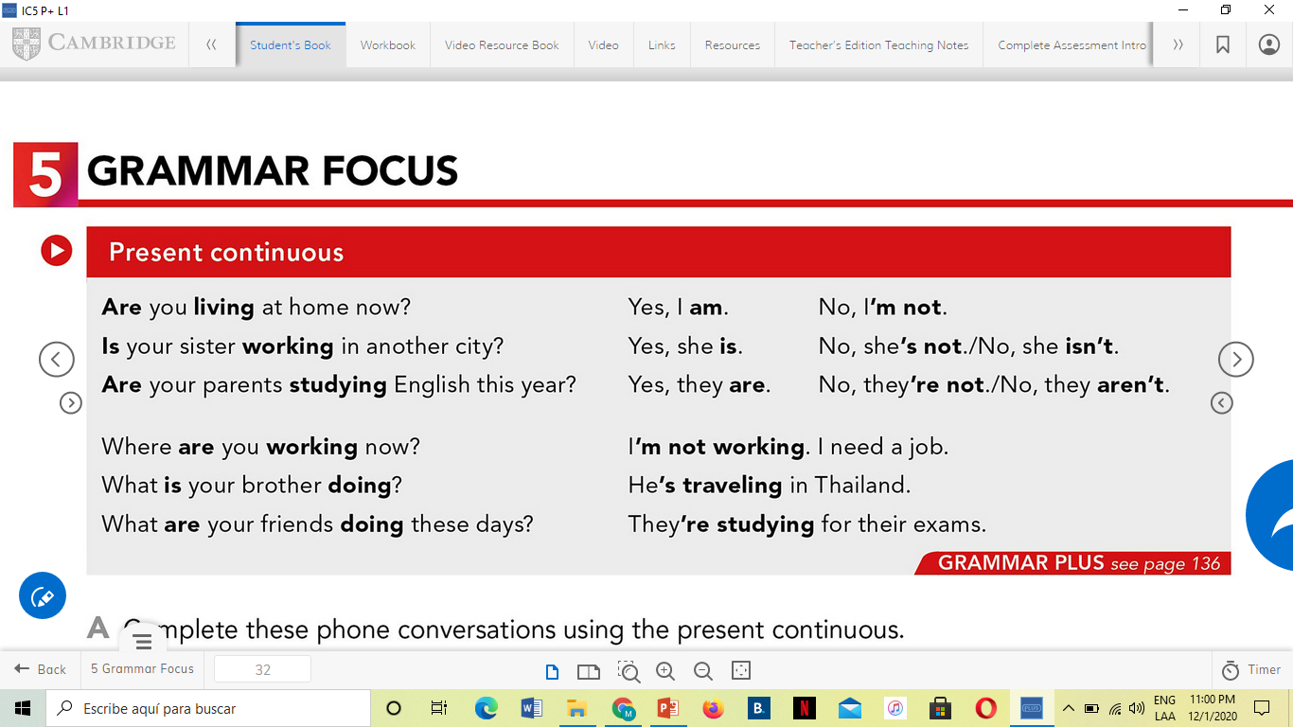
How are you doing?
What are you doing to stay safe? I’m keeping distance when I’m on the street.
How are you feeling?
Are you cold?
What are you wearing?
Not anymore
Spending time

Slide 3
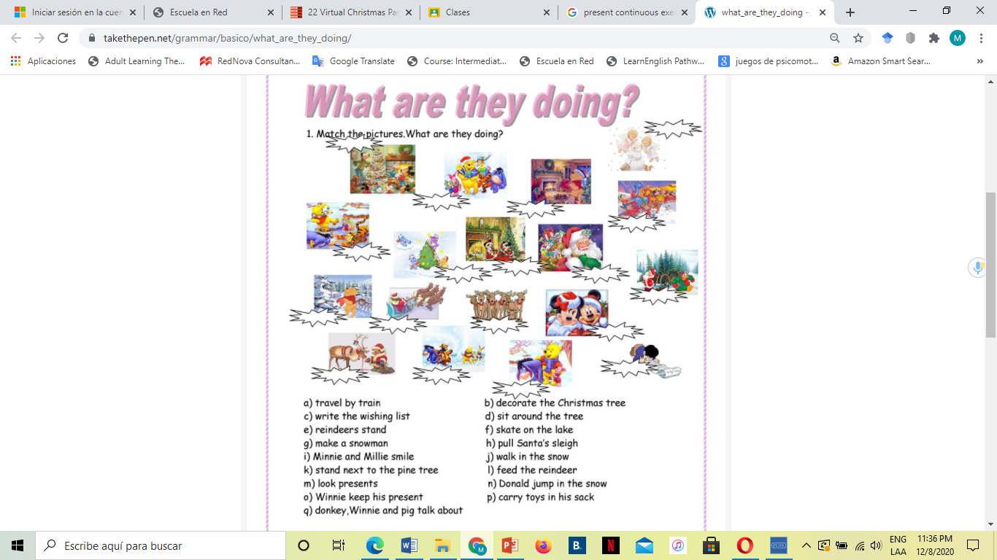

Slide 5
Activity #49 in Escuela en red
Participate in a forum. Read and prepare.
A forum is a situation or meeting in which people can talk about a problem or matter especially of public interest.
Online forums can be used for many purposes, such as reviewing material prior to an assignment or exam, engaging in discussion of course material, and reflecting on material people have read or worked with.
It’s an structured opportunity to interact with each other online around exam time.
It’s an online discussion, I hope encourages collaboration and to gives you a structured opportunity to give opinions and find answers to questions.
This activity would also help you to practice writing and explaining concepts.

Slide 6
Work book ex 2 and 5
Home work:
PAIR WORK. Complete activity Unit 5 Cycle 2.
INDIVIDUAL WORK. Participate in the forum.
Complete ELL’s on-line platform.
Check your grades and the attendance.

Slide 7
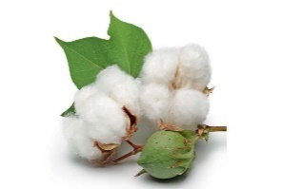

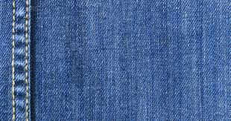

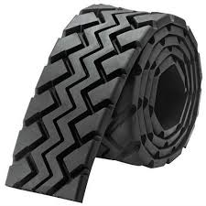
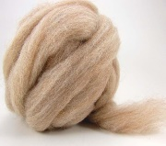
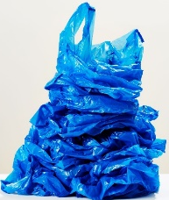


Warm-up:
How is it going?
What are you wearing today?
I’m wearing a cotton T-shit, denim pants. Long sleeve.
What are you doing these days?
I’m preparing for Christmas.
I’m decorating the house.
I’m buying toys for my children.
COTTON
LEATHER
DENIM
WOOL
RUBBER
GOLD
PLASTIC
SILVER
SILK

Slide 8
Today’s program. Friday, December 11th, 2020.
1. Reinforce Present progressive tense.
2. Reinforce Simple present vs Present progressive tenses.
3. Speaking activity: Family SURVEY
4. DISCUSSION. What are you doing these days?
5. Homework: Activity #49. Forum about family.
Message: If you had problems last Tuesday uploading activity #47 in Escuela en Red, please do it now. This is evidence of work Coordinators can check if they need to.

Slide 9
Present continuous questions and statements
C. Look at the Grammar Focus box.
What is the rule for forming for yes/no questions in the present continuous?
A=_Be___ + _subject___ + __verb__ +_ing___
is
are
am
Be =
YES/NO QS.
2. What is the rule for forming Wh-questions in the present continuous?
A=__Wh-question____ + __be__ + __subject_ + __verb___ +__ing__
NEGATIVE STATEMENT
WH-QS.
AFFIRMATIVE STATEMENT
D. Listen and practice.
E. Circle the time expressions in the Grammar Focus box that show the actions is temporary or current:

Slide 10
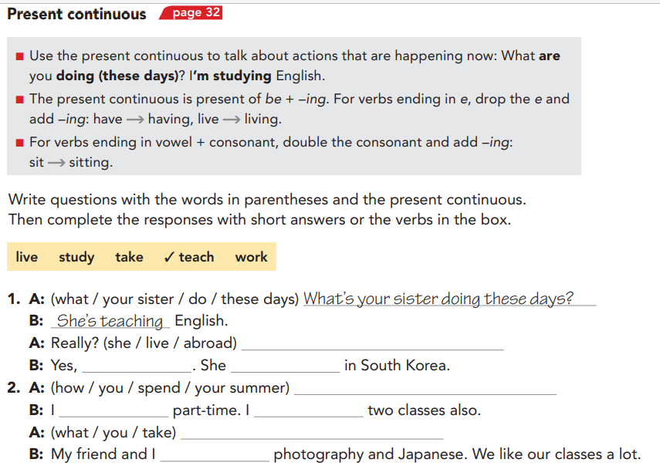
Gerund form: verb + ing
live - living
study - studying
take - taking
teach - teaching
work - working
Is she living abroad?
she is
is living
How are you spending your summer?
am working
am taking
What are you taking?
are taking
More exercises: https://www.ego4u.com/en/cram-up/tests/present-progressive-1

Slide 11
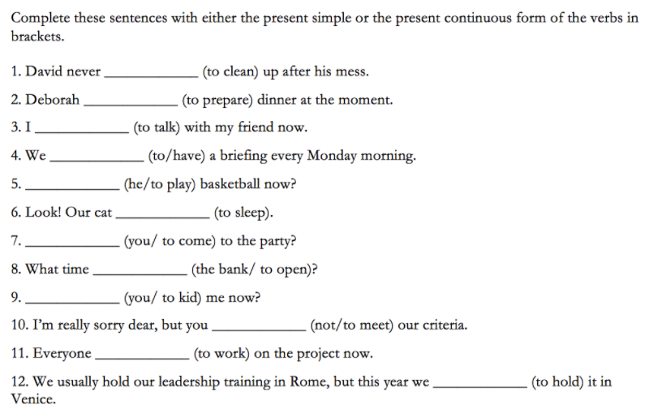
cleans
is preparing
I have
You have
We have
They have
She has
He has
It has
am talking
have
Is he playing
is sleeping
Are you coming
does the bank open
Are you kidding
don’t meet
is working
are holding
More exercises:https://www.ego4u.com/en/cram-up/grammar/simpre-prepro

Slide 12
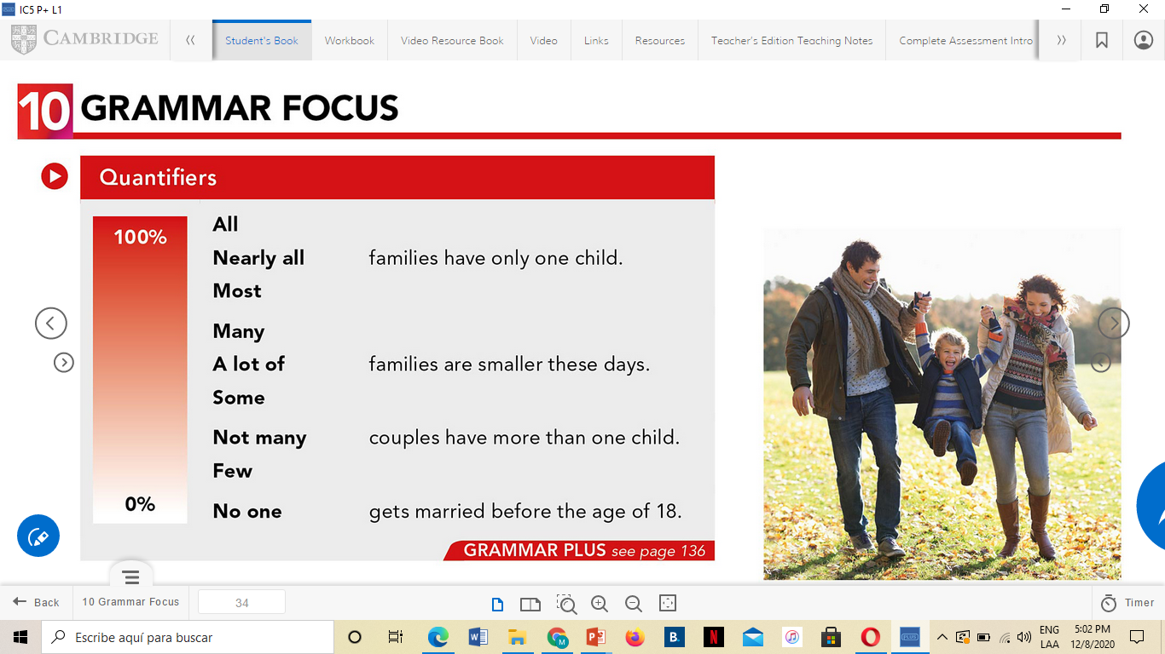
Speaking activity: Family SURVEY
PRACTICE talking about families using quantifiers.
.
PLURAL NOUN
STEPS
1. Think of one yes/no question you can ask to obtain interesting information about families from your class.
Example:
Are you an only child?
Is your family big? / Do you have a big family?
Do your parents work?
Does your family always eat dinner together?
2. Join a sharing group.
3. Ask your question to at least ten people, including yourself or the teacher.
4. Report back to the group. Draw a chart and add it to the google slide to present your findings, using quantifiers. https://docs.google.com/presentation/d/1UuAhIbuD58MIM-kA1GpijelDRzuOs3FjiTlBan2H19o/edit?usp=sharing
singular
Few people are only children.
Most people have one brother or sister.
All their parents work.

Slide 13
INTERACTION 1
Sharing group 1
1. Ana – Lore Álvarez
2. Nayeli Ramos – Mariana Ávila
Sharing group 4
7. Lore Iracheta – Yaneth
8. Nayely Ibarguen – Mariana García
Sharing group 2
3. América – Blanca
4. Andrea – Lucy
Sharing group 5
9. Jazmín – Karina
10. Tahmara - Fátima F. - Paola Durón
Sharing group 3
5. Cristy – Mayela
6. Rose – Paola Dávila
Sharing group 6
11. Yesi – Fátima N.
12. Claudia - Luz

Slide 14
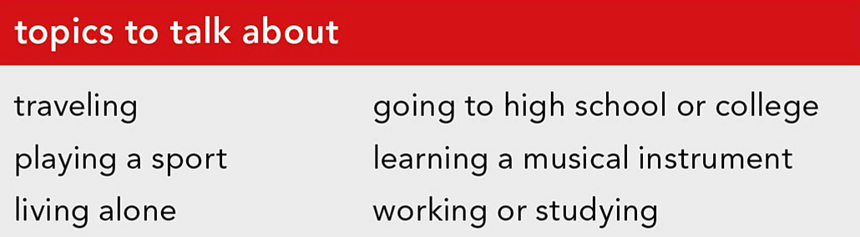
DISCUSSION. What are you doing these days?
Group work. Take notes and be ready to report to the class orally.
Ask and answer questions about what you are doing . Use the topics in the box and your own ideas. Ask follow-up questions to get more information.
Model:
A: So, What are you doing these days?
B: I’m playing basketball at Sports City.
A: That’s nice. And are you enjoying it?
2. What’s good or bad about these things?
- being the oldest child - having a lot of brothers and sisters
- being the youngest child - having few brothers and sisters
- being a middle child - having no brothers
- being an only child - having no sisters

Slide 15
Read the survey results and the survey report. Number the results in the order they appear in the report.
7
6
2
8
3
5
4

Slide 16
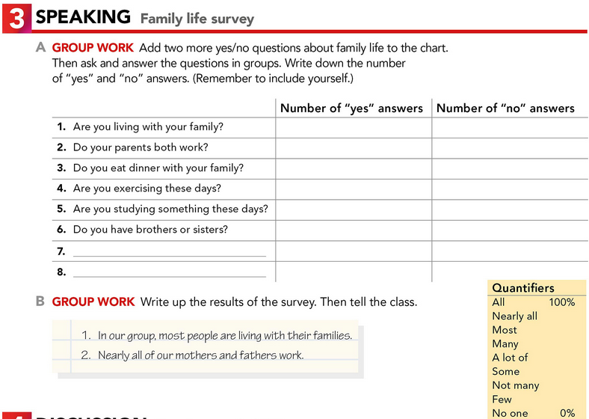
Thursday, January 13th 2021, class activity
3
1
Type of answers:
Yes I am. / No, I’m not.
Yes, I do. / No, I don’t
Each team member must report two of the results.

