Slide 1
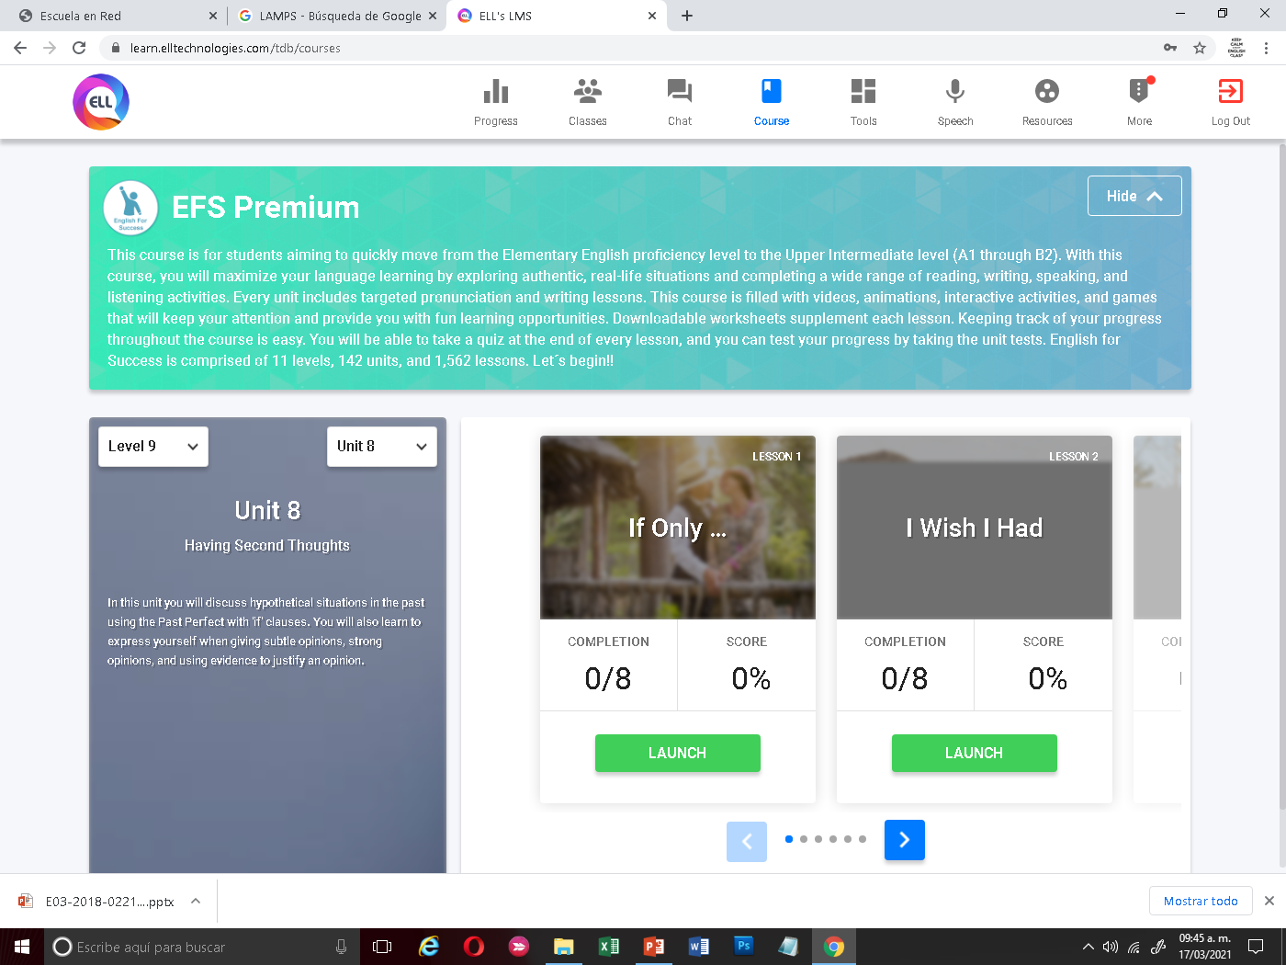
Can Do statements
I can talk about emotions, opinions, behavior and work. I can talk about hypotetical situations in the past. I can talk about what I wish for in the past, present or future.

Slide 2
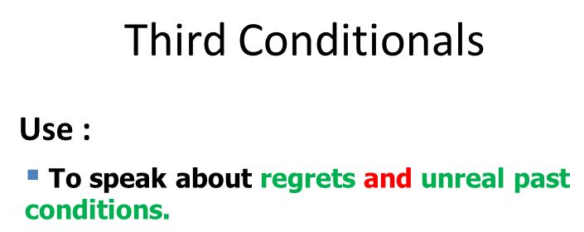
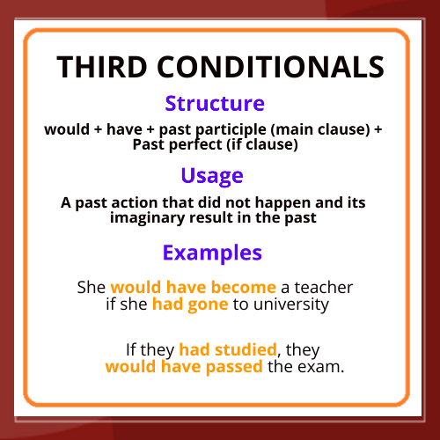
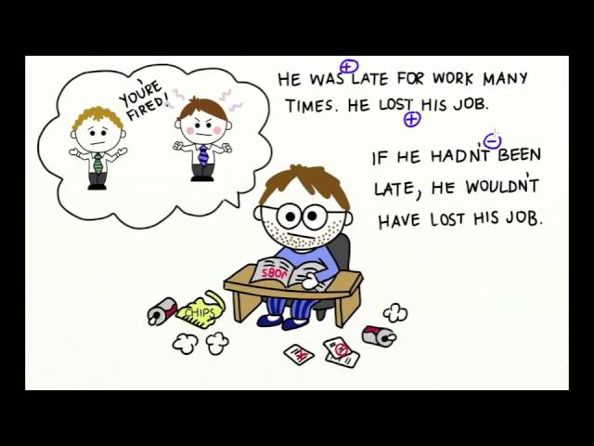

Slide 3
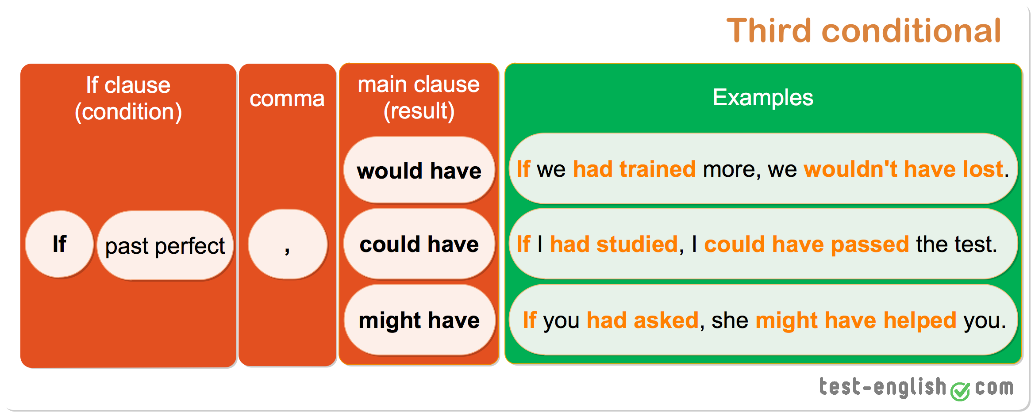
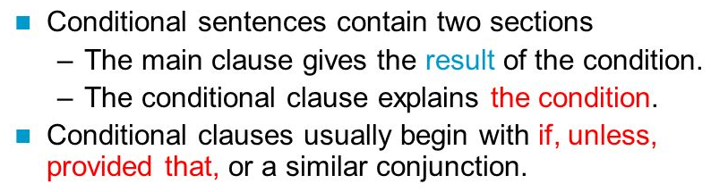
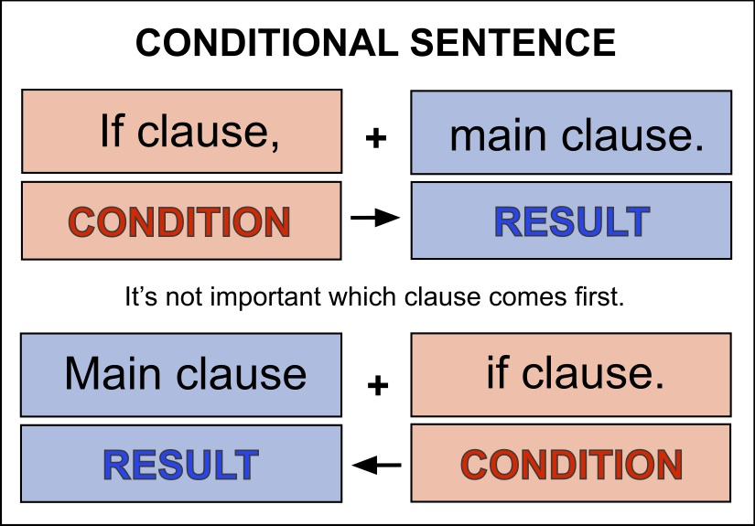

Slide 4
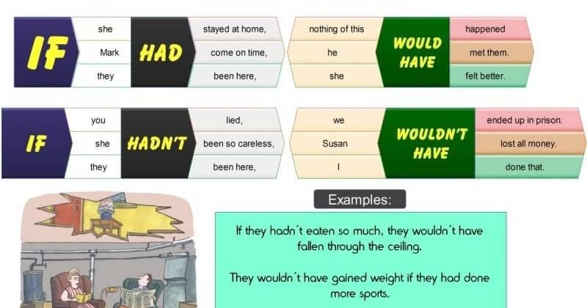
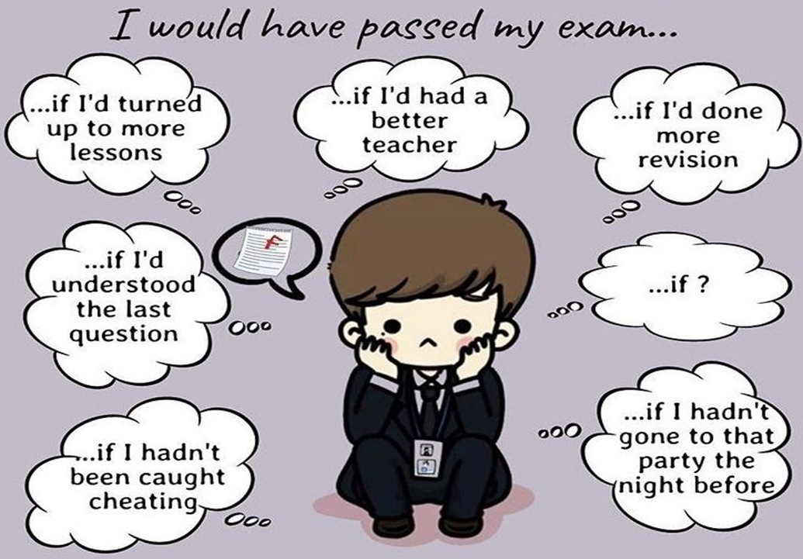

Slide 5
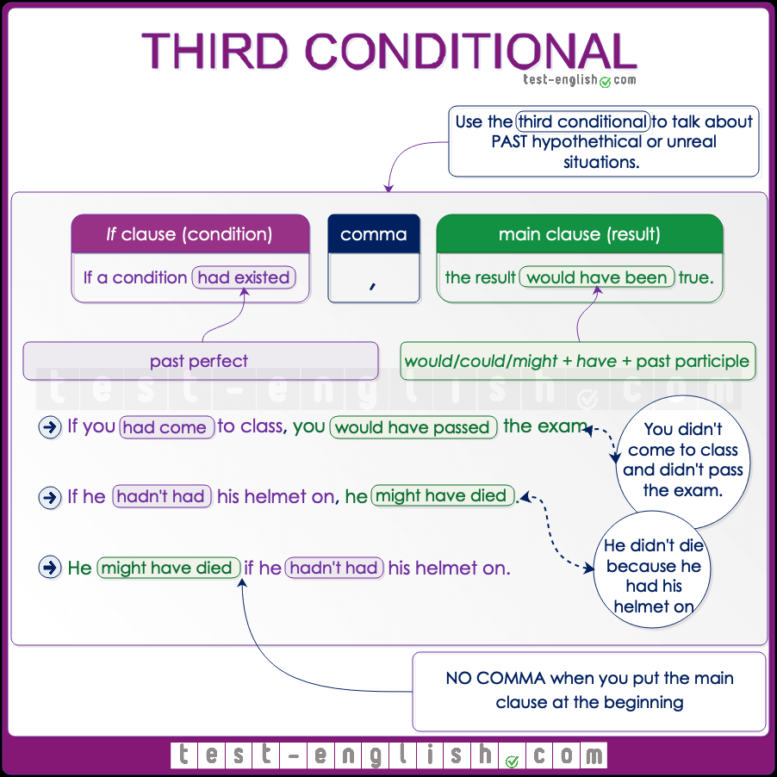

Slide 6
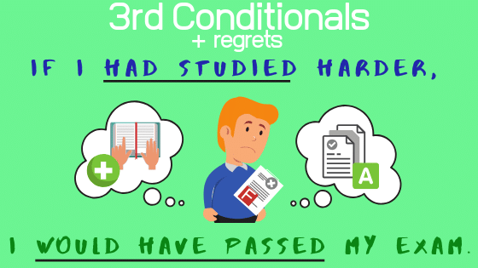
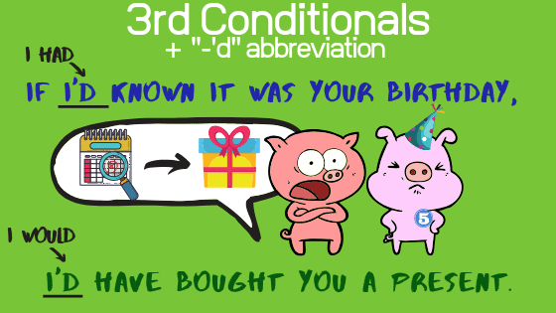
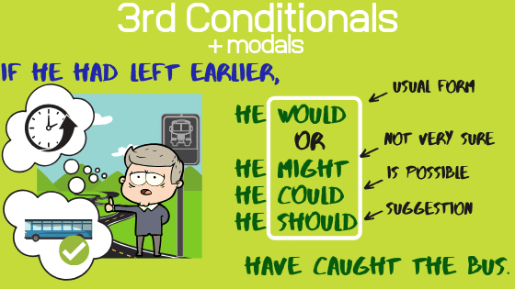
http://www.engames.eu/how-to-form-and-use-the-third-conditional/

Slide 7
Let´s talk about it!
Would you have had a better life if you had lived in another era ? Would your life have been better if you´d been born in another place? If you hadn´t born in the place you were born, where would you have born? If you hadn´t studied this career what other career would you have chosen? How would your life have been different if you´d chosen a different school? If you hadn´t lived in your current house where would you have lived?

Slide 8
CLICK ON THE FOLLOWING LINK TO STUDY AND PRACTICE THE THIRD CONDITIONAL (THERE ARE THREE EXCERCISES YOU MUST COMPLETE)
https://learnenglishteens.britishcouncil.org/grammar/intermediate-grammar/third-conditional

