Slide 1
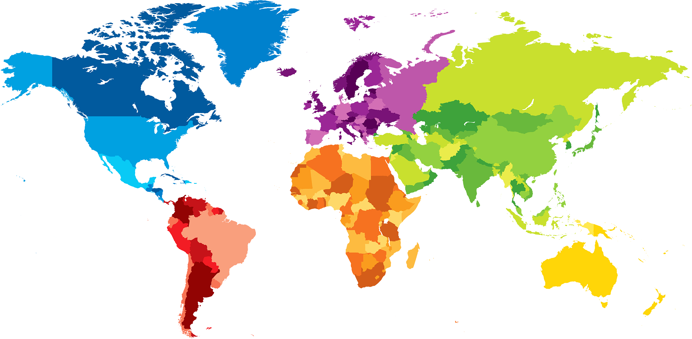
ENGLISH A2.1
UNIT 1 “WHERE ARE YOU FROM?”
SEPTEMBER 5TH

Slide 2
OBJECTIVES
To use be and possessive adjectives in a conversation about people meeting for the first time.
To make statements/contractions with be; use possessive adjectives to describe oneself and others; ask and answer Wh-questions with be

Slide 3
WH- QUESTIONS WITH BE
Where’s your friend?
He’s in class.
She is my classmate.
Is Arturo from México?
It’s a very exciting city.
Who is Soo-jin?
We are from Brazil.
Are you free on Saturday?
They are pretty interesting.
Where are you and Vanessa from?
They are really nice.
Yes, they are. They are really interesting.
What are your classmates like?
No, I’m not. I have to go to my English class.
Is Alexa from Brazil?
What’s Seoul like?
Yes, she is. She is from Sao Paulo.
Are your classes interesting?
No, he isn’t. He is from Canada.
How are your classes?

Slide 4
REMEMBER
VERB BE (AM, IS, ARE) = YO SOY/ESTOY
I ‘M FROM BRAZIL.
HE IS A GREAT STUDENT.
WE ARE IN THE SAME CLASS.
POSSESSIVE ADJECTIVES – BEFORE A NOUN
MY NAME IS LETICIA.
HER LAST NAME IS COSTA.
OUR PARENTS ARE IN CANADA.

Slide 5
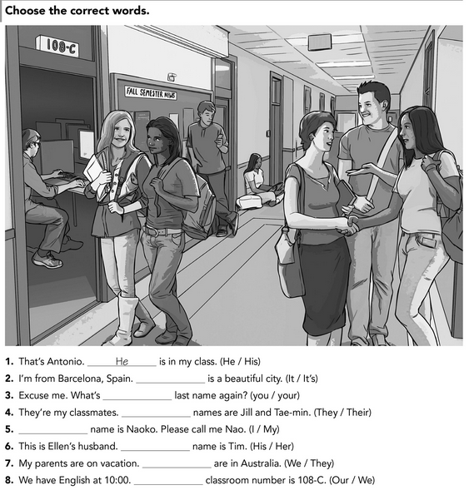

Slide 6
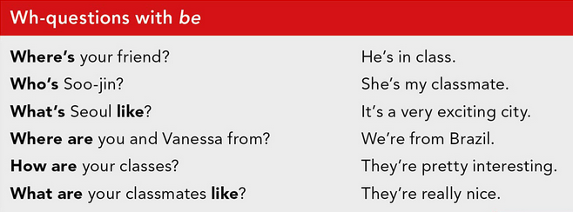
WH- WORD +. VERB BE (AM, IS, ARE) + COMPLEMENT?

Slide 7
COSA
LUGAR
TIEMPO
PERSONA

Slide 8
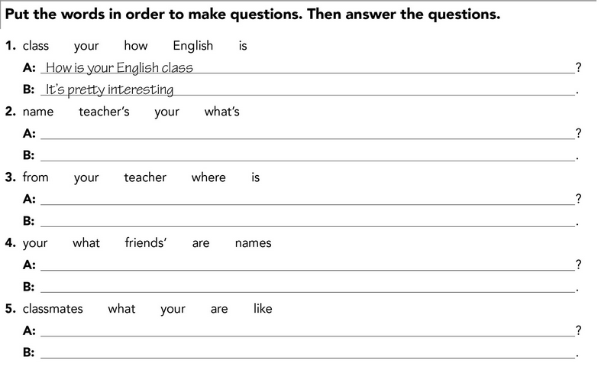

Slide 9
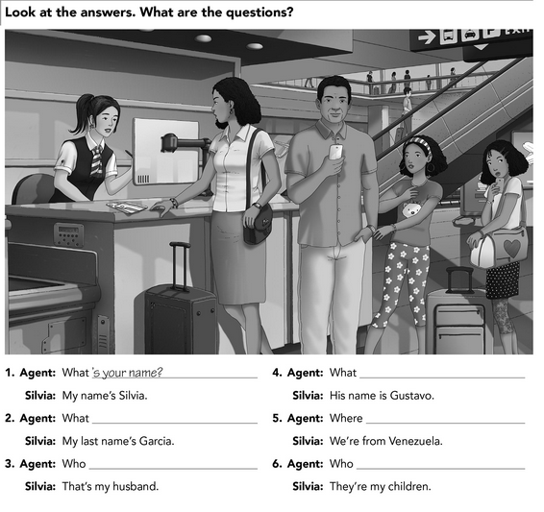

Slide 10
VERB BE (AM, IS, ARE) + SUBJECT + COMPLEMENT?

Slide 11
