Slide 1
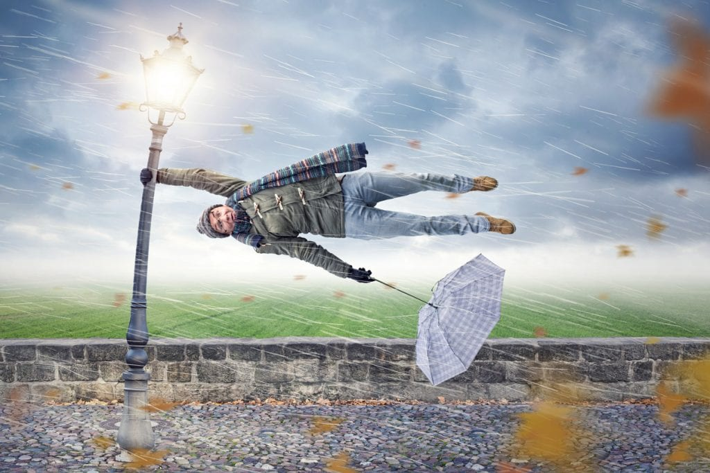
UNIT 4
It´s windy today !
Unit objectives:
Discuss work and free-time clothes; colors
Discuss the weather and what people are wearing

Slide 2
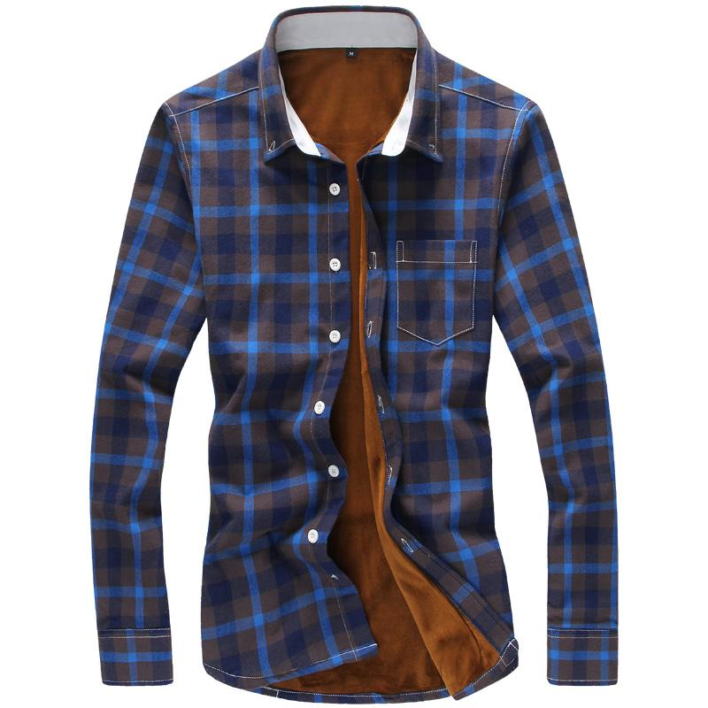
UNIT 4
LESSON 1
Vocabulary “clothes”
Lesson objectives:
Identify work/free-time warm-cold weather clothes
Practice singular and plurals with this and these
Practice Yes/no questions and short answers.

Slide 3
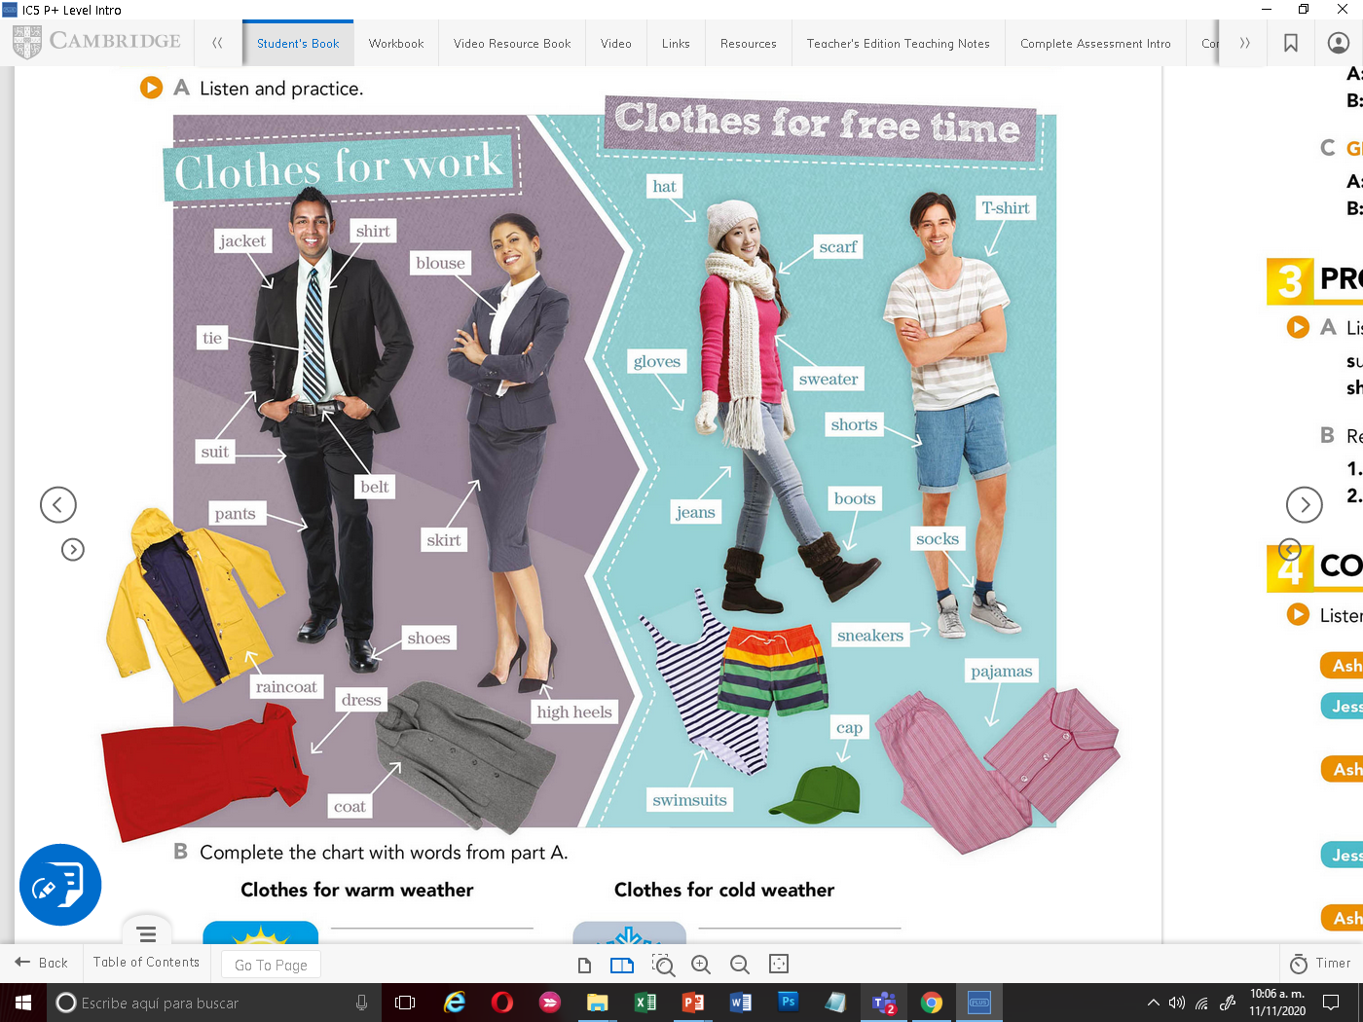
Vocabulary “clothes”
Listen and practice

Slide 4
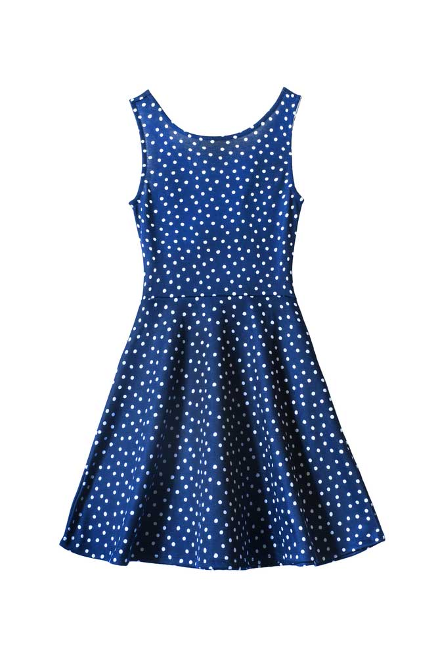
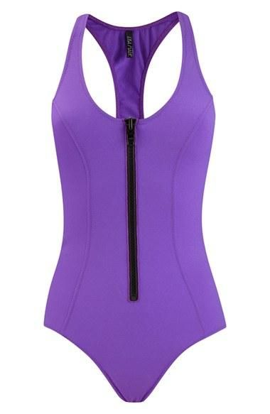
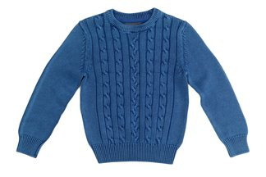
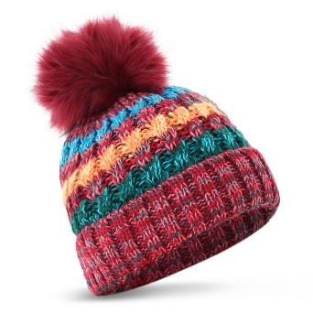
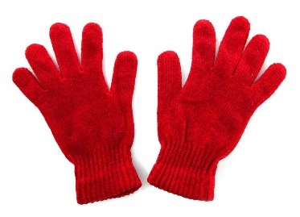
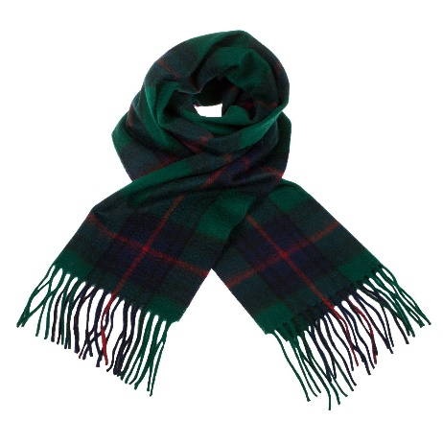
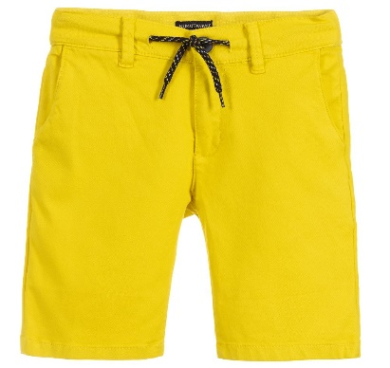
Complete the chart with the correct pictures. Coloca las prendas en la categoría adecuada.
CLOTHES FOR WARM WEATHER | CLOTHES FOR COLD WEATHER

Slide 5
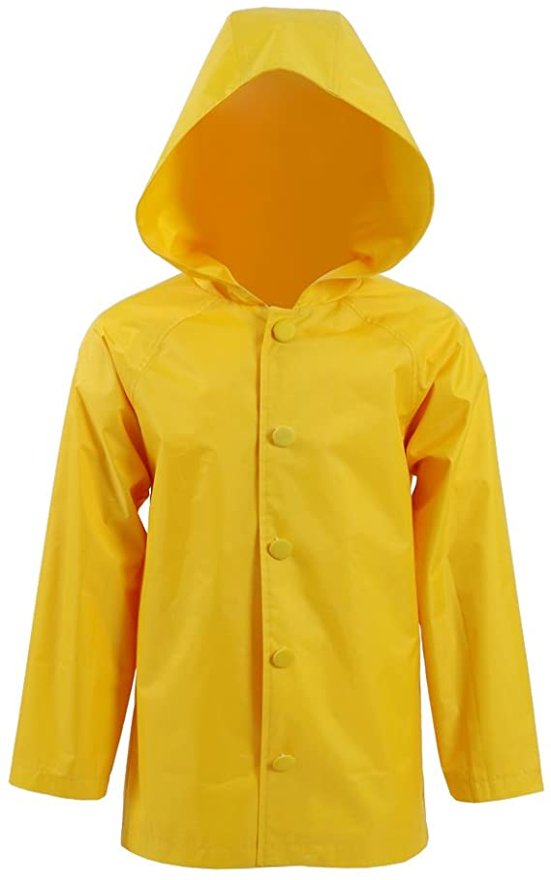
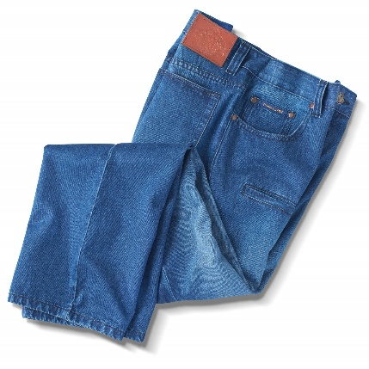
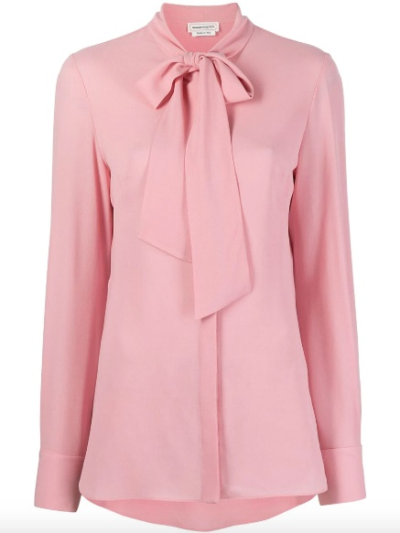
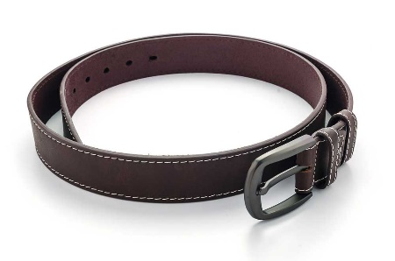
Match the picture with the correct word.
Blouse
Sweater
Gloves
Shirt
Scarf
Raincoat
Tie
Coat
Jeans
Belt

Slide 6
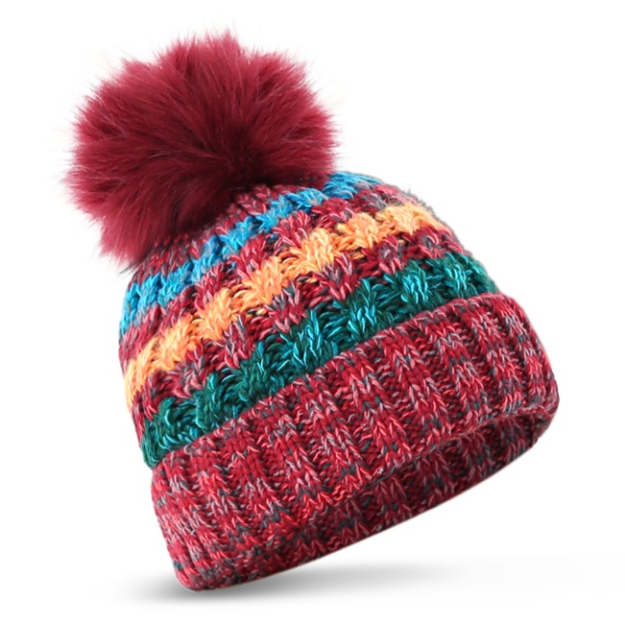
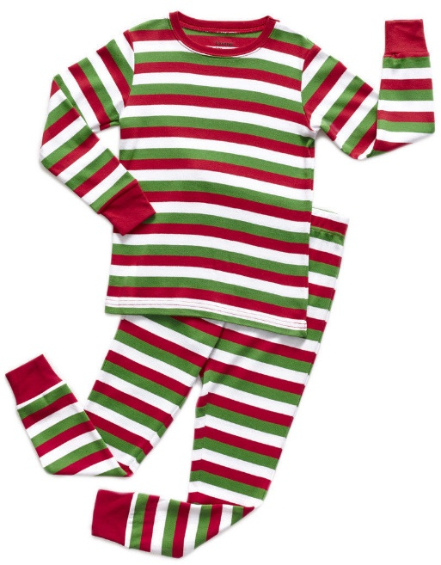
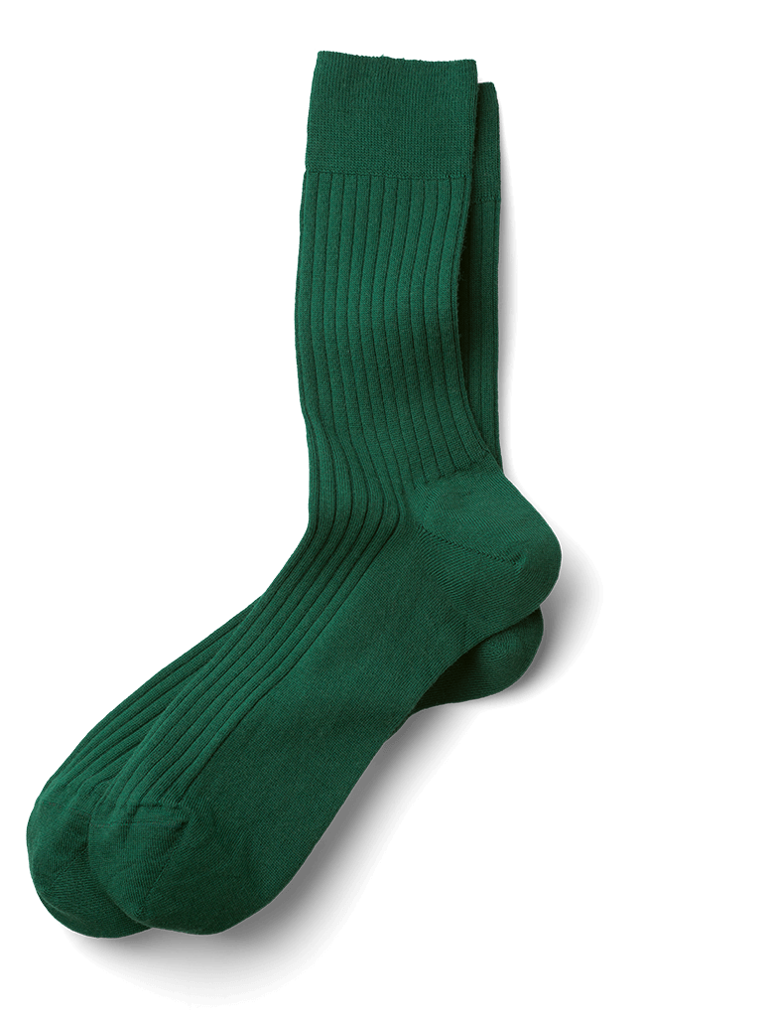
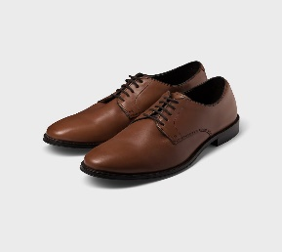
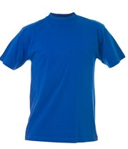
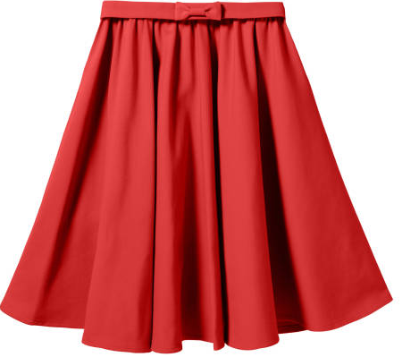
Listen and number the following clothing.

Slide 7
Click on the following links to practice clothing vocabulary
https://www.kidslearningville.com/clothes-vocabulary-esl-memory-game/
Print screen with your practice results and paste here
https://matchthememory.com/ClothesCMP
Print screen with your practice results and paste here

Slide 8
Practice Clothing vocabulary in workbook pg.19 ex 1, pg 20 ex 2

Slide 9
Draw or insert a picture for these words.
hoodie
earmuffs
mittens
high heels

Slide 10
GRAMMAR “Singular and plural this and these”
Watch the following video and practice the use of What is this? / What are these?
https://youtu.be/ogmVGs1HTus

Slide 11
GRAMMAR “Singular and plural, this and these”
What is this? to ask about singular nouns
What are these? to ask about plural nouns
What is this?
This is a skirt
It´s a skirt
What are these?
These are sneakers
They´re sneakers

Slide 12
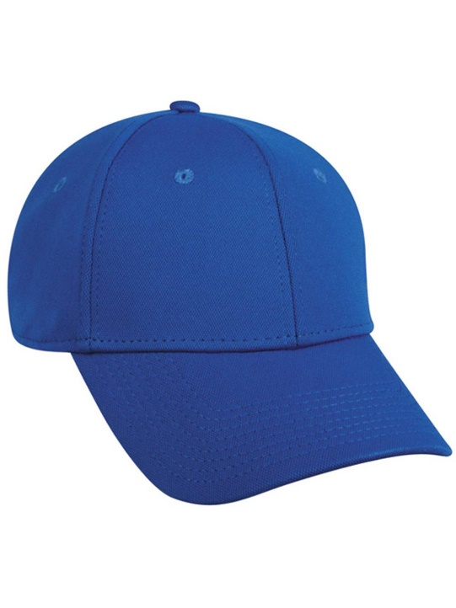
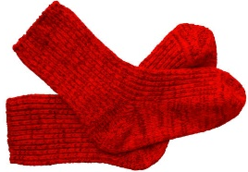
Clothing Vocabulary, Singular and plurals practice
Write questions and give answers
What is this?
It´s a hat

Slide 13
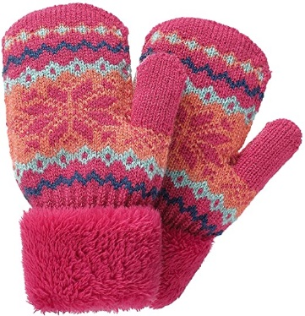
Clothing Vocabulary, Singular and plurals practice
Write questions and give answers
What is this?

Slide 14
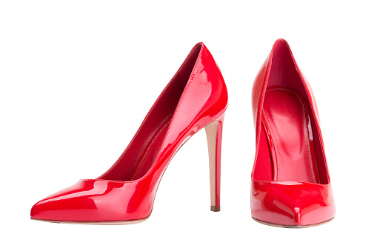
GRAMMAR “Yes/no questions and short answers”
Is this a dress?
Is it a dress?
Yes it is.
Are these sneakers?
Are they sneakers?
No, they´re not.

Slide 15
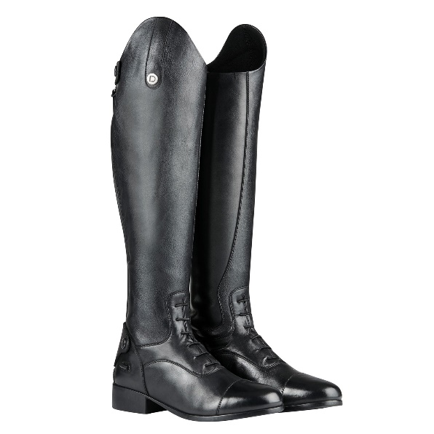
Clothing Vocabulary, Yes/no questions and short answers practice
Write questions and give answers
Are these mittens?
No, they´re not.
scarf?
Is this a t-shirt?
boots?
sneakers?
raincoat?

Slide 16
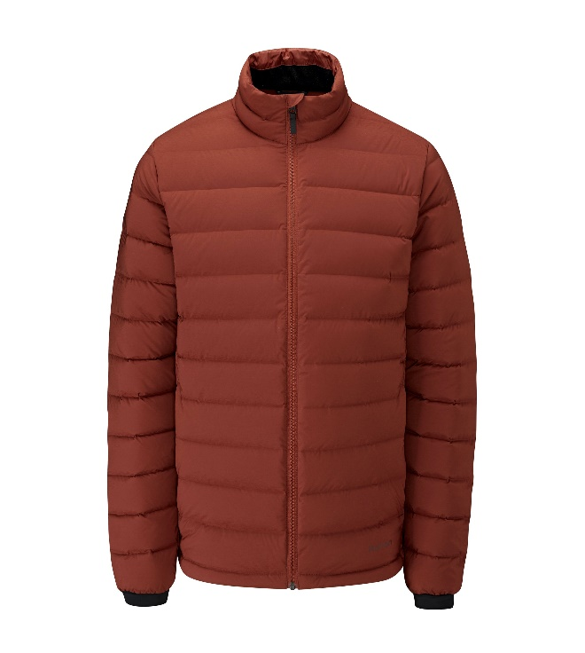
Clothing Vocabulary, Yes/no questions and short answers practice
Write questions and give answers
Are these high heels?
scarf?
dress?
belt?
sneakers?
scarf?

