Slide 1
UNIT 4
LESSON 4
Lesson objectives:
Identify and use the Whose question to ask about belongings

Slide 2
GRAMMAR “ POSSESSIVES ADJECTIVES”
POSSESSIVE CASE “ ´ ” The Possessive case ( ´ ) is used to express that something belongs to someone El sajón genitivo ( ´ ) es una construcción muy común en inglés que se usa para indicar posesión
Susan
Pablo
Susan´s shirt is light blue
Susan´s shoes are brown
Pablo´s shirt is pink
Pablo´s tie is brown
The possessive case (´) is located after the subject before the belonging object

Slide 3
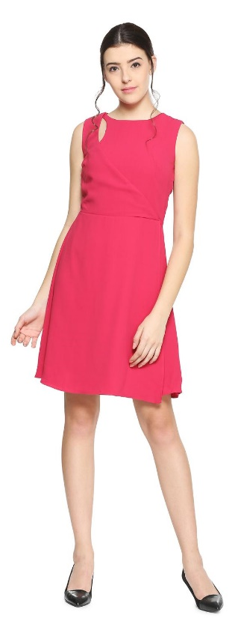
WRITING PRACTICE “ POSSESSIVE CASE”
Write 5 sentences using possessive case, then record your voice with your practice.
Follow the previous example.
Katherine
Jhon
Andrea
Robert

Slide 4
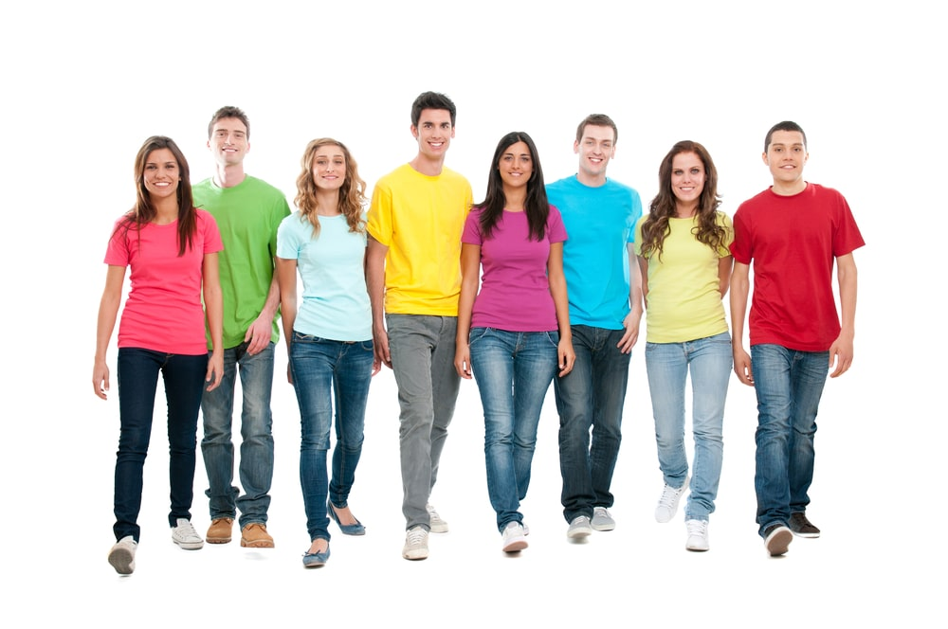
LISTENING PRACTICE “ POSSESSIVES ADJECTIVES”
Listen to 6 people´s belongings match the name with a line.
Tom
Rosy
Mark
Martha
Albert

Slide 5
WRITING PRACTICE “ POSSESSIVES ADJECTIVES AND POSSESSIVE CASE”
Practice on workbook pg 20 ex 3.

Slide 6
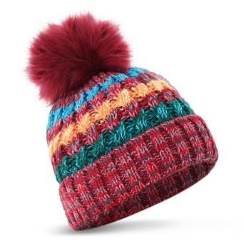
UNIT 4
LESSON 5 Whose question
Whose
+
hat
+
is this ?
Lesson objectives:
Identify and use the Whose question to ask about possession

Slide 7
DISCOVERY LEARNING “Whose question”
Click on the following link, learn and practice
https://www.youtube.com/watch?v=pxKt7hbKj0M

Slide 8
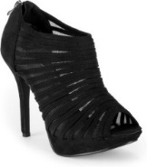
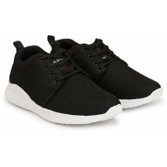
GRAMMAR “ Use of WHOSE to show possession”
“ Whose ” is a pronoun used in questions to ask who owns something Whose es un pronombre que se usa para preguntar quien posee algo.
Whose hig-heels are these?
They are Andrea´s hig-heels
The possessive case (´) is located after the subject before the belonging object
Whose sneakers are these?
They are Robert´s
Whose hat is this?
It is Andrea´s hat
Andrea
Robert

Slide 9
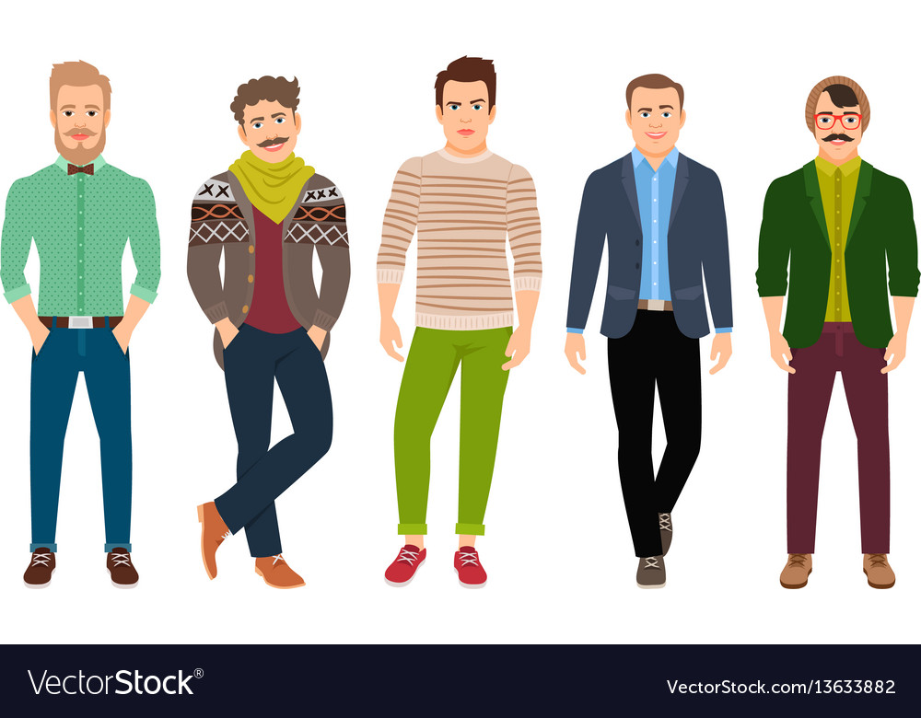
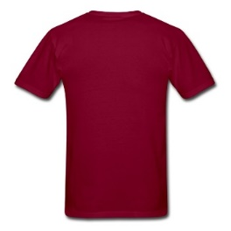
Answer the following questions
Mark
Tom
Alan
Jhon
Rick
Whose glasses are these?
Whose belt is this?
Whose jeans are these?
Whose t-shirt is this?

Slide 10
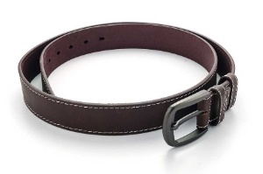
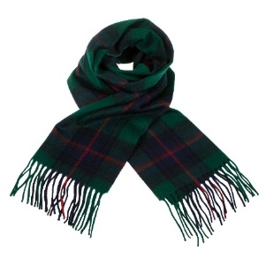
Write questions and give correct answers (use the object and nouns in the box to match belongings).
 | Whose keys are these? | They are janet´s
Janet
Roger
Erick
Tom
Martha

Slide 11
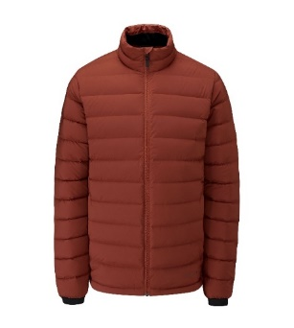
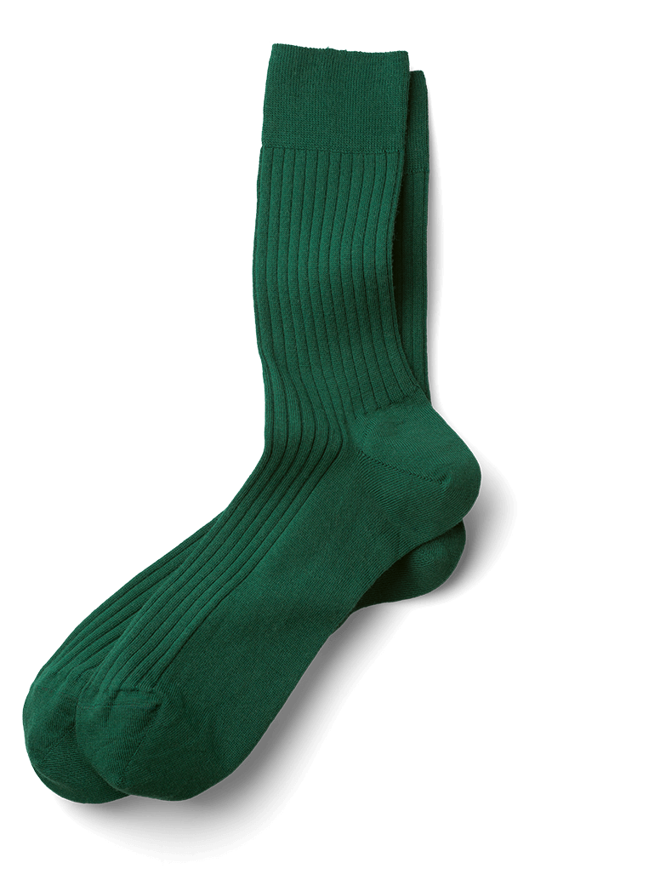
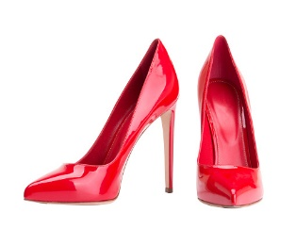
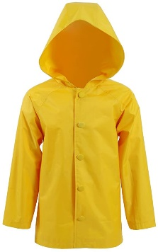
Write questions and give correct answers (use the object and nouns in the box to match belongings).
Mario
Roger
Mary
Monica
Karen

Slide 12
WRITING PRACTICE “ WHOSE QUESTION”
Practice on workbook pg 21 ex 4 (A).

