Slide 1
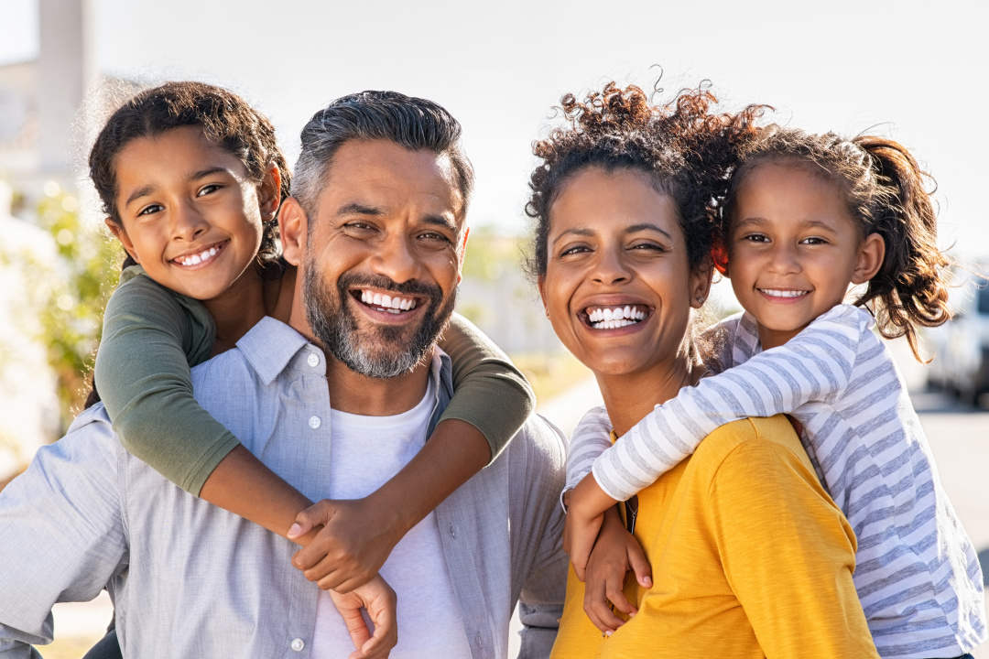
UNIT 6
Lesson 2 “My family”
Lesson objectives:
Learn and practice family vocabulary

Slide 2
Family members “vocabulary”
Learn and practice vocabulary of family members.
Husband
Wife
Father/dad Mother/mom
(parents)
Son Daughter
(children / Kids)
Brother
Sister

Slide 3
Family members “vocabulary”
Learn and practice vocabulary of family members. Stbk. Pg 37
Complete the sentences about the Mitchell family. Then listen and check your answewrs
children
husband
son
daughter
brother
sister
Parents
Listen to the audio and check your answers

Slide 4
Listen and complete the sentences, then write the names of the family members in the picture.
Anne is Charles' | Wife
Jason and Sophia are his | Children
Charles is Anne's | husband
Jason is Anne's | son
Sophia is Anne's | daughter
Jason is Sophia's | brother
Sophia is Jason's | Sister
Charles and Anne are Jason's | Parents
charles
anne
Jason
Sophia

Slide 5
Complete the following statements with the words in the box. Workbook pg 31
mother
Father
husband
wife
children
daughters
son
sister
brother

Slide 6
Relatives “vocabulary”
A relative is a person in your family connected by blood or marriage.
grandfather
married
grandmother
grandparents
father
married
mother
uncle
married
aunt
parents
sister –in-law
brother
me
cousin
cousin
nephew
niece

Slide 7
Relatives “vocabulary”
A relative is a person in your family connected by blood or marriage.
husband
married
me
married
son -in-law
daughter
grand son
grand
daughter
grandchildren/ grandkids

Slide 8
Fill in the chart with female and male relatives names.
Female relatives names | Male relatives names
Mother Mother- in law | Father Father-in-law
daughter | son
wife | husband
Sister Sister-in-law | Brother Brother-in-law
aunt | uncle
Sister-in -law | son-in- law
grandmother | Grandfather

Slide 9
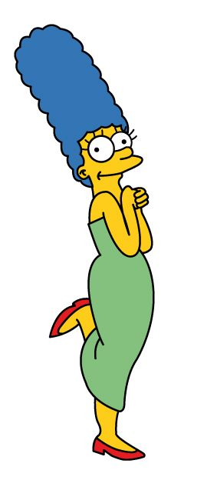
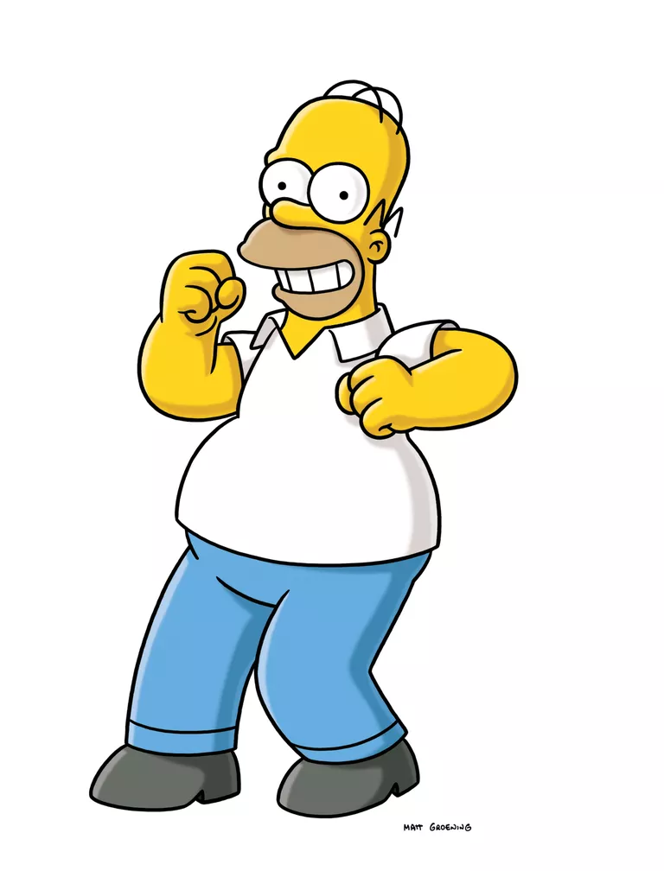
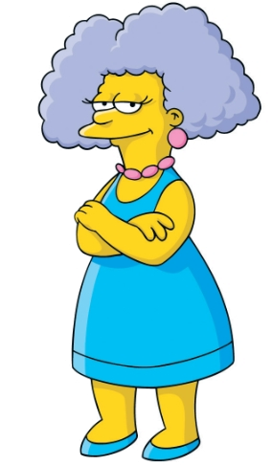
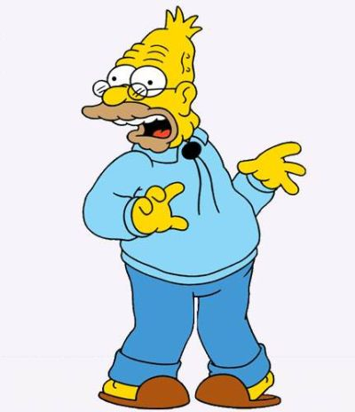
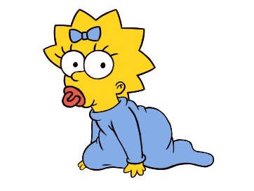
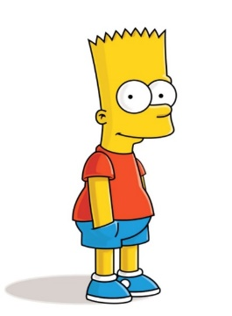
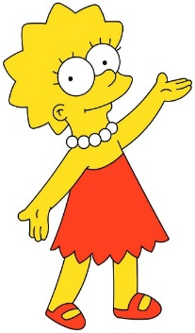
Look at the picture and answer the following activities
A. Answer true or false | T | F
1.- Homer is Bart´s father
2.- Bart is Marge´s brother
3.- Lisa is Bart´s sister
4.- Maggie is Bart´s mother
5.- Selma is Lisa´s aunt
Marge
Selma
Homer
Abraham
Lisa
Maggie
B. Complete the following statements
1.-Lisa and Maggie are Marge´s daughter
2.-Abraham is Marge´s father-in-law
3.-Homer is Abraham´s son
4.-Lisa and Bart are Maggie´s sibilings
5.-Selma is Homer´s sister-in-law
Bart
C. Write 2 more statements
1.Marge´s and homer´s are lisa parents.
2. Maggie´s and lisa are bart´s sisters.

Slide 10
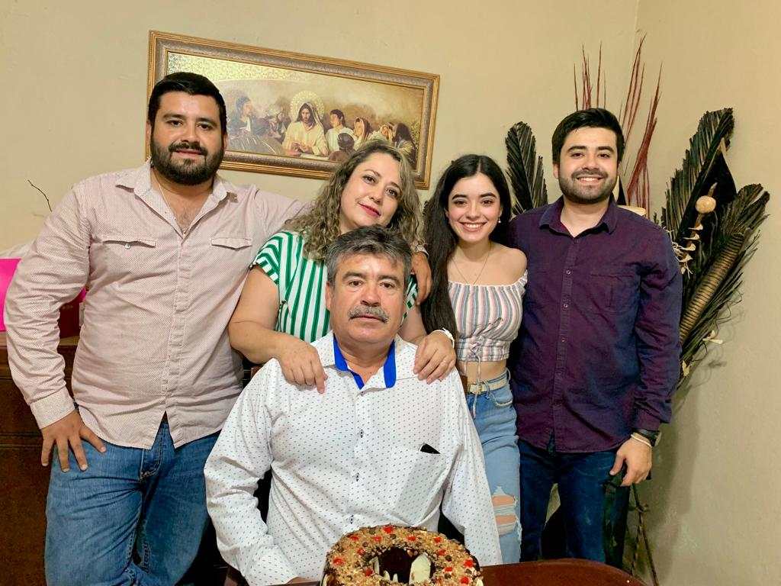
Speaking Activity.
Draw your family tree. (you can insert pictures of them) Share to the class and talk about it.
Who are the people in your family? What are their names?
My father´s name is… / My mother´s mother is………/ This is my brother… His names is… / etc..

Slide 11
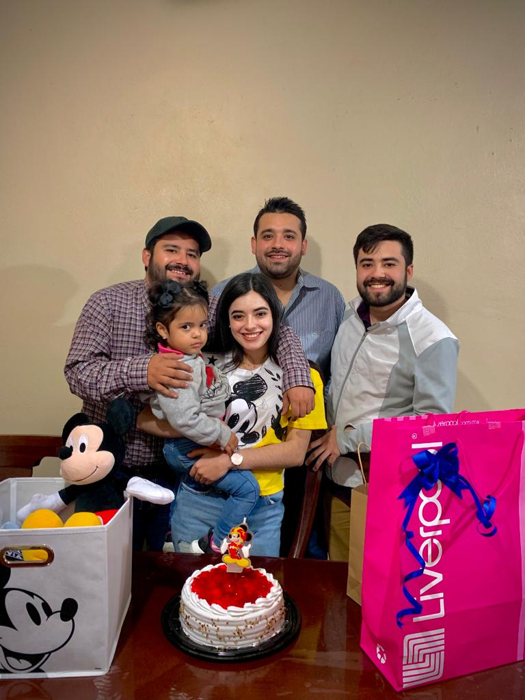

Slide 12
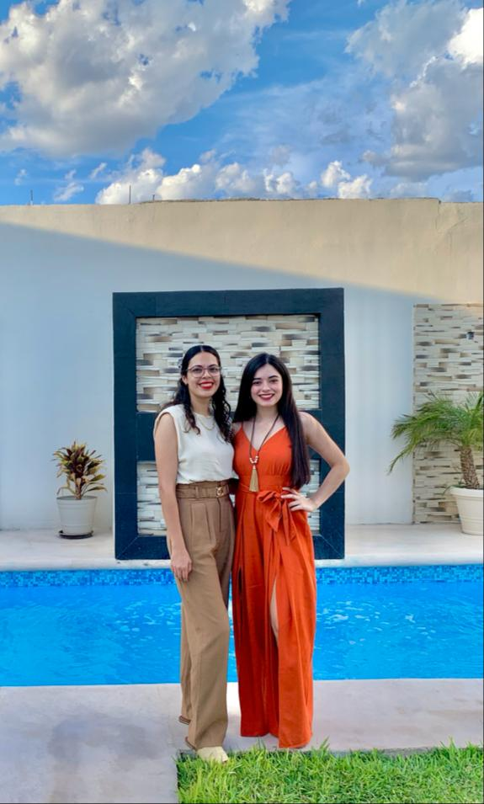

Slide 13
Click on the folowwing link to practice family vocabulary, share the results of your practice
https://www.cambridgeenglish.org/learning-english/activities-for-learners/a1l053-my-family

