Slide 1


UNIT 7
Lesson 6
WHERE WERE you yesterday?
LESSON OBJECTIVE:
Ask and answer “WH” BE questions in simple past

Slide 2






GRAMMAR FOCUS “Wh BE Questions”
A WH-question is used for seeking content specific information, related to persons, things, facts, time, place, reason, manner, etc. Wh-questions differ depending on the kind of content information sought.
Wh-questions begin with what, when, where, what time, How, etc..
WH question | USE
 | to ask for information about something
 | to ask for the time
 | to ask what day or date
 | to ask for what place or position
 | to ask about the manner
 | to ask about the a period of time
What
What time
When
Where
How
How long

Slide 3

GRAMMAR FOCUS “Wh BE Questions”
Wh-questions begin with what, when, where, what time, How, etc.
Wh | Be in simple past | Subject/noun | complement
Where | Was | I He She It
 | Were | You We They

Slide 4

GRAMMAR FOCUS “Was/Were Questions”
GRAMMAR FOCUS “SIMPLE PAST Yes /No questions with BE”
Use WHERE to ask for what place or position
WHERE WERE you last night?
I was in my house

Slide 5

GRAMMAR FOCUS “SIMPLE PAST WH questions with BE”
Use WHAT to ask for information about something
What Was Anita´s favorite book in highshool?
It was a history book.

Slide 6


GRAMMAR FOCUS “SIMPLE PAST WH questions with BE”
Use WHAT TIME to ask for the time.
What time WERE they at the pool?
They were at the pool at 2:00 o’ clock

Slide 7

GRAMMAR FOCUS “SIMPLE PAST WH questions with BE”
Use WHEN to ask what day or date.
When Was the party?
It was on Saturday

Slide 8

SIMPLE PAST WH .. QUESTIONS
Use HOW to ask about the manner.
How Was your last birthday?
It was fun

Slide 9
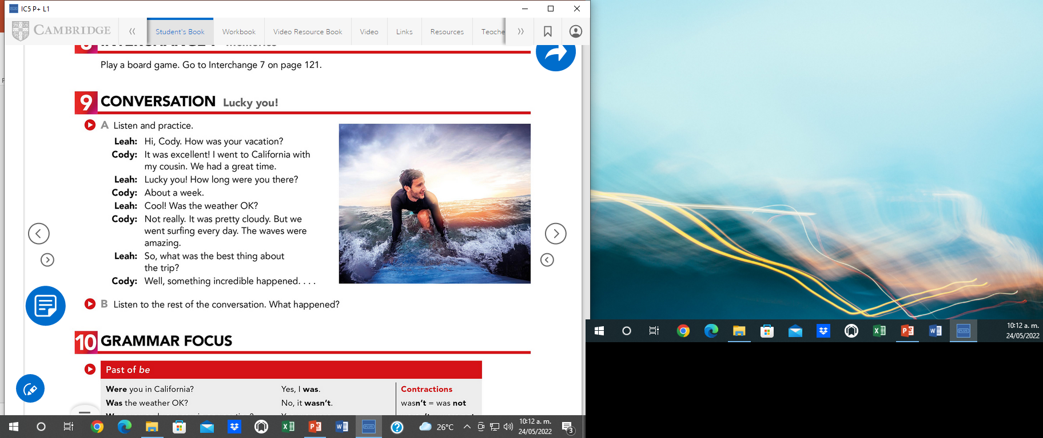

Studentbook pg 47

Slide 10
GRAMMAR FOCUS “SIMPLE PAST WH questions with BE”
Speaking practice: Answer the following questions.
SIMPLE PAST WH BE QUESTION | ANSWER
When was your last english test? What time was the last english test? How long was the test? How was the test? What was your score? | It was on Wednesday It was at 11:00 a.m It was 20 minutes long It was dificult It was excellent
How long was your practice period? Who was your teacher tutor? Where was your practice period? | It was 2 weeks Was teacher Efi It was Ninfa Davila
When was the last Nodal´s concert? Where was the last Nodal´s concert? What time was the concert? How long was the concert? | It was on september It was in saltillo It was at 7:00 p.m It was

Slide 11
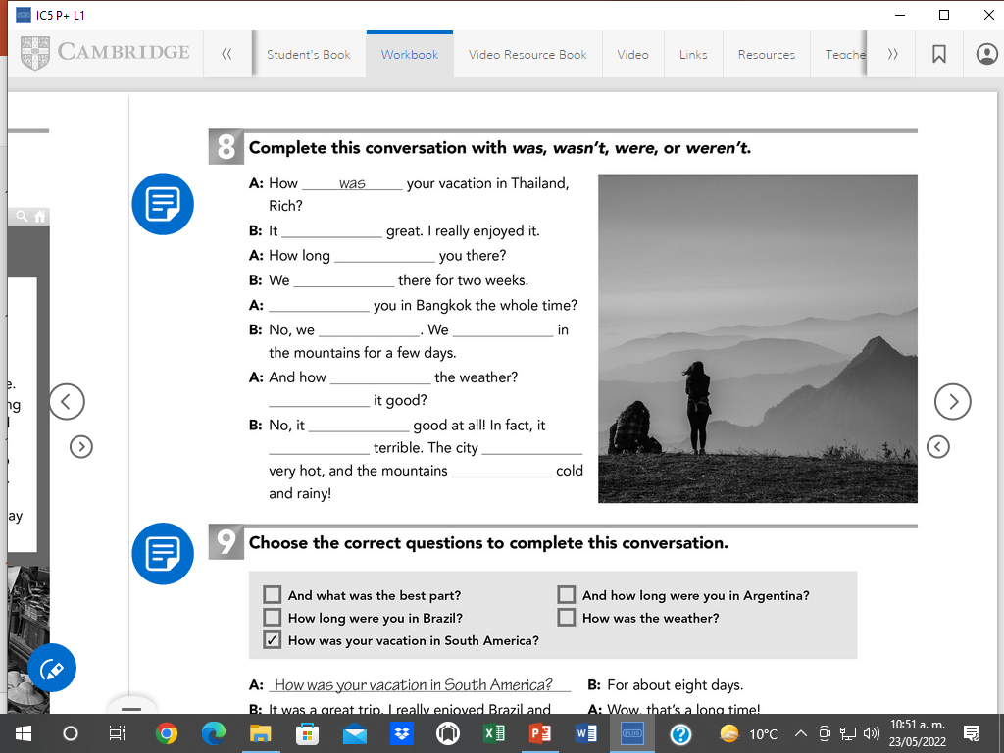
Workbook pg 41 ex 8
was
were
were
were
Weren’t
were
was
was
Wasn’t
was
was
were

Slide 12
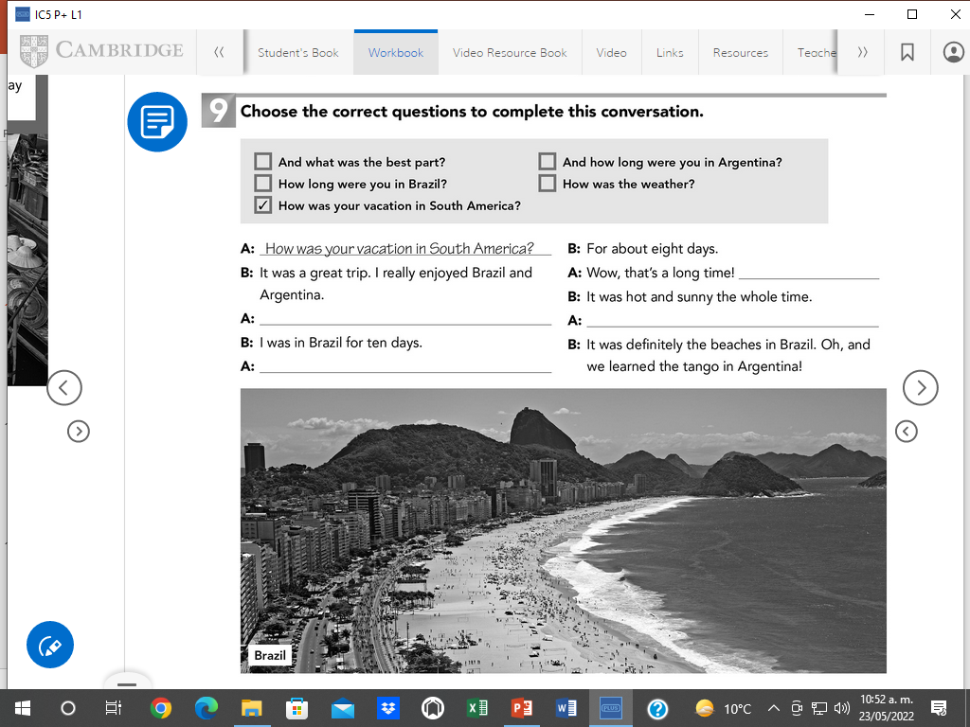
Workbook pg 41 ex 9
How was the weather?
How long were you in Brazil?
What was the best part?
How long were you in Argentina?

Slide 13
GRAMMAR FOCUS “SIMPLE PAST WH questions with BE”
Listening practice: Click on the following link to practice simple past Wh Be questions.
https://es.liveworksheets.com/ve338820hc
Insert here your results

Slide 14
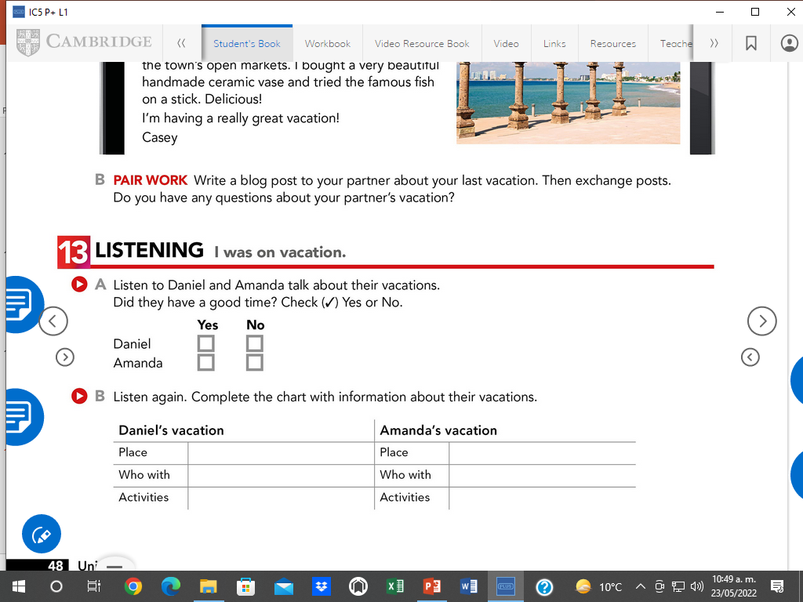
Studentbook pg 48 ex 13

Slide 15
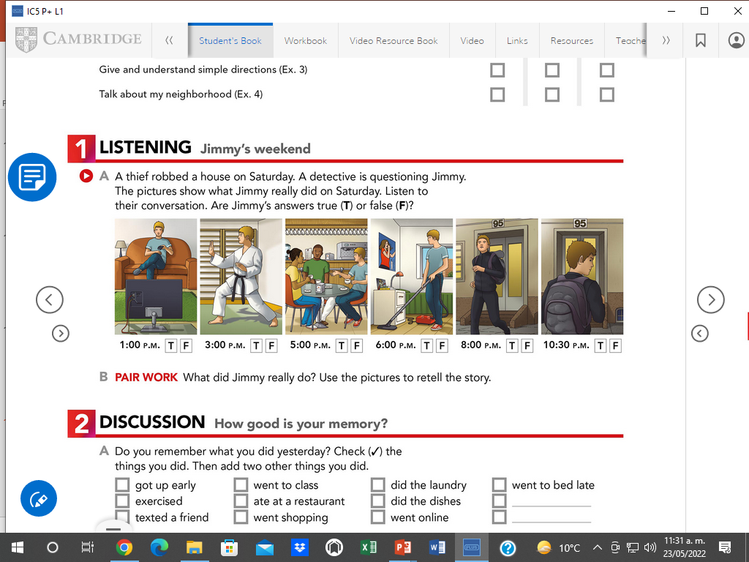
Studentbook pg 56 ex 1

Slide 16
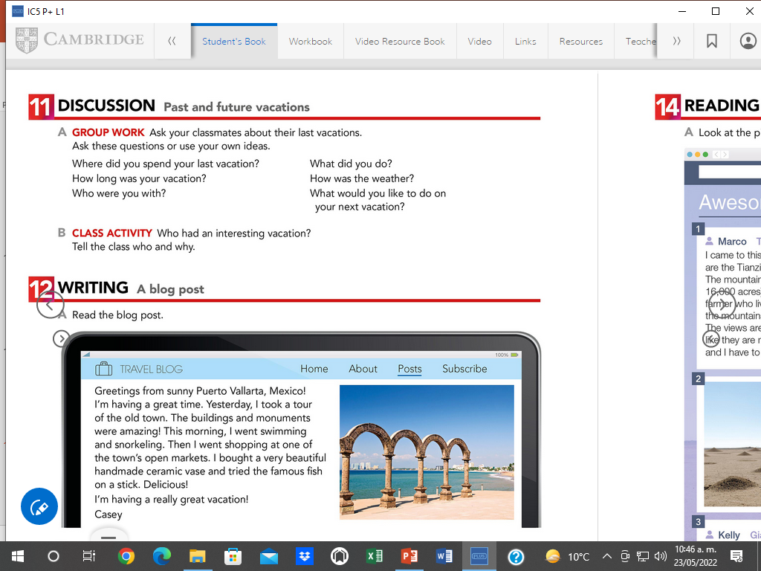
Discussion. My last vacations
Speaking practice. Studentbook pg 48 ex 11

