Slide 1


UNIT 7
Lesson 6
WHERE WERE you yesterday?
LESSON OBJECTIVE:
Ask and answer “WH” BE questions in simple past

Slide 2






GRAMMAR FOCUS “Wh BE Questions”
A WH-question is used for seeking content specific information, related to persons, things, facts, time, place, reason, manner, etc. Wh-questions differ depending on the kind of content information sought.
Wh-questions begin with what, when, where, what time, How, etc..
WH question | USE
 | to ask for information about something
 | to ask for the time
 | to ask what day or date
 | to ask for what place or position
 | to ask about the manner
 | to ask about the a period of time
What
What time
When
Where
How
How long

Slide 3

GRAMMAR FOCUS “Wh BE Questions”
Wh-questions begin with what, when, where, what time, How, etc.
Wh | Be in simple past | Subject/noun | complement
Where | Was | I He She It
 | Were | You We They

Slide 4

GRAMMAR FOCUS “Was/Were Questions”
GRAMMAR FOCUS “SIMPLE PAST Yes /No questions with BE”
Use WHERE to ask for what place or position
WHERE WERE you last night?

Slide 5

GRAMMAR FOCUS “SIMPLE PAST WH questions with BE”
Use WHAT to ask for information about something
What Was Anita´s favorite book in highshool?

Slide 6


GRAMMAR FOCUS “SIMPLE PAST WH questions with BE”
Use WHAT TIME to ask for the time.
What time WERE they at the pool?

Slide 7

GRAMMAR FOCUS “SIMPLE PAST WH questions with BE”
Use WHEN to ask what day or date.
When Was the party?

Slide 8

SIMPLE PAST WH .. QUESTIONS
Use HOW to ask about the manner.
How Was your last birthday?

Slide 9
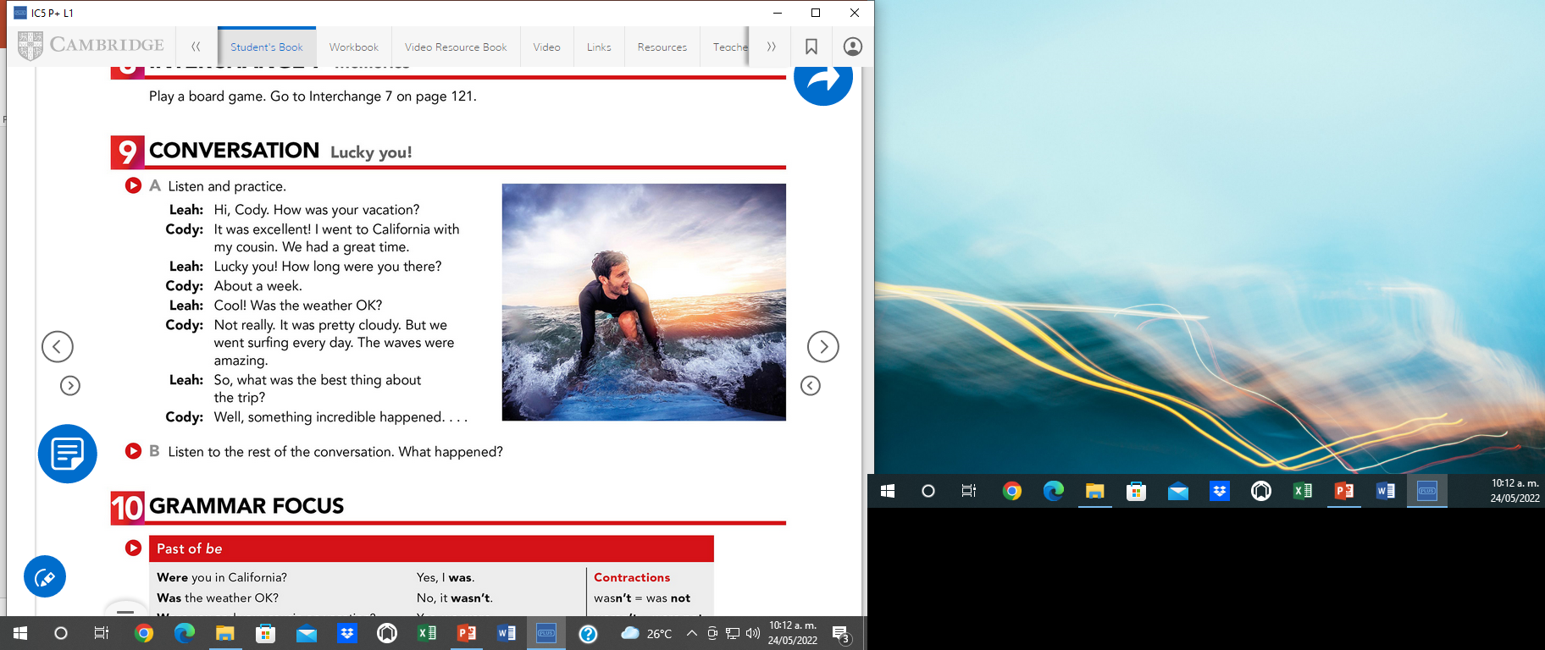

Studentbook pg 47

Slide 10
GRAMMAR FOCUS “SIMPLE PAST WH questions with BE”
Speaking practice: Answer the following questions.
SIMPLE PAST WH BE QUESTION | ANSWER
When was your last english test? What time was the last english test? How long was the test? How was the test? What was your score? | My last english test was last week. The test was during about 30-40 minutes. The test was easy. My score of the test was 89 points.
How long was your practice period? Who was your teacher tutor? Where was your practice period? | My teacher tutor was Juan Mendez. The period of my practice was the last 2 weeks.
When was the last Nodal´s concert? Where was the last Nodal´s concert? What time was the concert? How long was the concert? | Nodal´s last concert was on November. The concert was on Torreon. The concert during about 2 or 3 hours.

Slide 11
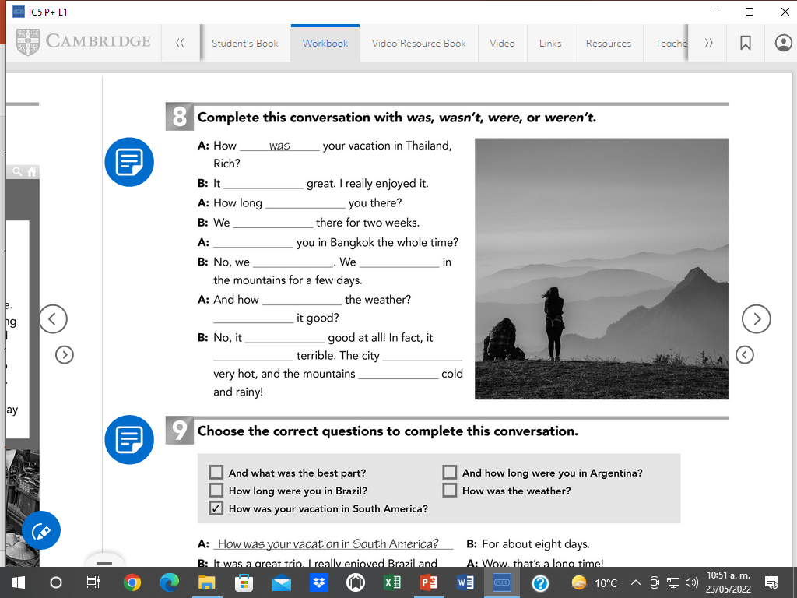
Workbook pg 41 ex 8
was
were
were
were
were
were
was
was
was
was
was
were

Slide 12
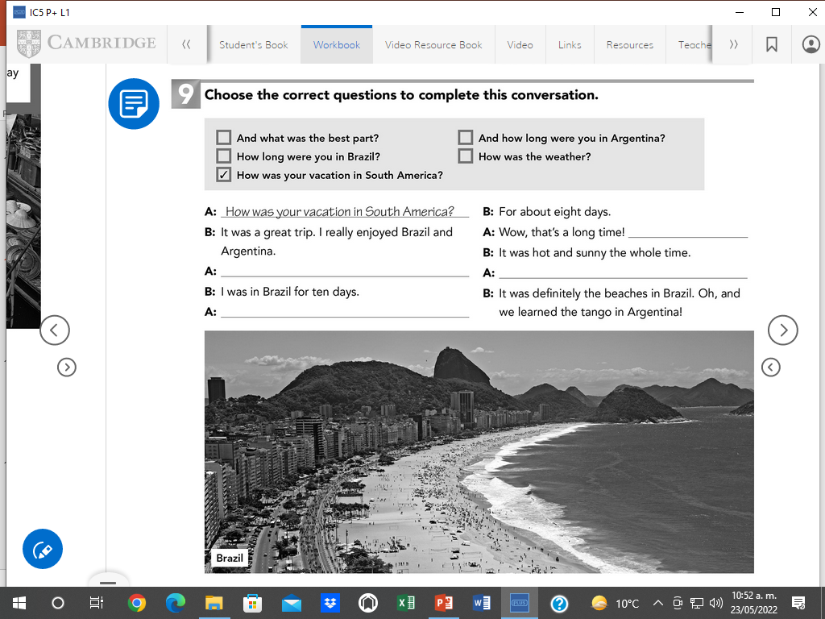
Workbook pg 41 ex 9
How was the weather?
How long were you in Brazil?
And what was the best part?
And how long were you in Argentina?

Slide 13
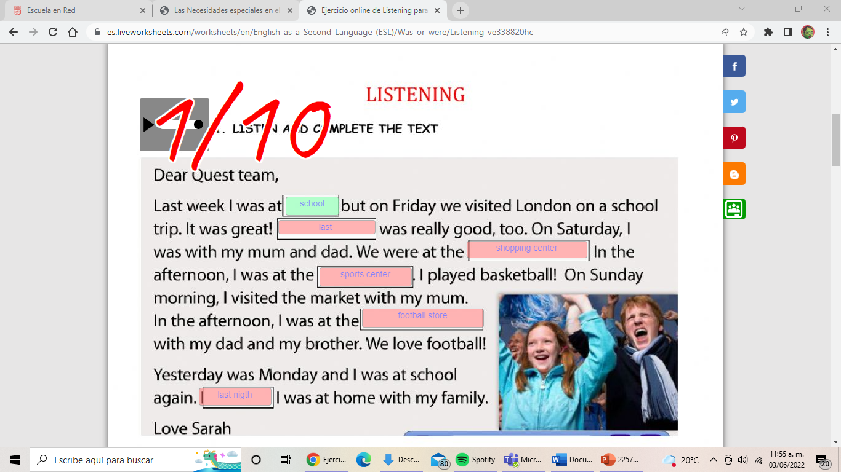
GRAMMAR FOCUS “SIMPLE PAST WH questions with BE”
Listening practice: Click on the following link to practice simple past Wh Be questions.
https://es.liveworksheets.com/ve338820hc
Insert here your results

Slide 14
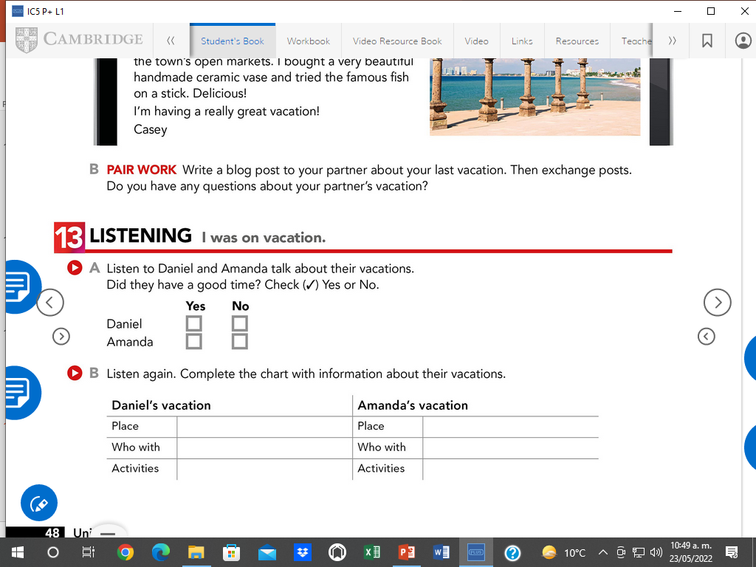
Studentbook pg 48 ex 13

Slide 15
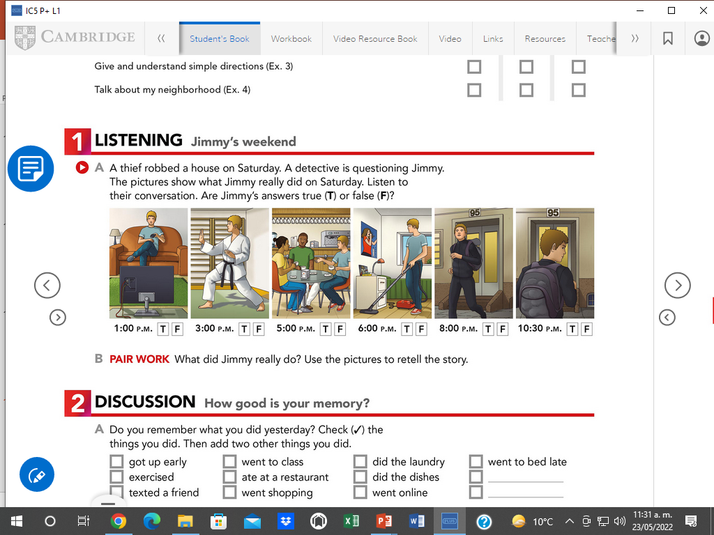
Studentbook pg 56 ex 1

Slide 16
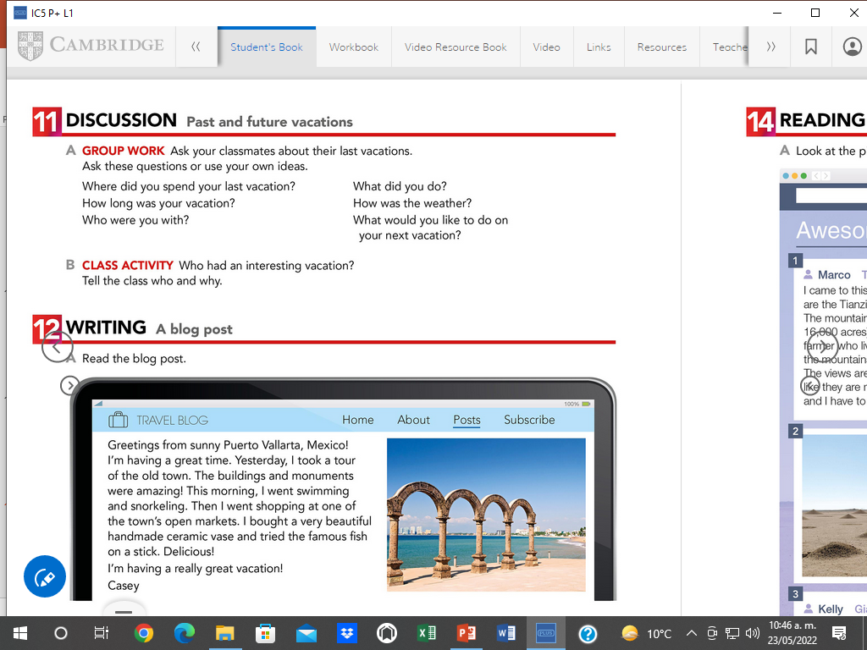
Discussion. My last vacations
Speaking practice. Studentbook pg 48 ex 11

