Slide 1
Unit 1
Where are you from?
REINFORCEMENT
AND ASSESSMENT

Slide 2
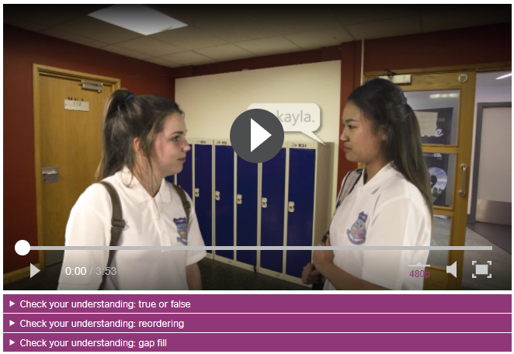
ONLINE SELF-CHECK LISTENING PRACTICE
Visit the following site. Practice your listening skills. Prepare to complete the exercise in the next slide.
https://learnenglishteens.britishcouncil.org/skills/speaking/beginner-a1-speaking/meeting-people
Find these exercises and complete them.

Slide 3

LISTENING EXERCISE
HOW ARE YOU? (It’s a busy Friday night. People are meeting at different places)
Listen to the conversations. Where are the people meeting? Number the pictures from 1 to 3.
B)

Slide 4
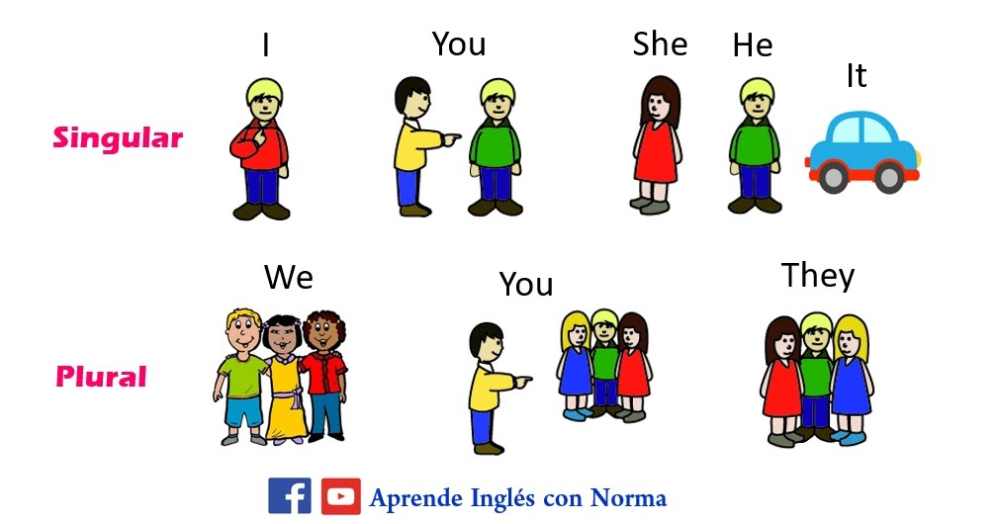
GRAMMAR EXPLANATION
In the grammatical sense, a personal pronoun refers to A particular person. Personal pronouns are not limited to people and can also refer to animals, places or objects.
Pronouns
Singular | I
 | You
 | He
 | She
 | It
Plural | We
 | You
 | They
A personal pronoun is a Word that takes place of a noun or nouns. It indicates the gender of the person and can be either singular or plural.
Mary is a student.
Jhon is my brother.
Alex and I are friends.
She is a student.
He is my brother.
We are friends.

Slide 5
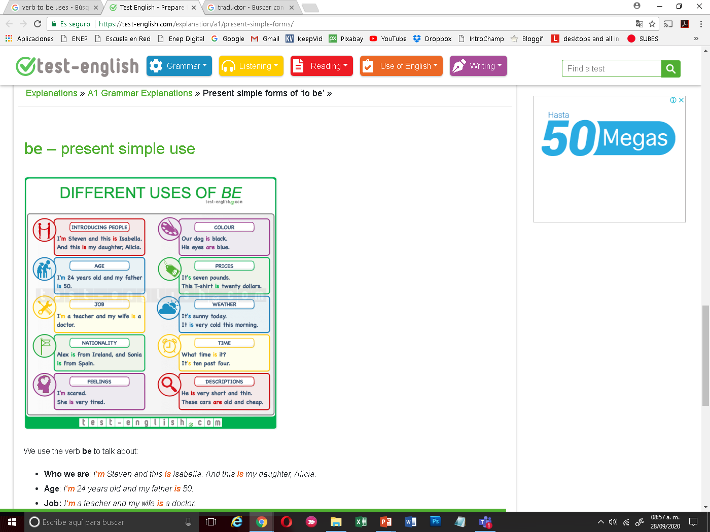
GRAMMAR EXPLANATION
Personal pronouns or subjects are followed by the verb “to be” to form statements for many different uses.
 | Pronoun | Verb be
Singular | I | Am
 | You | Are
 | He | Is
 | She | Is
 | It | Is
Plural | We | Are
 | You | Are
 | They | Are

Slide 6
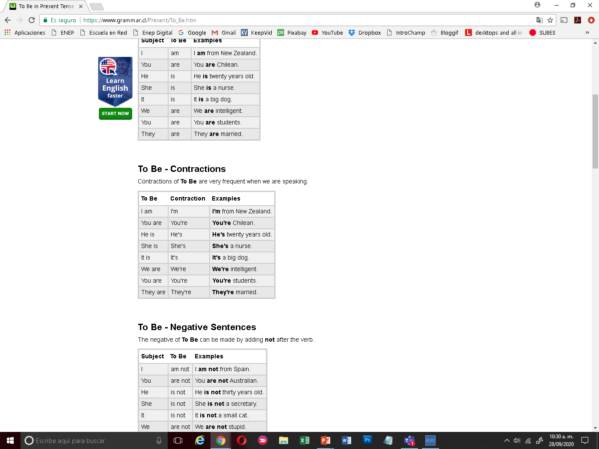
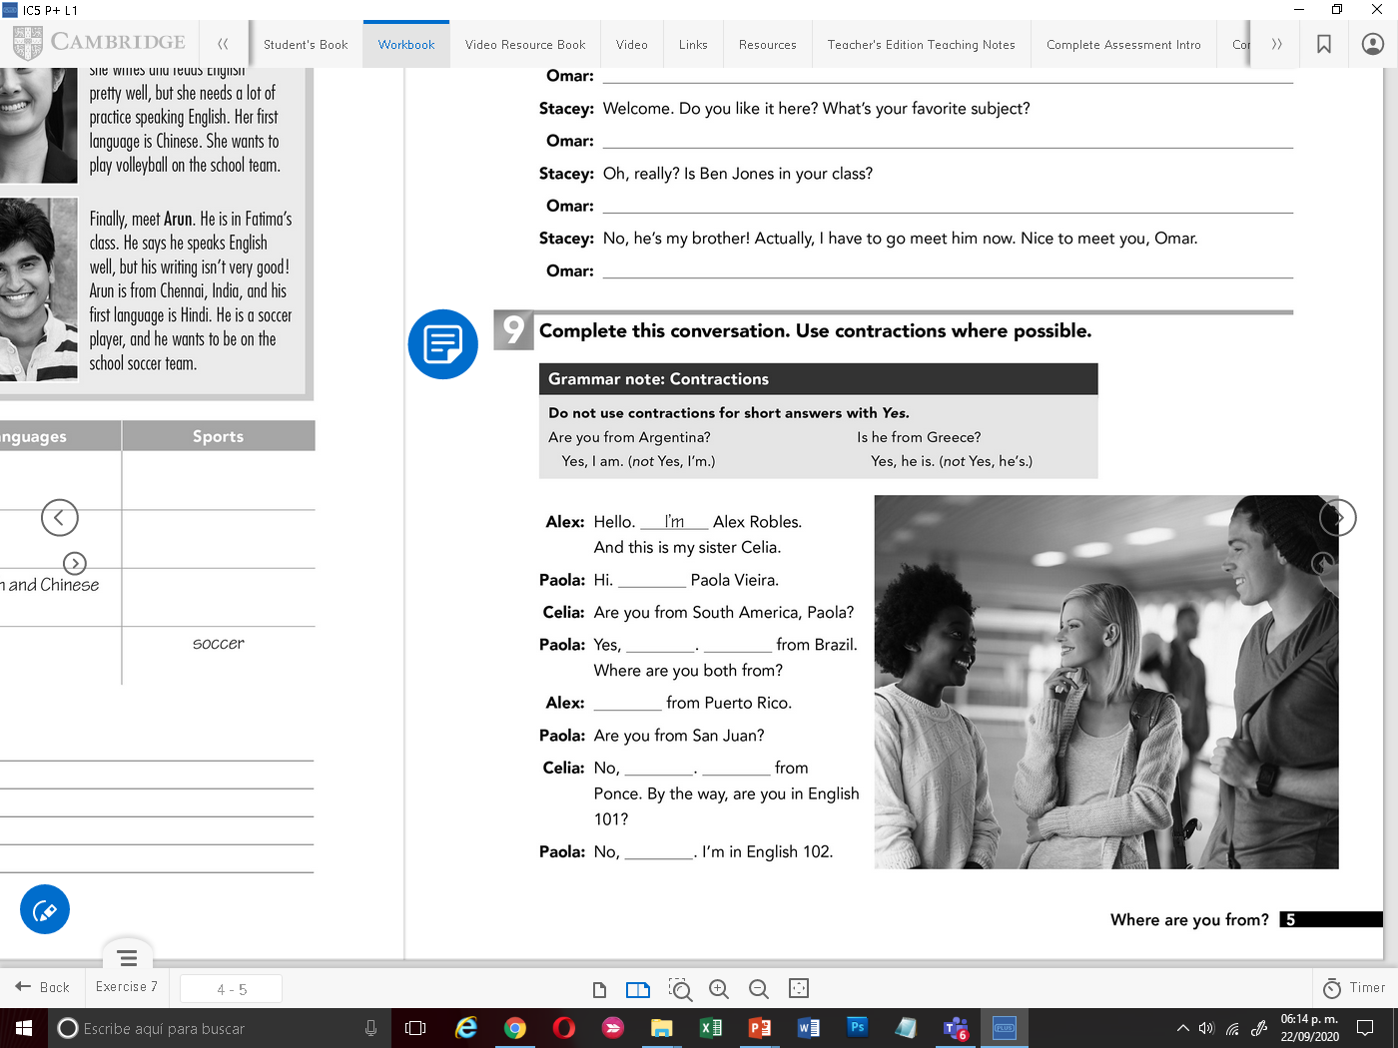
GRAMMAR EXPLANATION
Grammar contractions
A contraction is one Word made from 2 words. The first Word usually stays the same. Certain letters are taken out from the second Word. An appostrophe ( ´ ) will fill the space of the missing letters.
She is a student.
We are friends.
She´s a student.
We´re friends.
Note:

Slide 7
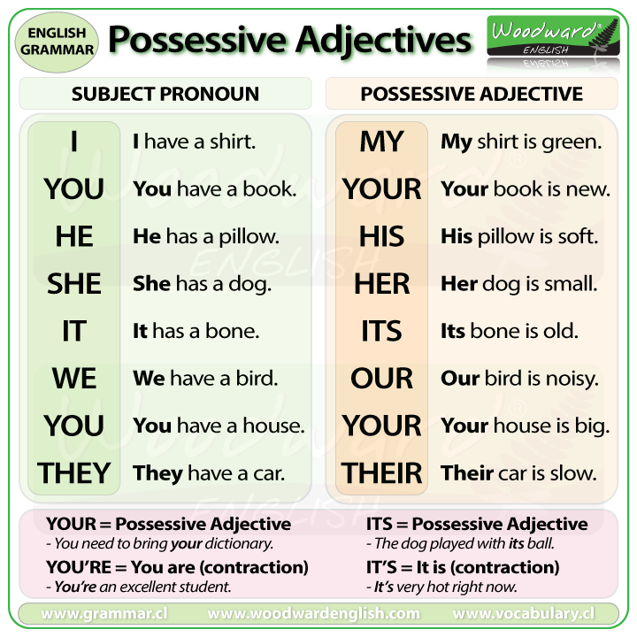
GRAMMAR EXPLANATION
His, Her, He, She
For more, click on the link and watch the video:
https://www.youtube.com/watch?v=4OvGoohdmv0
Or even more:
https://www.youtube.com/watch?v=akiVplj7jjE&feature=emb_logo

Slide 8
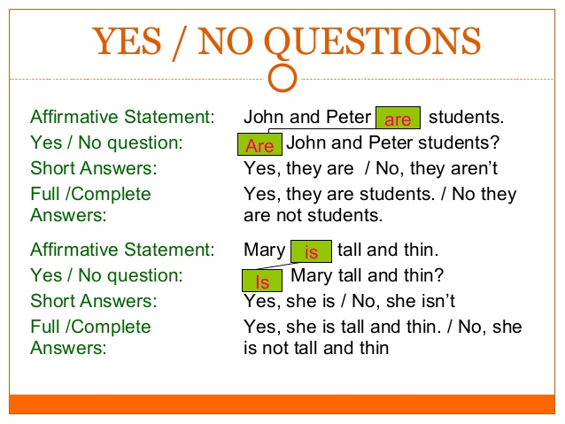

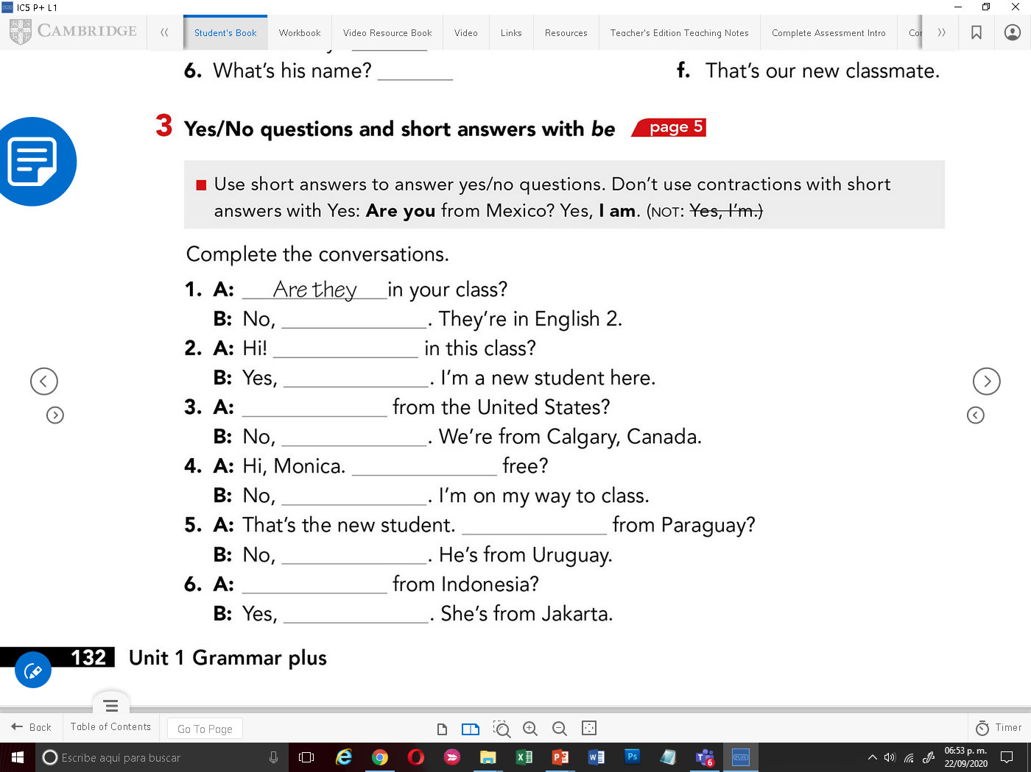
GRAMMAR EXPLANATION
In English, there are two main types of questions in this lesson we are going to study the first type which is:
Yes / No Questions
Yes / No questions are the questions which are expected to be answered with yes or no.
To form Yes/No questions, we use auxiliary verbs as “Be”
The verb “ To Be ” has three forms in the present; am, is and are.
The structure of the question starts with “Be”(am,is,are ) + Subject +complement

Slide 9
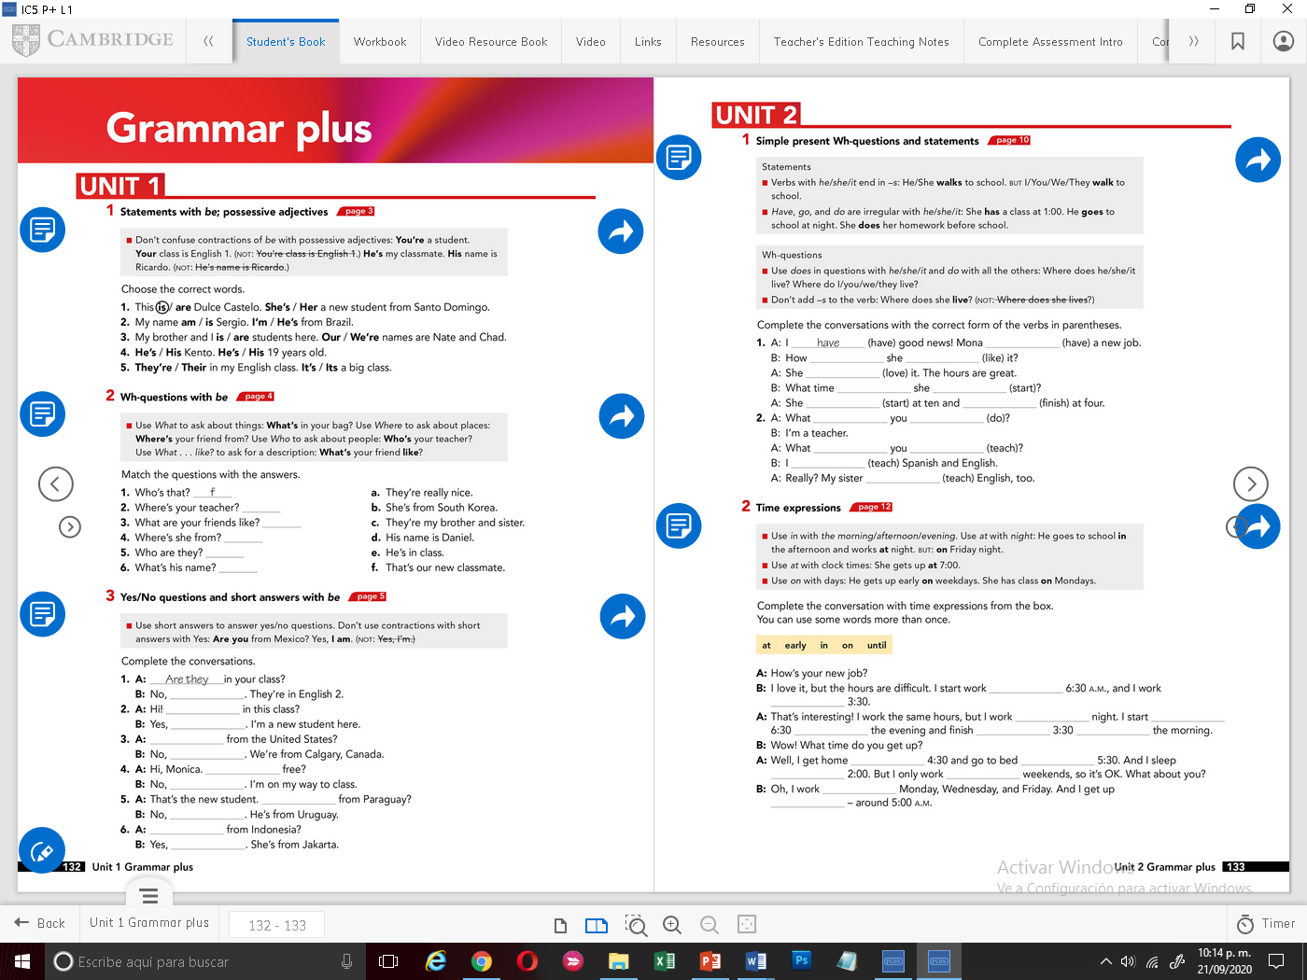
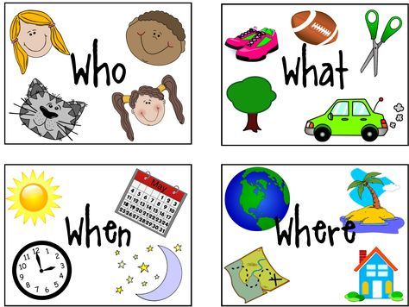
GRAMMAR EXPLANATION
In English, there are two main types of questions in this lesson we are going to study the second type which is:
WH Questions
Refers to a person
Refers to a thing
Or an action
Refers to time
Refers to a place
Many times we need to know specific information about people, places, activities or dates. We have words that help us ask to get that information.
They are called “WH-questions”
“WH-questions”are helpful to ask for specific information, they are used in interrogative sentences known as “Open Questions”
Wh question structure
Wh question | Verb to be | Subject +Complement
Who | Is | your friend?
Where | are | my shoes?
What | is | this ?
When | is | your birhtday?

Slide 10
ONLINE SELF-CHECK PRACTICE
Visit the following sites. Practice your grammar skills. Prepare to complete the exercises in the next slides.
Verb to BE - exercise
https://www.english-4u.de/en/tenses-exercises/verb-to-be.htm
The verb be (am, are, is) in a text
https://www.englisch-hilfen.de/en/exercises/tenses/be3.htm
Negative forms of the verb to be – exercise
http://www.eclecticenglish.com/grammar/PresentSimpleToBe1B.html
GAME
https://www.eslgamesplus.com/verb-to-be-auxiliary-verb-am-is-are-esl-grammar-activity/
Possessive adjectives
https://www.ego4u.com/en/cram-up/grammar/pronouns/exercises?03
WH Question Words – quick exercise
https://www.grammarbank.com/wh-questions.html
Present Simple 'Be' Yes / No Questions
https://www.perfect-english-grammar.com/present-simple-exercise-12.html
Short answers with am, are, is
https://www.englisch-hilfen.de/en/exercises/questions/short_answers_be.htm

Slide 11
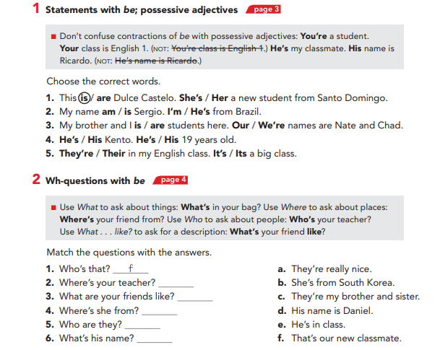
GRAMMAR EXERCISES

Slide 12
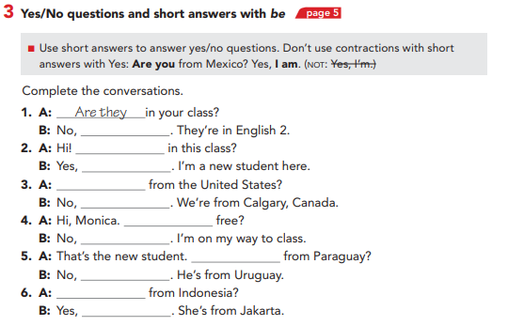
GRAMMAR EXERCISES

Slide 13
GRAMMAR EXERCISES

Slide 14
PRONUNCIATION AND SPEAKING EXERCISE
Listen to the audio. Record yourself saying the sentences aloud and responding.
SENTENCES
RESPONSES
EXAMPLE
1
2
3
4
5
6
SENTENCES
RESPONSES

Slide 15
PRONUNCIATION AND SPEAKING EXERCISE
SENTENCES
RESPONSES
7
8
9
10
11
12
13

