Slide 1
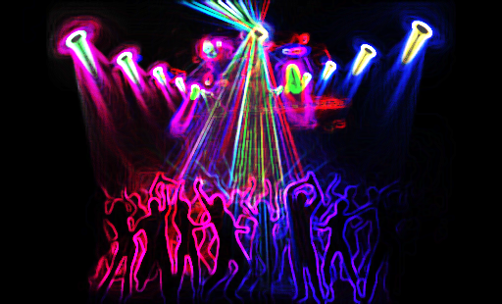
Unit 7
Cycle 1
We went dancing!
Aims:
Describe past daily and free-time activities
Describe past vacations

Slide 2
Objetivo de cada una de las presentaciones de PowerPoint.
Flipped classroom
Que el alumno…
Participe de forma activa, adquiriendo un protagonismo que propicia tu autonomía.
Reciba tratamiento individual para trabajar mejor los conceptos.
Acceda al conocimiento con mayor profundidad.
Trabaje cada ejercicio a su propia velocidad.
Desarrolle nuevas competencias, destrezas y habilidades
Se busca…
Promover el trabajo colaborativo. Posibilitar mayor interacción durante las sesiones en vivo.
Permitir al docente atender a las necesidades reales de los estudiantes de una forma más personalizada
Un entorno flexible, cultura de aprendizaje, contenidos directos y al docente como guía, mediador, facilitador, etc.
Referencia:
https://www.universia.net/mx/actualidad/orientacion-academica/docentes-que-consiste-clase-invertida-1127850.html

Slide 3
Objective questions
How did you spend yesterday? Where did you go? Did you have a good time?
Did you do anything special last weekend? What did you do? Was the weather OK?
Did you go anywhere on Friday night? Did you meet any friends? When did you go to bed?
Did you work on Saturday/Sunday? What time did you get up?
What was the best thing about your weekend? What would you like to do next weekend?
Did you see a movie last week? What did you see? How did you like it?
Did you [activity] last month? Were your friends with you? Who were you with?
Where did you spend your last vacation? How long were you there? Who were you with? What did you do there? How was the weather? How was the food?
Ask me about my last vacation. or Ask [classmate] about his/her weekend or last vacation.

Slide 4
Listen to these and have fun!
Britney Spears - Oops!...I Did It Again (Official Video)
https://www.youtube.com/watch?v=CduA0TULnow
Adele - Someone Like You (Lyrics & Sub Español) Official Video
https://www.youtube.com/watch?v=I6P4FNE2n4s
P!nk - Who Knew (Official Music Video)
https://www.youtube.com/watch?v=NJWIbIe0N90
Because You Loved Me-Celine Dion live (with Lyrics - SD Version) Theme from "Up Close & Personal"
https://www.youtube.com/watch?v=hjIEcwwod_Q
Ross and Rachel funniest scenes – FRIENDS Season 9
Minute :00 – 1:11
https://www.youtube.com/watch?v=9qNBpBkHbnk

Slide 5
1 SNAPSHOT
Learning objective: discuss free-time activities
A Check (√) the activities you do in your free time.
B List three other activities you do in your free time.
A=
C What are your favorite free-time activities?
A=
D Are there activities you don’t like? Which ones?
A=

Slide 6
2 CONVERSATION What did you do last weekend?
Learning objective: use the simple past in a conversation about past events
A Listen and practice with a partner.
B Listen to the rest of the conversation. What does Cara do on Sunday afternoons?
A=

Slide 7
A What time expressions can you find in the conversation?
A=

Slide 8
3 GRAMMAR FOCUS
Learning objective: ask and answer simple past questions; use simple past regular and irregular verbs
A Look at the Conversation once more. Find three questions with did.
A=
A=
A=
B Read, listen to and analyze the Grammar Focus box.
C Watch and review the lesson.
Past Simple Tense | Structuring Sentences
https://www.youtube.com/watch?v=mwh_IWwwN8Y
1. What is the rule for forming yes/no questions in the simple past?
A=
2. What is the rule for forming Wh-questions in the simple past?
A=
Did + subject + verb (base form)?
Wh-question + did + subject + verb (base form)?

Slide 9
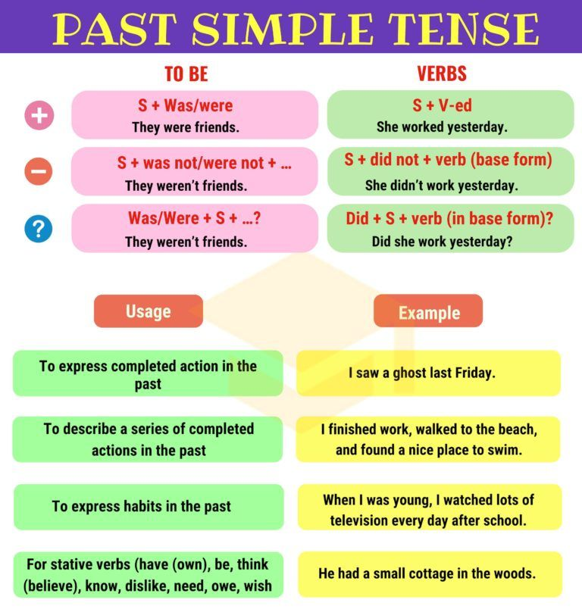
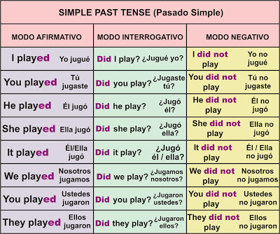
Analyze and study

Slide 10
Live session activity
Give some simple past question examples
Did + subject + verb (base form)?
Wh-question + did + subject + verb (base form)?
Write your examples in the following google drive file:
https://docs.google.com/document/d/1xHWXAuLaHULBaMoBtY2K_zQ7O-J_MSCi1dECOH9oAcg/edit?usp=sharing

Slide 11
Live session activity
REGULAR AND IRREGULAR VERBS
REGULAR VERBS
work – worked
invite – invited
A= stayed
A= studied
IRREGULAR VERBS
do – did
drive – drove
A= go - went
A= swim- swam
forget - forgot
Look at the conversation again.
1. What are the simple past forms of the verbs stay and study?
2. What are the simple past forms of the verbs go and forget?

Slide 12
Live session activity
PRACTICE. Memorizing
Look for patterns. (e.g., i a: sit sat, swim swam, drink drank).
Open the appendix on the language summary.
bring – brought
Buy – bought
Teach – taught
Think - thought
cut – cut
Put – put
Set-set-set
drive - drove
Have –had -had

Slide 13
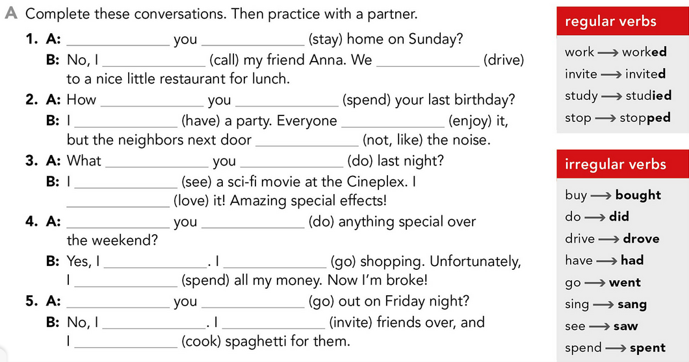
Live session activity
Did
stay
Didn’t call
drove
did
spend
had
enjoyed
did not like/ didn’t like
did
do
saw
loved
Did
do
did
went
spent
Did
go
didn’t
invited
cooked

Slide 14
4 PRONUNCIATION Reduction of did you
Learning objective: use the reduction of did you to sound more natural when asking past-tense questions

Slide 15
6 Learning objective: Discuss past activities and ask follow-up questions
Live session activity
B PRACTICE. Take turns asking the questions in part A. Pay attention to the pronunciation of did you.
Give your own information when answering.
Join your sharing group and socialize. Take 20 min. Take notes. Then comeback to the general group and share. Tell the class about your partner’s past activities.
Reporting: Some classmates …
Did you stay home on Sunday?
How did you spend your last birthday?
What did you do last night?
Did you do anything special over the weekend?
Did you go out on Friday night? Where did you go? Who did you go with? What time did you go?

Slide 16
5 WORD POWER Chores and activities
Learning objective: discuss daily chores and activities using do, go, have, make, and take;
A Find two other words or phrases from the list that usually go with each verb. Change the verb to the past form like the example phrases. Then add one more word or phrase to each verb. Search for the verb COLLOCATIONS to find the phrases. Type for example: “Collocations with do”
did my homework
went online
had a party
made a phone call
took a day off

Slide 17
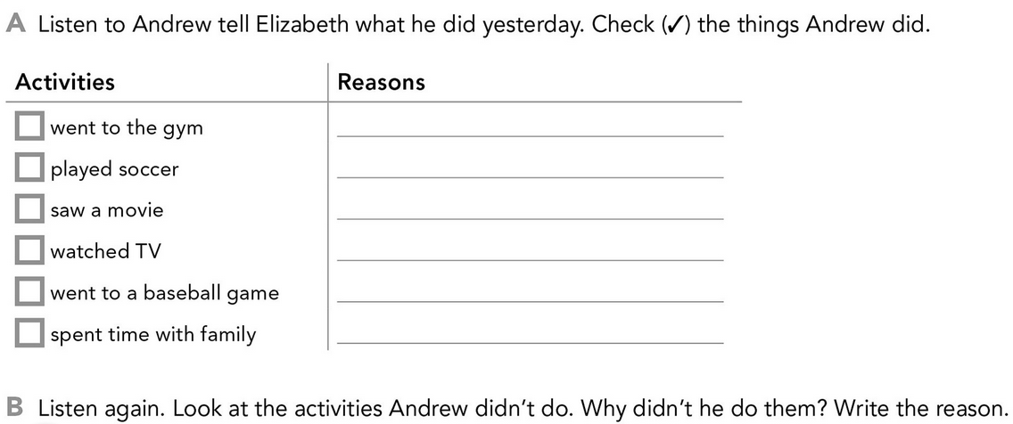
7 LISTENING Did you have a good holiday?
Learning objective: listen for details about past activities
A=

Slide 18
GRAMMAR PLUS
Live session activity

