Slide 1
TKT PROGRAM ODD SEMESTER 21-22

Slide 2
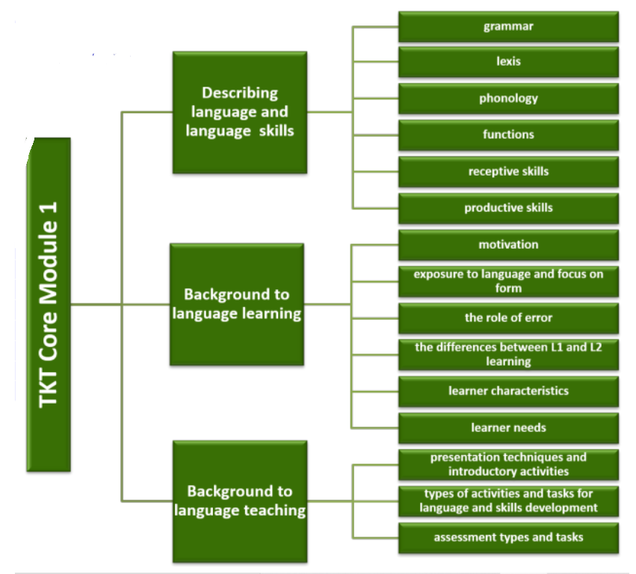
LEARNING UNIT 1
LEARNING UNIT 2
LEARNING UNIT 3

Slide 3
GRADING CRITERIA FOR EACH LEARNING UNIT
PRODUCTS | SCORE
Evidence of all your TKT tasks in your portfolio | 80%
TKT Practice test | 20%
NOTE: the evidence of your scores in the practice test will be shared in your portfolio as well. Remember that the scores are not evaluated since they are just practice. What Will be evaluated is completion of the tasks.

Slide 4
GLOBAL EVALUATION
100 %

