Slide 1
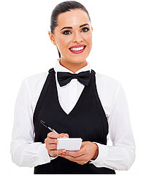
UNIT 3
Lesson 4
What would you like to order?
LESSON OBJECTIVE:
Use would and will to order food at a restaurant.

Slide 2
GRAMMAR FOCUS “Would and Will for requests”
GRAMMAR FOCUS “Would and Will for requests”
Studentbook pg 19
Studentbook pg 19
We use modals would and will for requests:

Slide 3
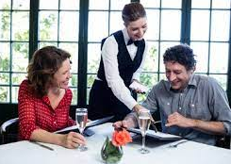
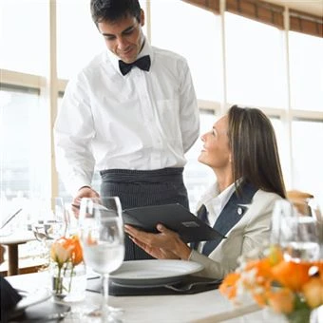
GRAMMAR FOCUS “Would and Will for requests”
GRAMMAR FOCUS “Would and Will for requests”
Studentbook pg 19
Studentbook pg 19
Modal would is used to :
offer something to someone in a more polite manner.
Would you like some soup?
What kind of soup would you like?
Would you like to order?
What would you like to drink?
say that we want something in a more polite manner.
I´d like a veggie Burger
I´d like the onion soup.
I´d like to drink tea

Slide 4
Grammar Practice
Complete this conversation with would like or would like to
1.- I´m thisty. I_________ a glass of wáter, please.
2.- _______ you ___________ drink something?
3.- ______ you _________ chocolate or vanilla ice-cream?
4.- What pizza combo ________ you ___________ order?
5.-______ you ________ a Cesar or a Green salad?
6.-What _______ you ___________ drink?
7.-I ______________ a veggie burger.
8.-I _____________ eat a slice of chocolate cake.

Slide 5
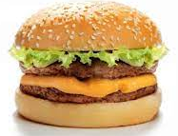
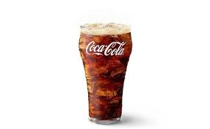
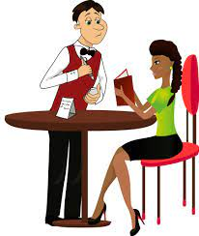
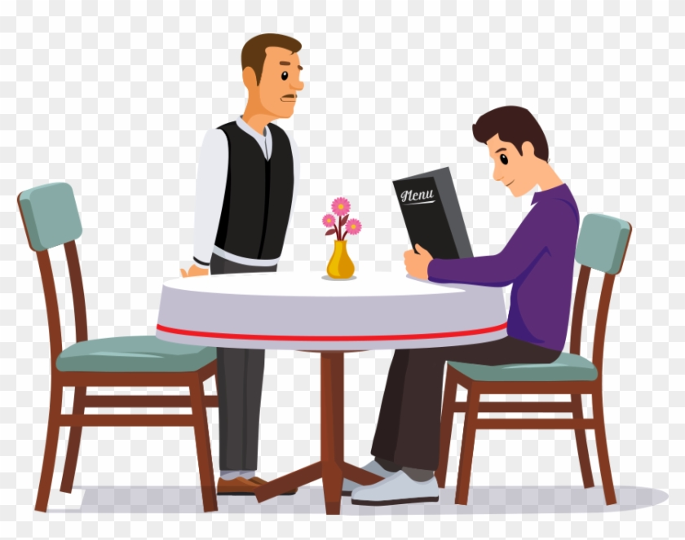
GRAMMAR FOCUS “Would and Will for requests”
GRAMMAR FOCUS “Would and Will for requests”
Studentbook pg 19
Studentbook pg 19
Modal will have is used to :
express our decision about something, is to say what we want in a less polite manner.
I´ll have a veggie Burger.
I´ll have the onion soup.
I´ll have a coffee.
Grammar Practice
Complete the conversations with I will have / I´ll have
What would you like to order?
What would you like to drink?
_______________
_____________

Slide 6
Listening Practice “May I take your order”
Studentbook pg 18 ex 6
A. Listen and practice, circle the modals in this ocnversation.
B. Listen to the server talk to the next customer.
What does she order?

Slide 7
Grammar Practice
Complete this conversation with Would (´d) or Will. (´ll)
1.- A:What______________ order?
B:I______ have the fried chiken.
A:________________ rice or potatoes?
B:I________ like potatoes.
A:What kind of potatoes ________________?
B: I _______ like the mashed potatoes.
A:___________ a beverage?
B: Yes, please. I________ have a lemonade.

Slide 8
Grammar Practice
Studentbook pg 19 ex 7
Complete this conversation with Would or Will.

Slide 9
Grammar Practice
Workbook pg 16 ex 5
Use one or more words to complete this conversation between a server and a customer.

Slide 10
Grammar Practice
Studenbook pg 84 ex2
Complete this conversation with Would, I´d or I´ll.

Slide 11
Grammar Practice
Workbook pg 17 ex 6
Choose the correct responses

Slide 12
Listening Practice “Working late”
Studenbook pg 20 ex 9
A. Steven and Sarah are working late. Listen as their boss asks what they would like to dinner. What do they order? Fill in the blanks.
B. Listen to their conversation after the food arrives.
Write the two ítems that are missing from the order
Steven | Sarah

Slide 13
Listening Practice “In a restaurant”
Studenbook pg 28 Ex 2
A. Listen to six requests in a restaurant. Check the best response.

Slide 14
Grammar Practice “In a restaurant”
Studenbook pg 28 Ex 2
Click on the following link to practice Would like and Will have.
https://es.liveworksheets.com/worksheets/en/English_language/Modal_verbs/Would_and_will_for_requests._ir1305484xy

