Slide 1

UNIT 3
WRAP UP
Video avtivity
LESSON OBJECTIVE:
Review and practice the content of unit 4

Slide 2
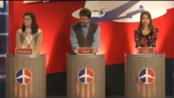
Video Practice “Around the world”
Watch the following video. Then practice with the given activities
https://www.youtube.com/watch?v=_d4jxoCUCsY

Slide 3
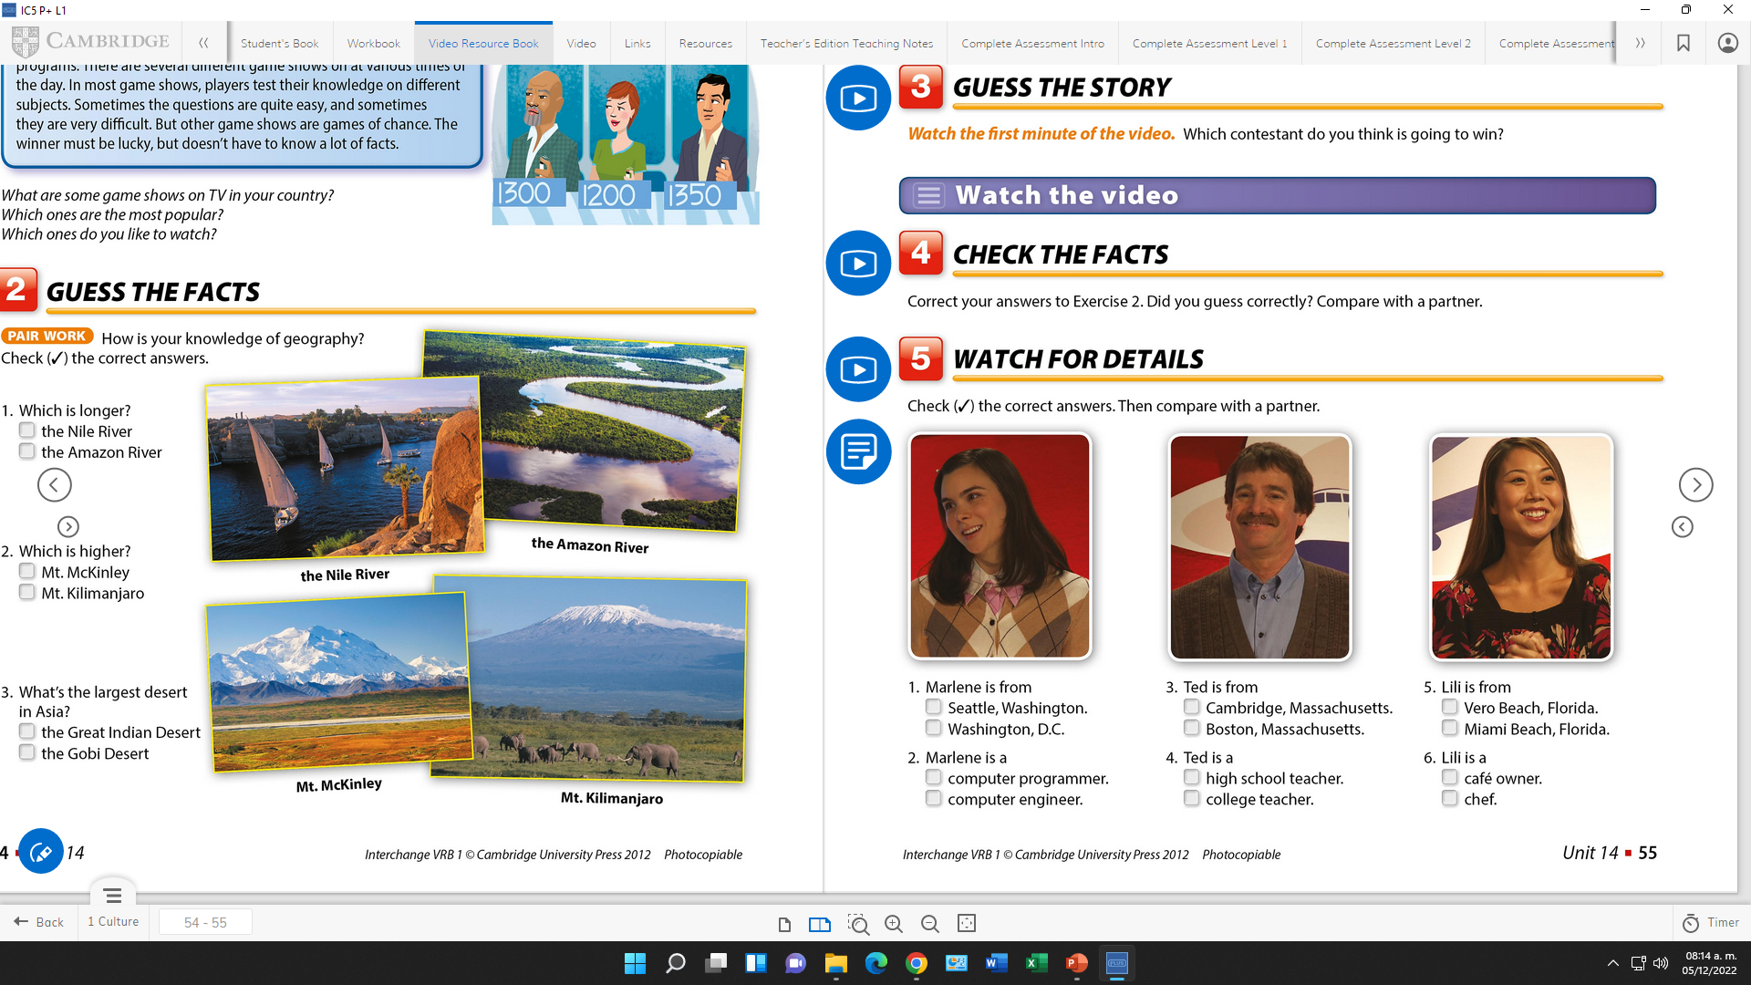
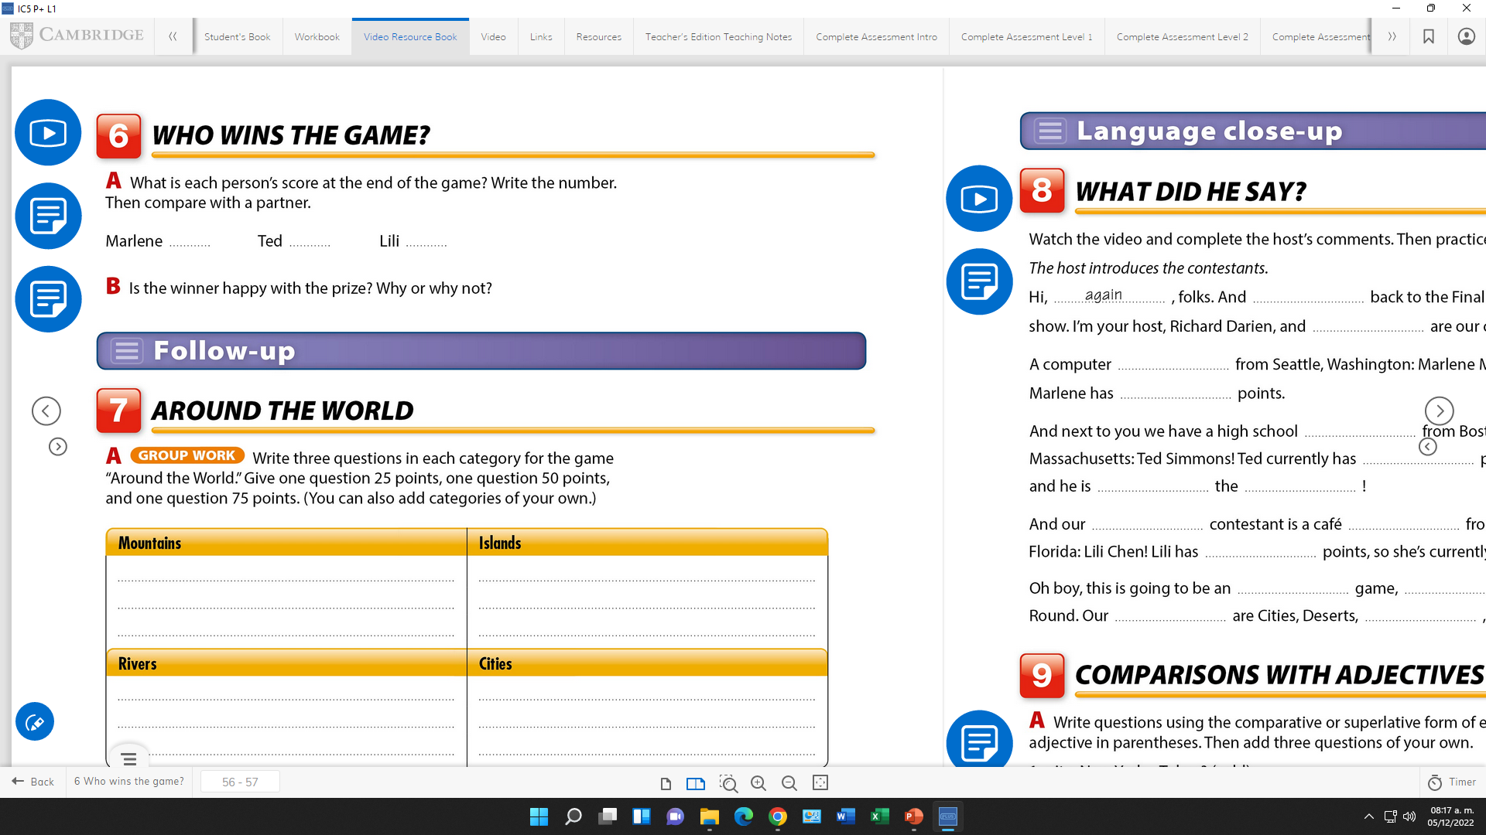
Video Practice “Around the world”
Watch the video and check the correct answers.

Slide 4
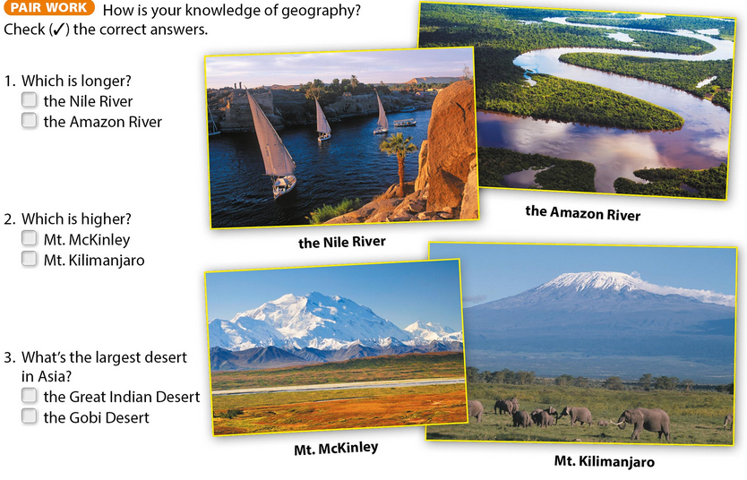
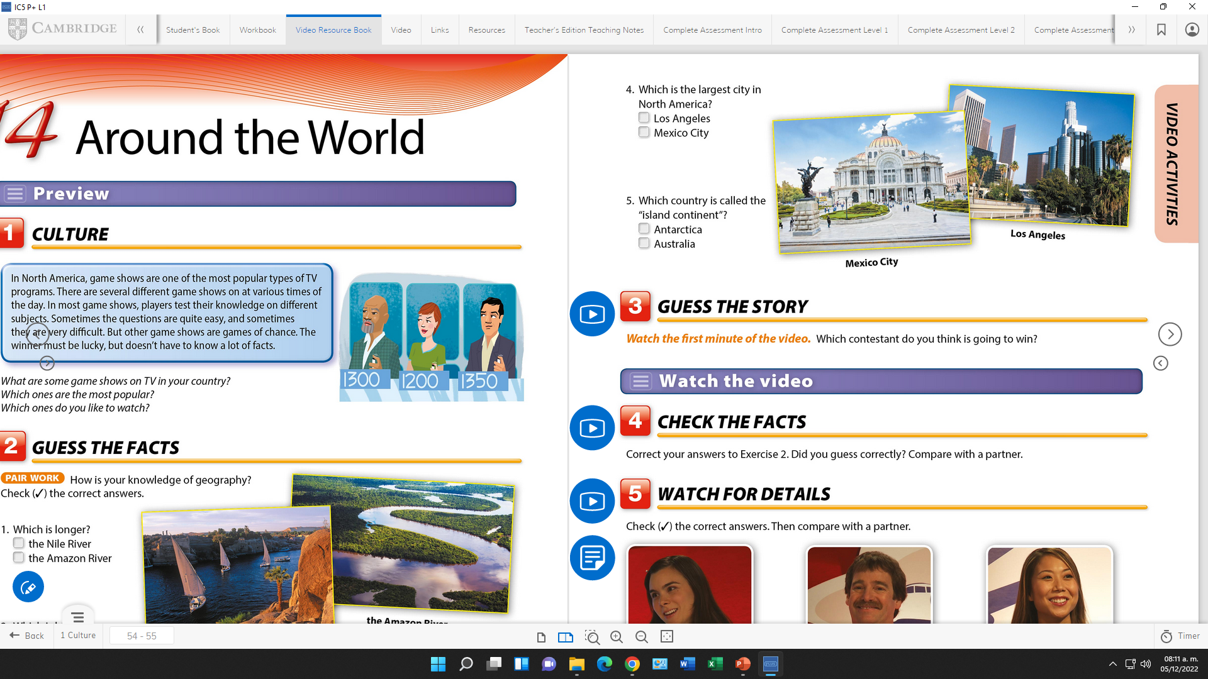
Vocabulary Practice “ An article about a place”
Check the correct answers.

Slide 5
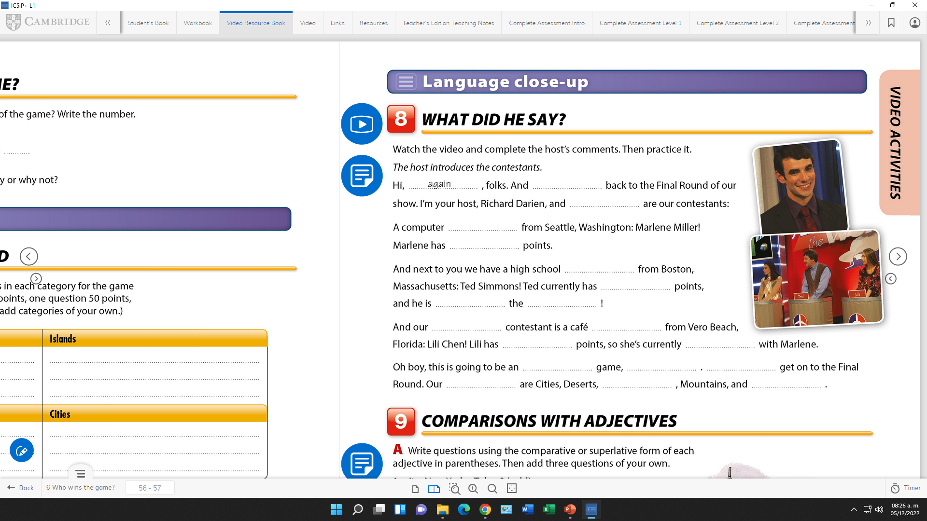
Speaking Practice “ An article about a place”
Watch the video and complete the host´s comments. Then practice it.

Slide 6
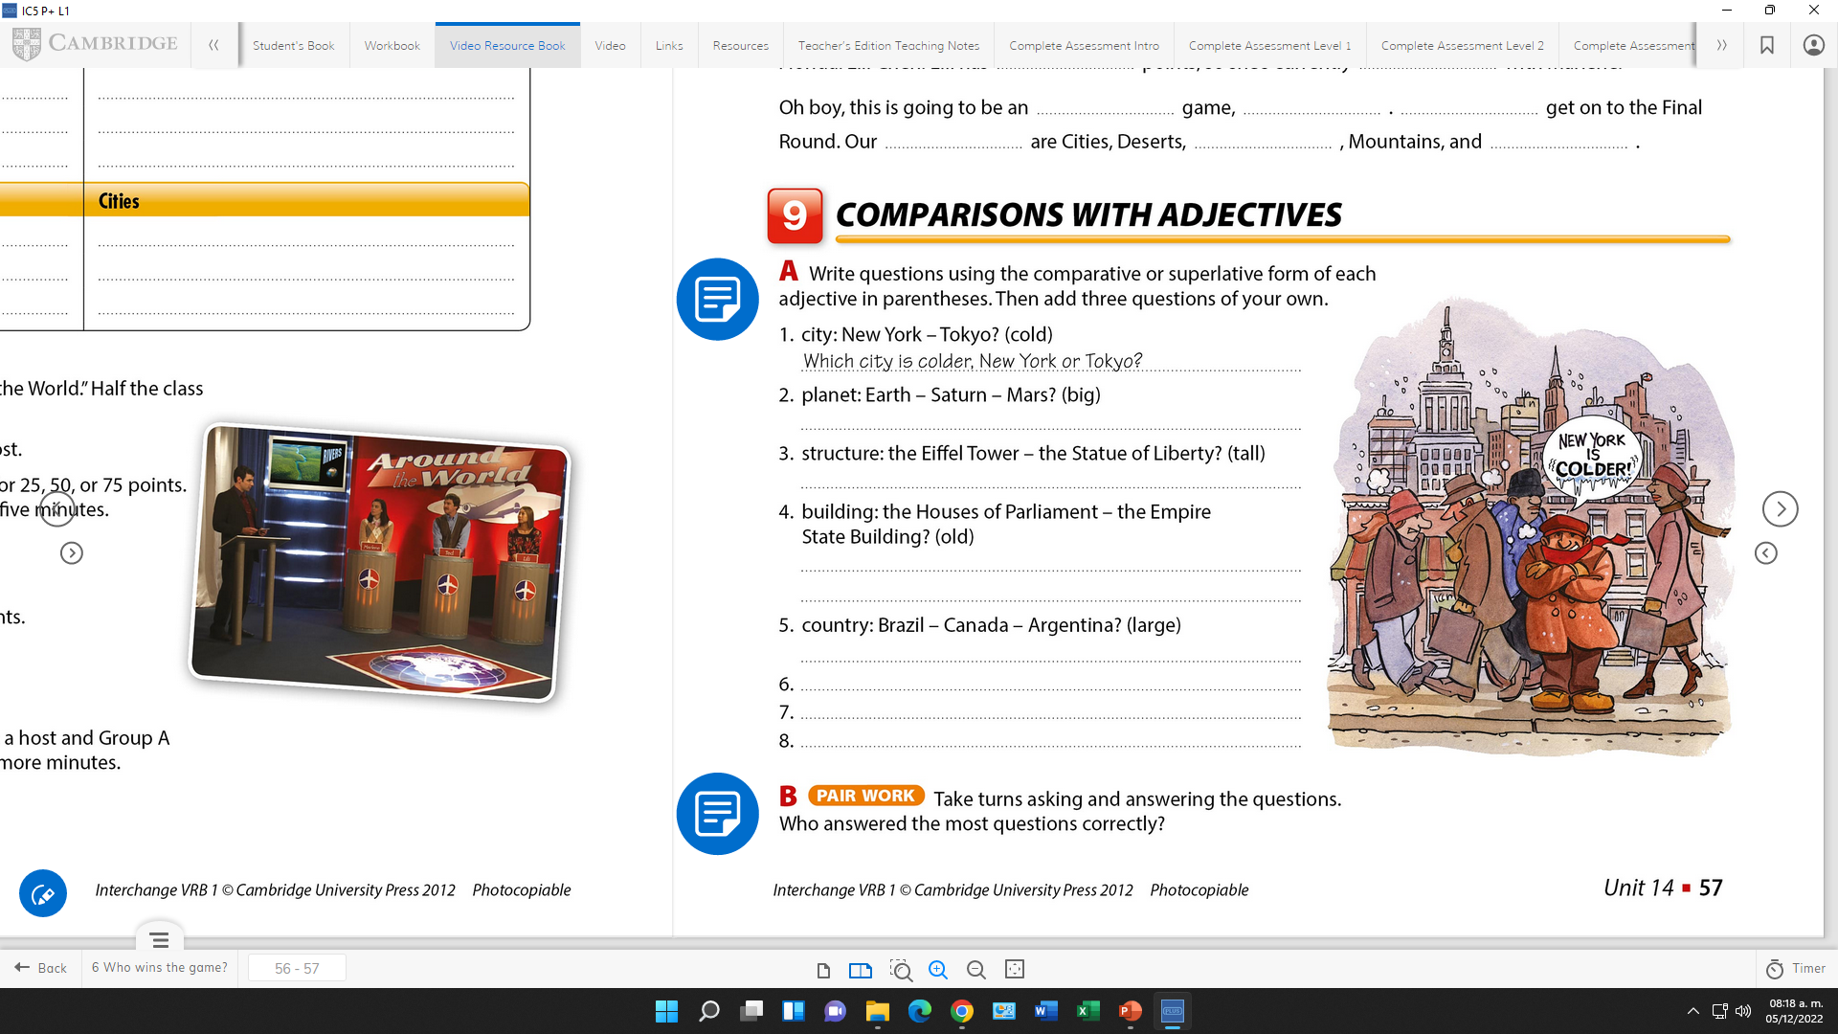
Grammar Practice “ Comparatives,supérlatives”

