Slide 1
Weather and seasons

Slide 2
Seasons

Slide 3
Weather

Slide 4
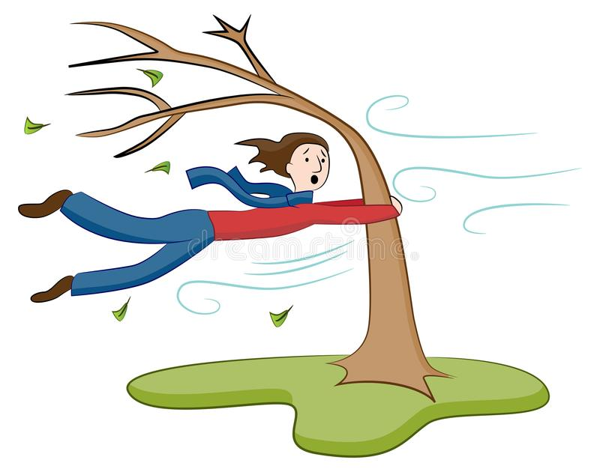
Examples
Today is windy
It´s spring in Mexico. It´s warm and very sunny.
It´s summer in Costa rica. It´s hot and humid.

Slide 5
Grammar focus
PRESENT CONTINUOUS:
Pronoun + is/are + verb ing+ object
She is wearing boots
Today is sunny, I am wearing a dress.
Today is raining, she is wearing a raincoat.

Slide 6
Example
It´s hot and sunny today. Michael is wearing light blue shorts and White sneakers.
He is wearing a White T-shirt, but he isn´t wearing a cap.

Slide 7
Grammar focus questions
Is/are+ pronoun+ verb ing+ object+?
Example: Are you wearing sunglasses? Yes, I am.
Is she wearing a dress? No, she isn´t.

Slide 8
Complete exercises 5,6,7,and 8 Workbook

