Slide 1
Class work
Practice prepositions of place, complete the following sentences

Slide 2
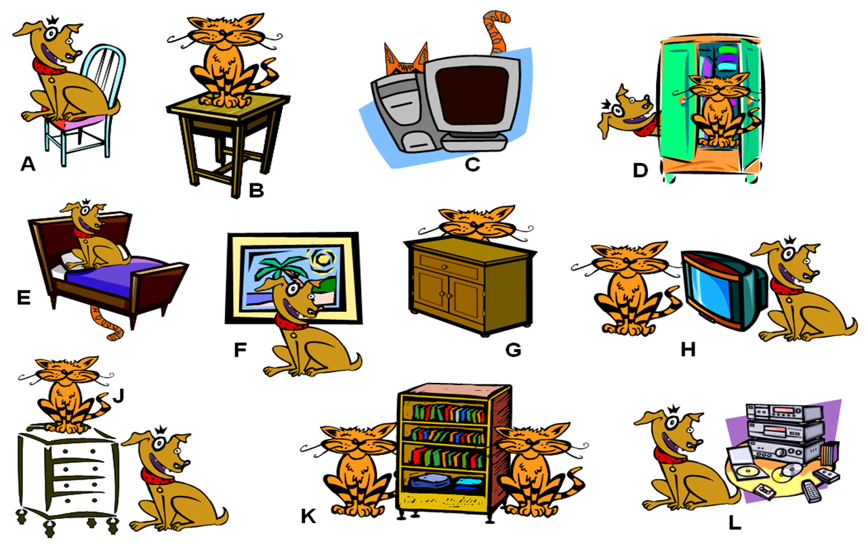
Class work
Write 10 sentences (min). use prepositions of place, practice with your partner orally

Slide 3
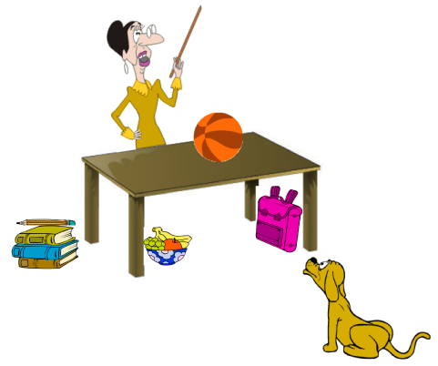
EXTRA Practice At home!!!
Make oral sentences use prepositions of place

