Slide 1
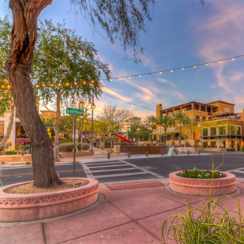
UNIT 1
Lesson 3
Saltillo
is a small city, but has great places to visit.
LESSON OBJECTIVE:
Learn what is a landmark.
Remind the use of is and has.
Learn and practice the use of conjuctions.

Slide 2
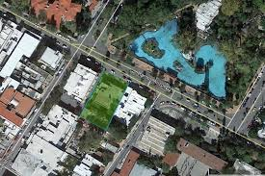
Speaking practice “Landmarks”
Talk about a local landmark in your country
Give some sentences, use is or has to give a description.
Saltillo is a big city, it has many places to visit.
Saltillo has Alameda
Alameda is a big park, it has a many tres
the center has too shoe stores, chinese shop and restaurants
The chinese shops are very cheap
-Insert a picture-

Slide 3
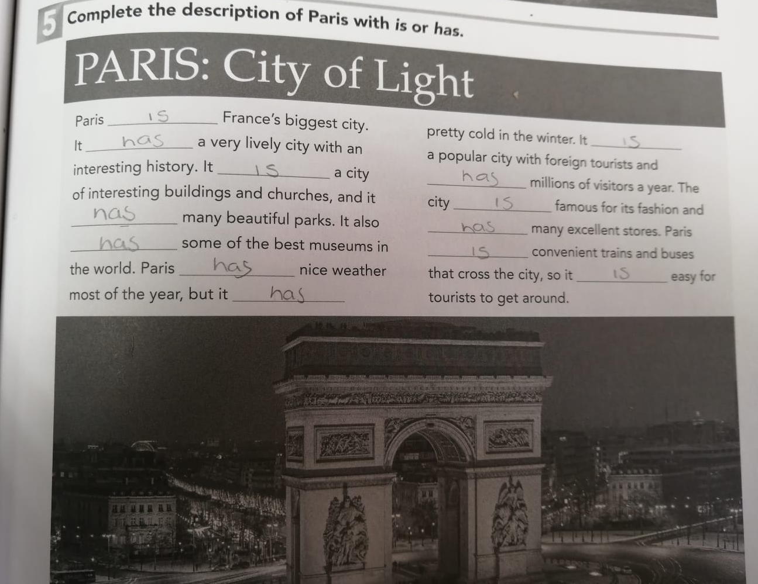
Grammar practice
Workbook pg 3 ex 5
Complete the description of Paris with is or has.

Slide 4
Grammar practice
Studentbook pg 82 ex 2

Slide 5
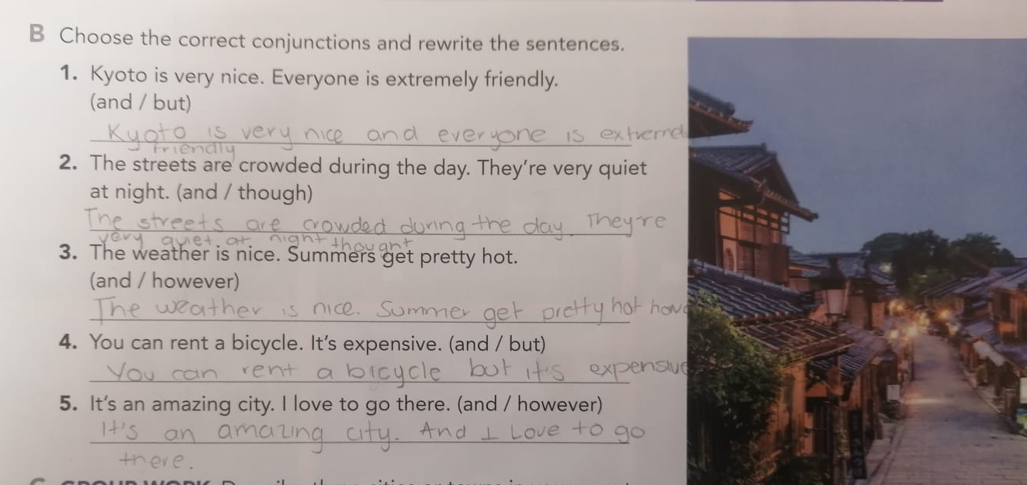
Grammar practice
Studentbook pg 3 ex B
Choose the correct conjuctions and rewrite the sentences.

Slide 6
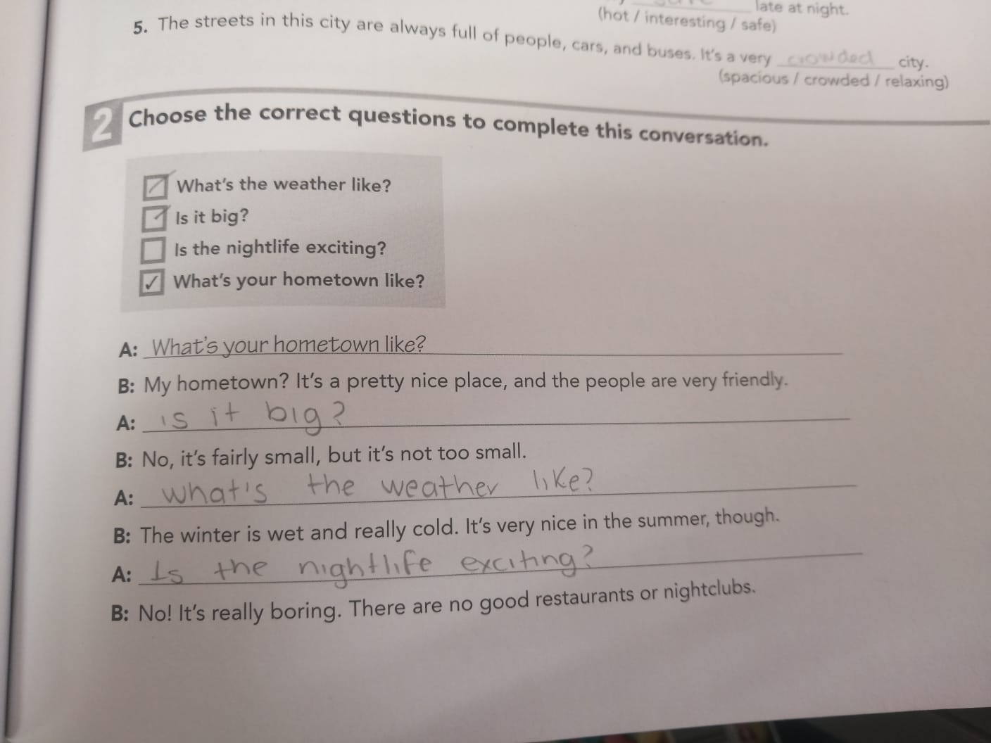
Grammar practice
Workbook pg 1 ex 2
Choose the correct questions to complete this conversation. Circle the conjuctions you find.

Slide 7
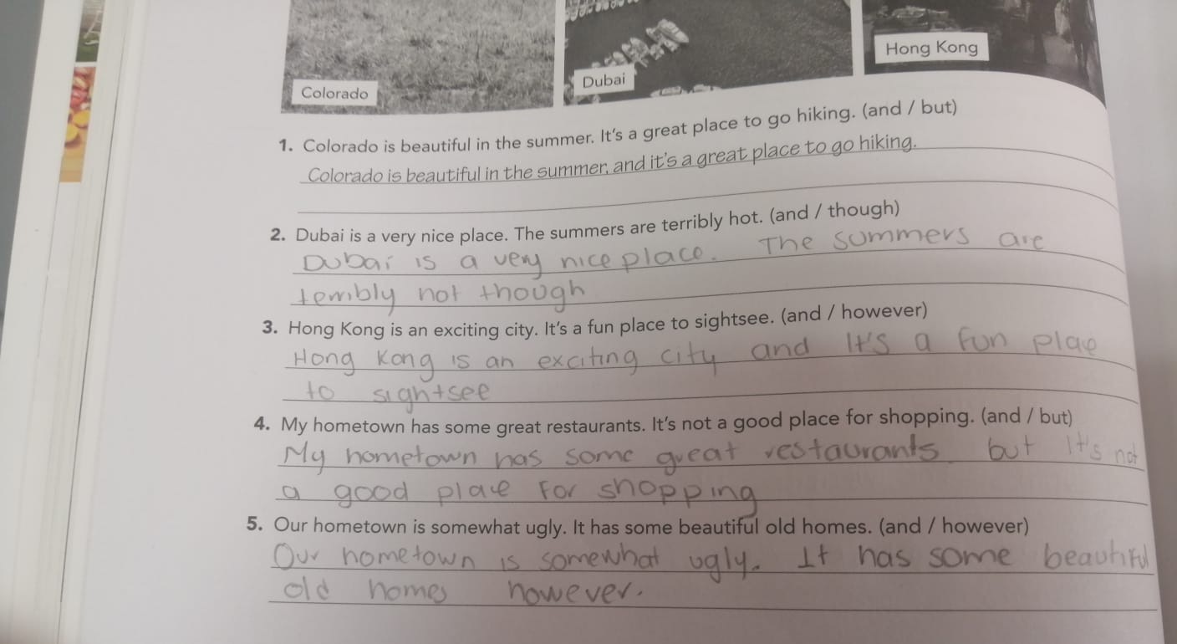
Grammar practice
Workbook pg 2 ex 3
Choose the correct conjuctions and rewrite the sentences.

Slide 8
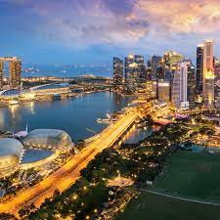
Writing practice
Studentbook pg 3 ex C
Describe one city or town in your country. State two positive features and one negative. (remind to use connectors to add or contrast information)
Example.-
Your description:
San Luis a big city and has many places to visit. But is too expensive
La huasteca potosina is a beatiful place and has many trees, however it’s dangerous.
Guadalajara is an exciting city and it’s a fun place to sightsee, but has many traffic
-Insert a picture-

Slide 9
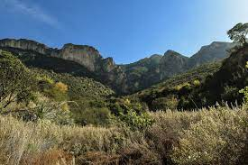
the san lorenzo canyon is a mountain in coahuila
Writing practice “ A great place to live”
Studentbook pg 4 ex 5
it's perfect for camping
Write about interesting places for tourists to visit in your hometown.
Example.-
Your description:
the san lorenzo canyon is a mountain in Coahuila
es un lugar muy bonito y relajante . Has many trees and birds, it's perfect for camping. but it is dangerous because of the fires and because you can get lost

