Slide 1
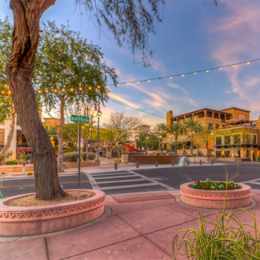
UNIT 1
Lesson 3
Saltillo
is a small city, but has great places to visit.
LESSON OBJECTIVE:
Learn what is a landmark.
Remind the use of is and has.
Learn and practice the use of conjuctions.

Slide 2
Grammar practice
Workbook pg 3 ex 5
Complete the description of Paris with is or has.

Slide 3
Grammar practice
Studentbook pg 82 ex 2

Slide 4
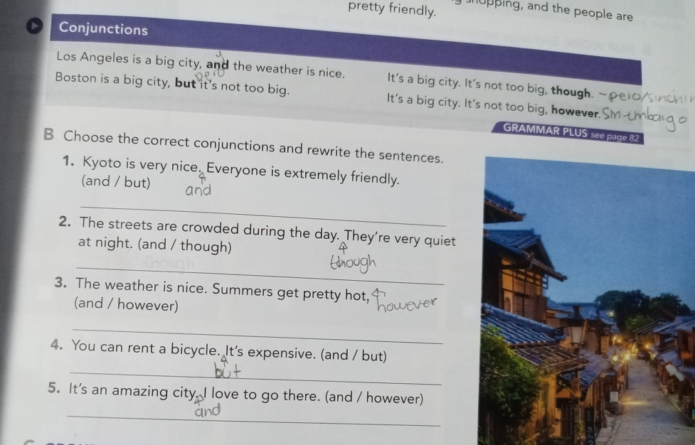
Grammar practice
Studentbook pg 3 ex B
Choose the correct conjuctions and rewrite the sentences.

Slide 5
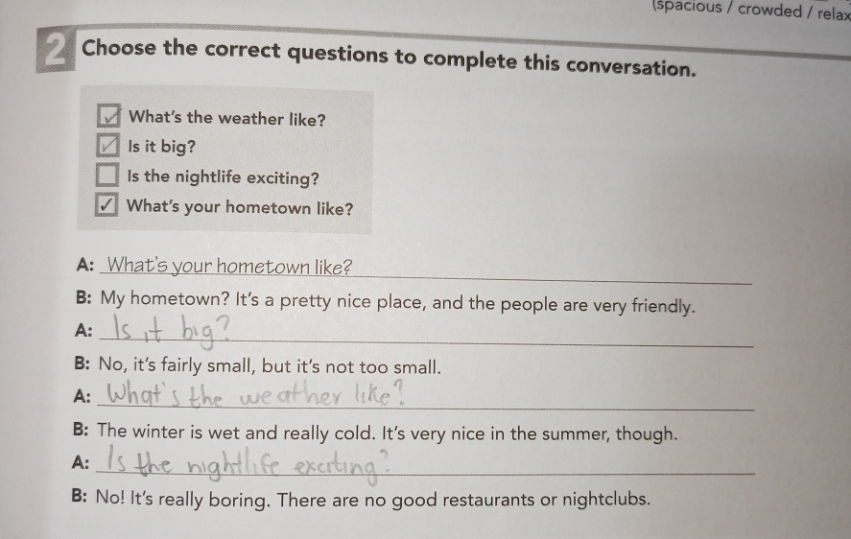
Grammar practice
Workbook pg 1 ex 2
Choose the correct questions to complete this conversation. Circle the conjuctions you find.

Slide 6
Grammar practice
Workbook pg 2 ex 3
Choose the correct conjuctions and rewrite the sentences.

Slide 7
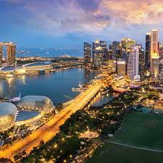
Writing practice
Studentbook pg 3 ex C
Describe one city or town in your country. State two positive features and one negative. (remind to use connectors to add or contrast information)
Example.-
Your description:
-Insert a picture-
________________________________________________________________________________________________________________________________________________________________________________________________________
Los cabos is a big city and has a beautiful beach, but it’s too expensive
Cuatrocienegas is a small city, but it’s pretty hot in the summer and has a good people

