Slide 1
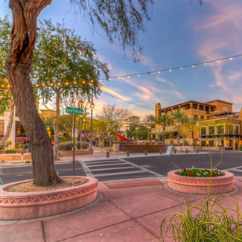
UNIT 1
Lesson 3
Saltillo
is a small city, but has great places to visit.
LESSON OBJECTIVE:
Learn what is a landmark.
Remind the use of is and has.
Learn and practice the use of conjuctions.

Slide 2
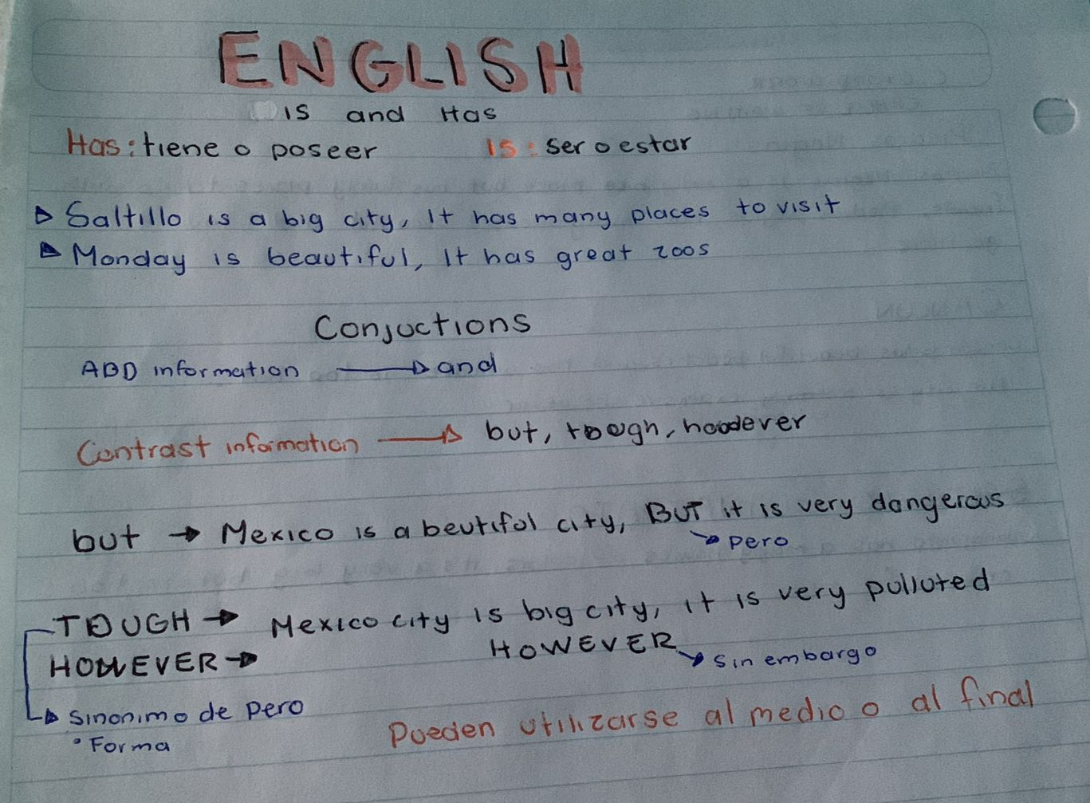
Speaking practice “Landmarks”
Talk about a local landmark in your country
Give some sentences, use is or has to give a description.
Los angeles is a big city, has many place to go.
Paris is a very lively city, it has millions of visitors a year.

Slide 3
Grammar practice
Workbook pg 3 ex 5
Complete the description of Paris with is or has.

Slide 4
Grammar practice
Studentbook pg 82 ex 2

Slide 5
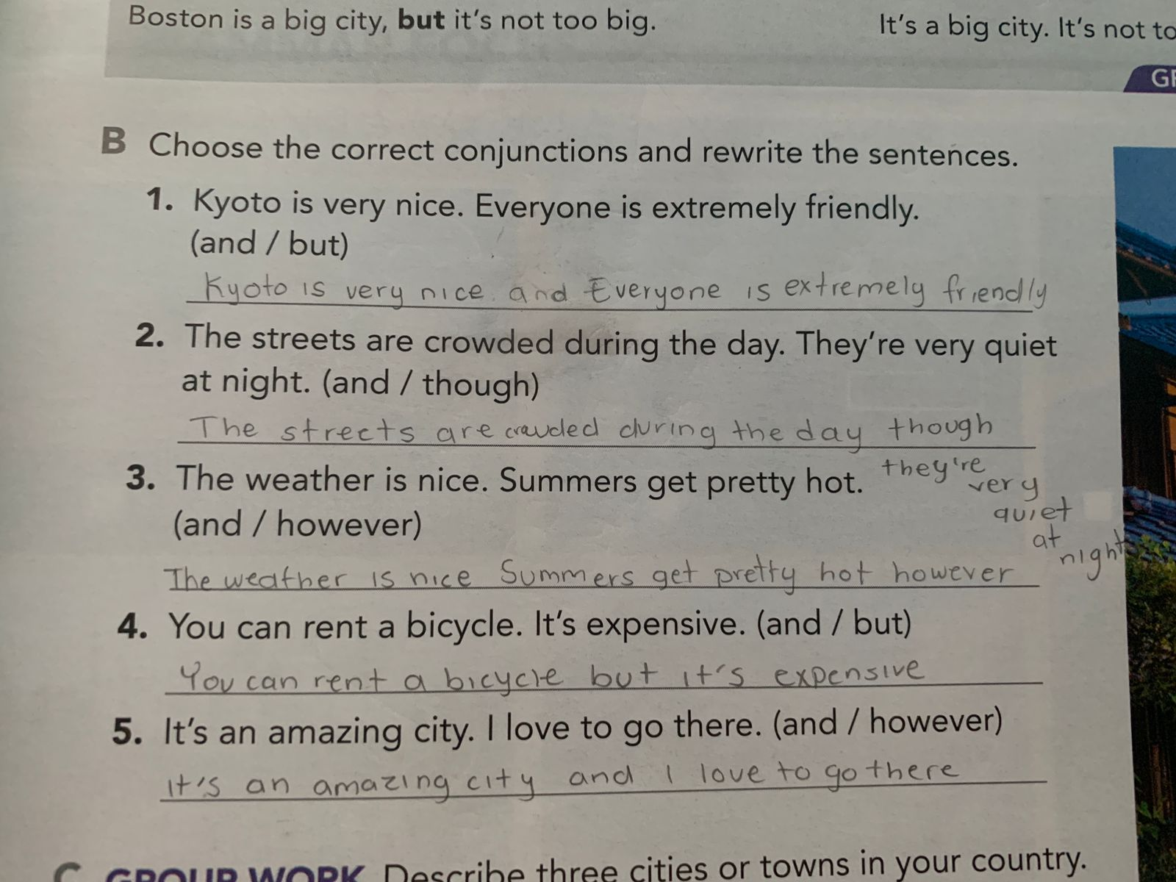
Grammar practice
Studentbook pg 3 ex B
Choose the correct conjuctions and rewrite the sentences.

Slide 6
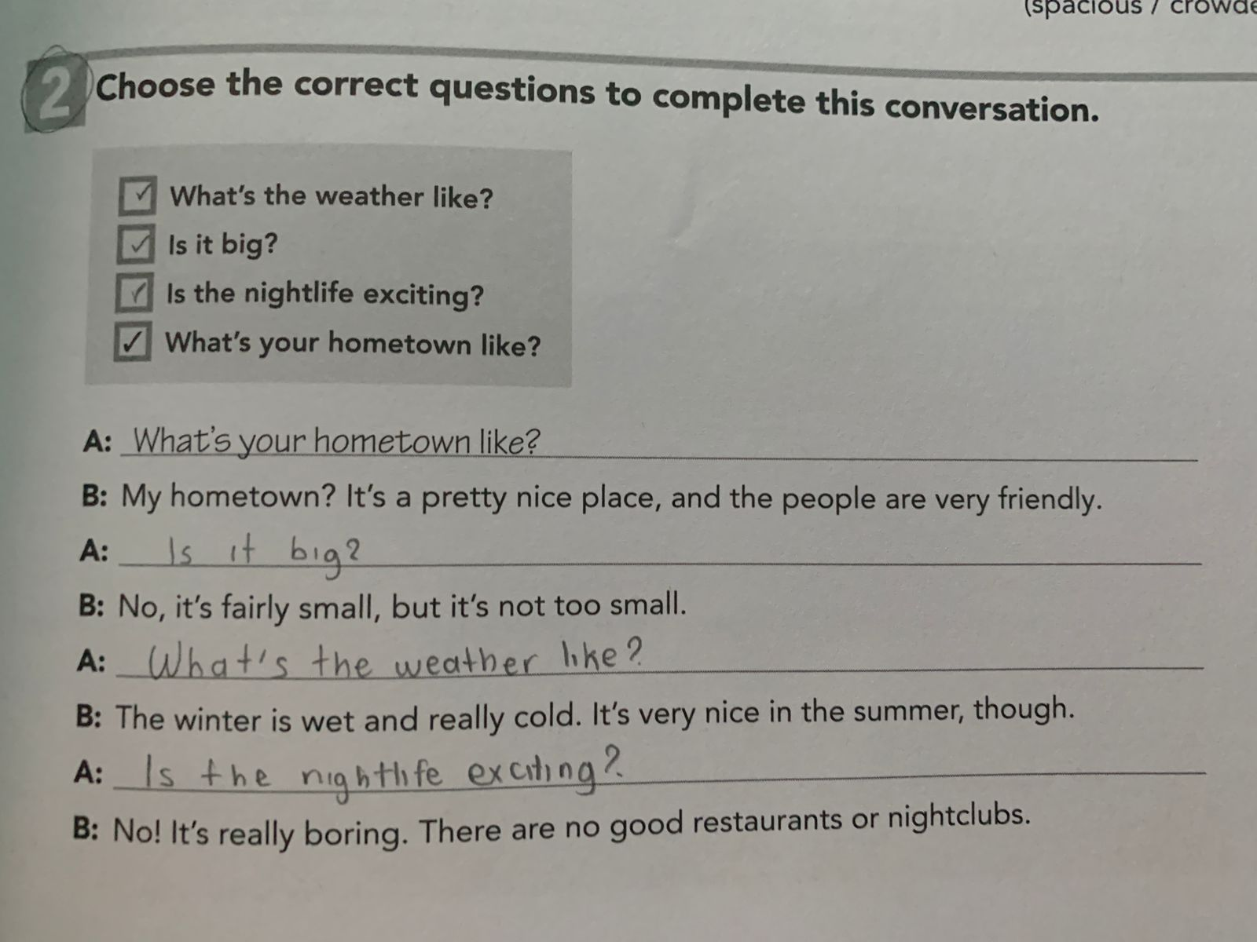
Grammar practice
Workbook pg 1 ex 2
Choose the correct questions to complete this conversation. Circle the conjuctions you find.

Slide 7
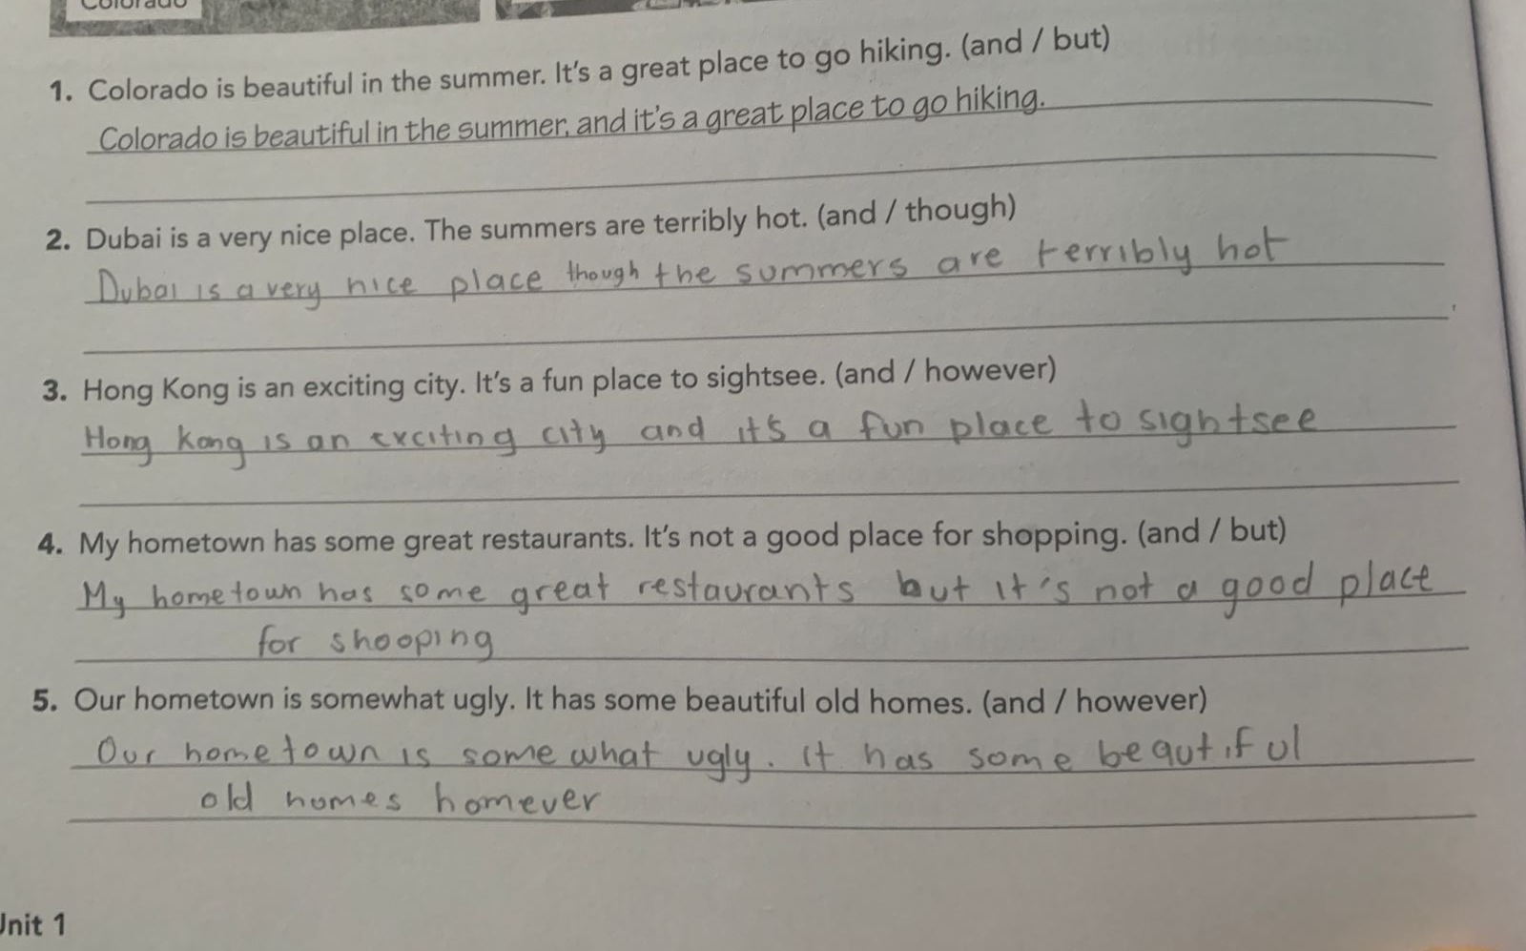
Grammar practice
Workbook pg 2 ex 3
Choose the correct conjuctions and rewrite the sentences.

Slide 8
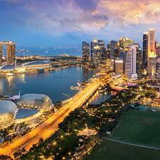
Writing practice
Studentbook pg 3 ex C
Describe one city or town in your country. State two positive features and one negative. (remind to use connectors to add or contrast information)
Example.-
Your description:
Piedras Negras is a really nice place but has fairly places to go with Friends. Piedras negras has a good people and i love to go there.
Cancun is has beautiful beaches and the weather is too hot. The city is a extremely expensive however.
Guanajuato has many colorful houses, the city is a very big but is too crowded for me.

Slide 9
Writing practice “ A great place to live”
Studentbook pg 4 ex 5
Write about interesting places for tourists to visit in your hometown.
Example.-
Your description:
New York is a place I am interested in going because it has great buildings, It is also a very big city, it has many places to go, but for that reason it is full of people. I really like New York City because it is a very beautiful city, though is extremely expensive and the weather is nice.

