Slide 1
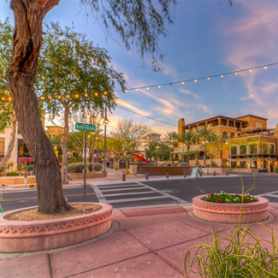
UNIT 1
Lesson 3
Saltillo
is a small city, but has great places to visit.
Monserrat Alejandro Sánchez
2°A
English A2.2
LESSON OBJECTIVE:
Learn what is a landmark.
Remind the use of is and has.
Learn and practice the use of conjuctions.

Slide 2
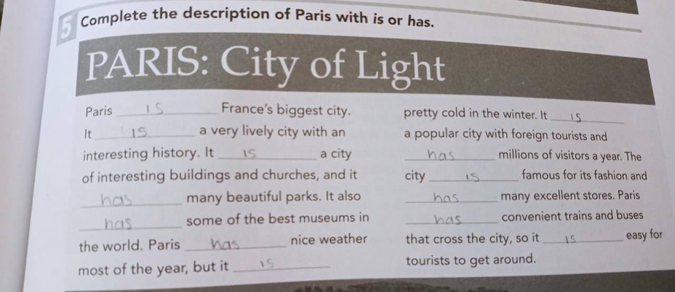
Grammar practice
Workbook pg 3 ex 5
Complete the description of Paris with is or has.

Slide 3
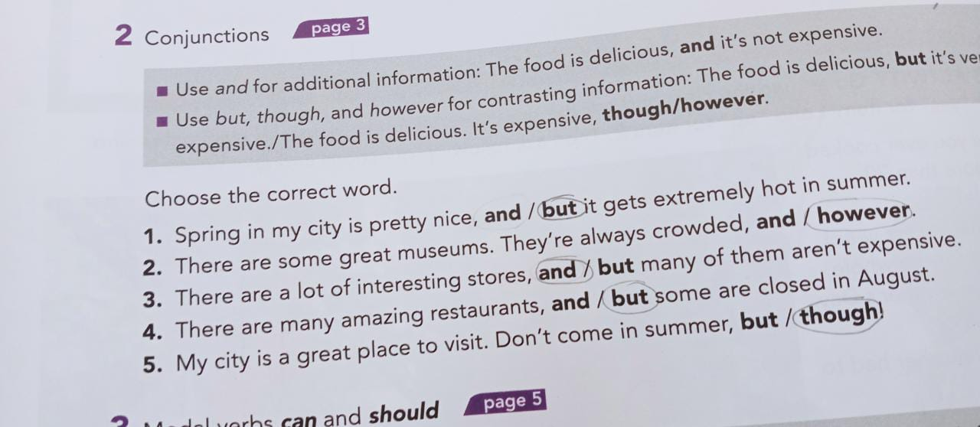
Grammar practice
Studentbook pg 82 ex 2

Slide 4
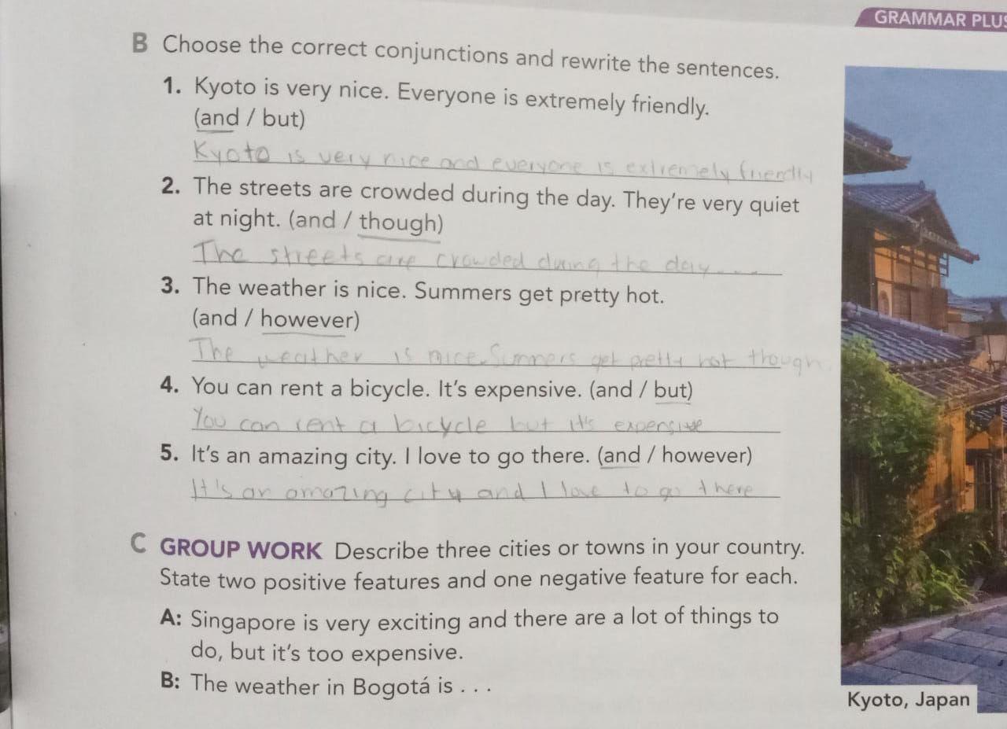
Grammar practice
Studentbook pg 3 ex B
Choose the correct conjuctions and rewrite the sentences.

Slide 5
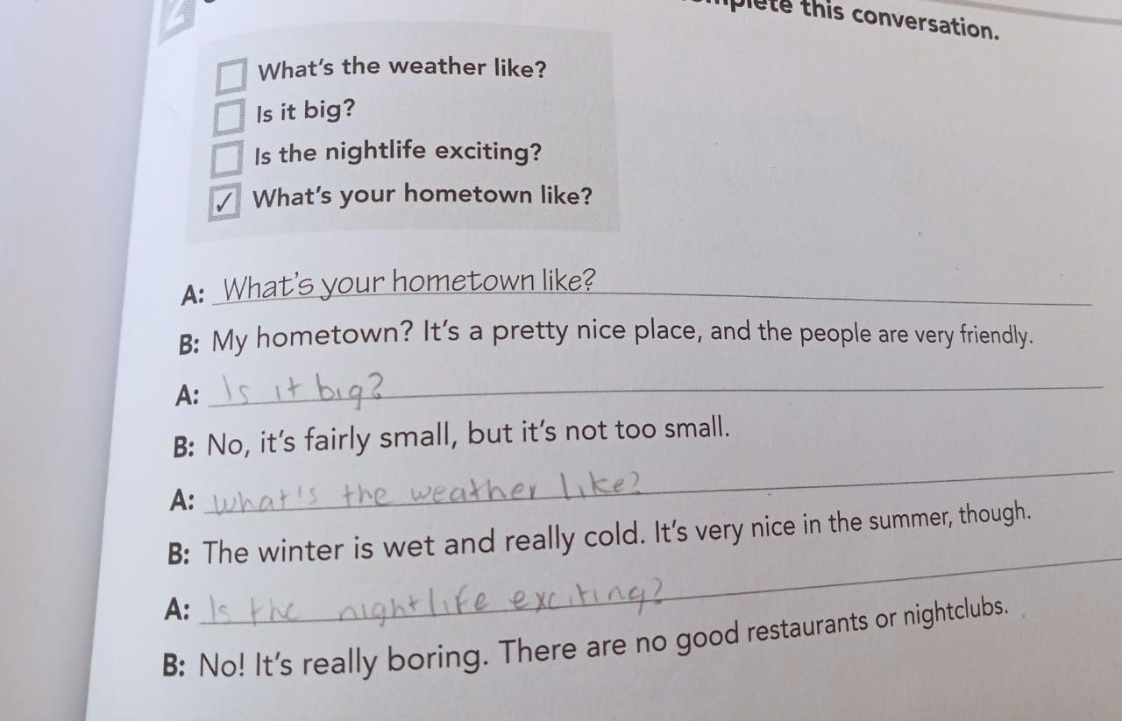
Grammar practice
Workbook pg 1 ex 2
Choose the correct questions to complete this conversation. Circle the conjuctions you find.

Slide 6
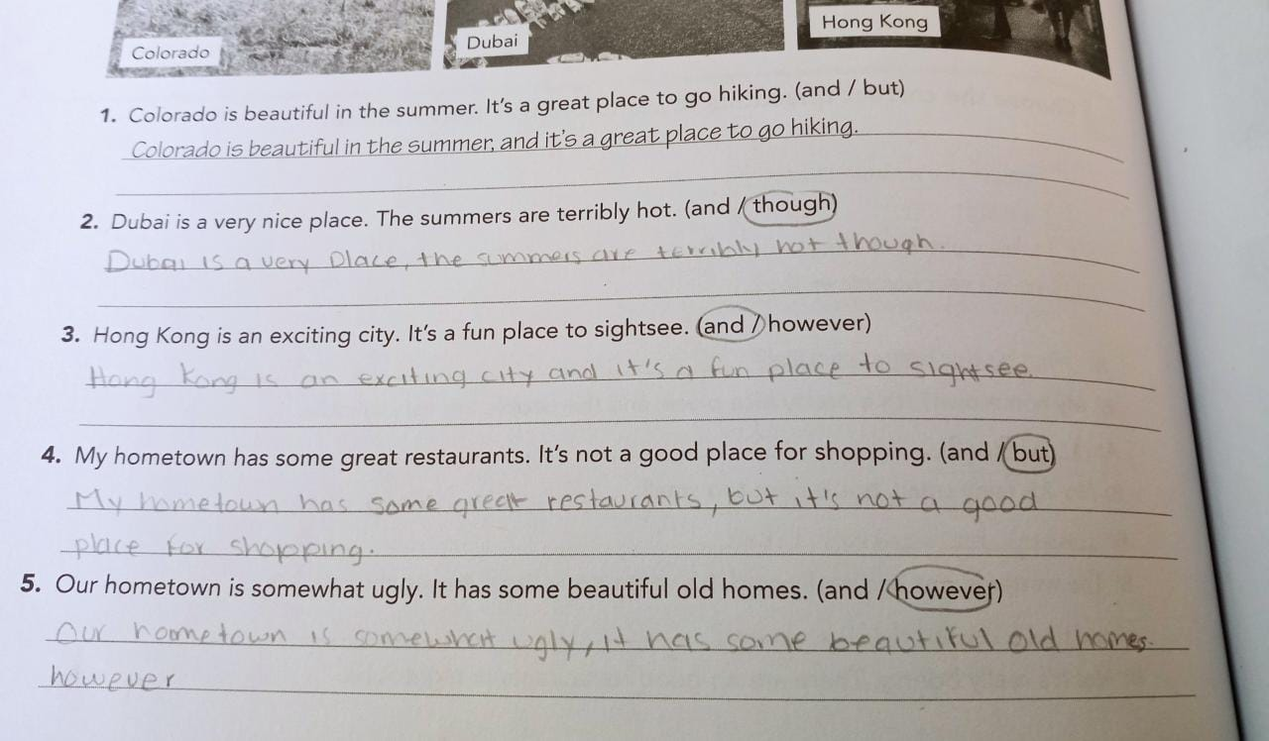
Grammar practice
Workbook pg 2 ex 3
Choose the correct conjuctions and rewrite the sentences.

Slide 7
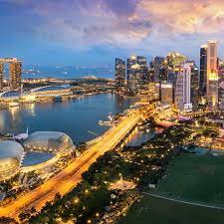
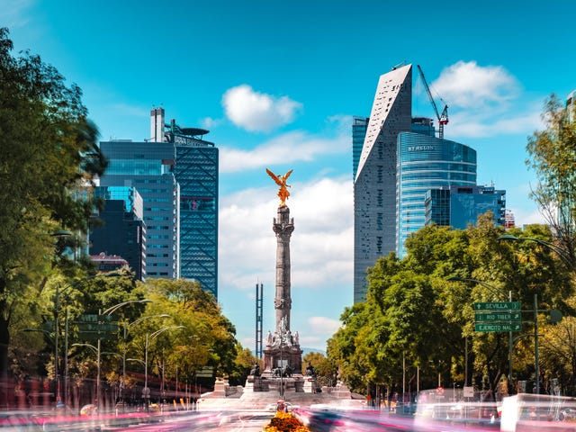
Writing practice
Studentbook pg 3 ex C
Describe one city or town in your country. State two positive features and one negative. (remind to use connectors to add or contrast information)
Example.-
Your description:
Mexico City is very huge and it has beautiful buildings, but it’s too polluted.
Monterrey is a beautiful city and it has many parks to visit but the weather is very hot.
San Luis Potosi is a historical city and it has beautiful waterfulls, it is a place not very safe though

Slide 8
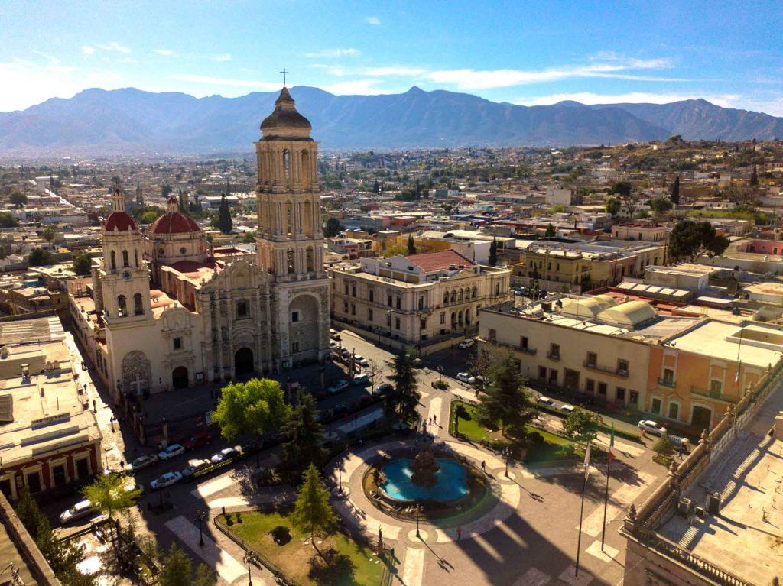
Writing practice “ A great place to live”
Studentbook pg 4 ex 5
Write about interesting places for tourists to visit in your hometown.
Example.-
Your description:
Saltillo is a very interesting and extremely beauty town in Coahuila, it has museums to visit, it parks are beautiful and clean, the town is big but not too big like Mexico city. It catedral is too pretty and it’s big. It’s a safe city.

