Slide 1
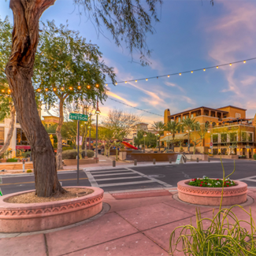
UNIT 1
Lesson 3
Saltillo
is a small city, but has great places to visit.
LESSON OBJECTIVE:
Learn what is a landmark.
Remind the use of is and has.
Learn and practice the use of conjuctions.

Slide 2
Speaking practice “Landmarks”
Talk about a local landmark in your country
Give some sentences, use is or has to give a description.
-Insert a picture-

Slide 3
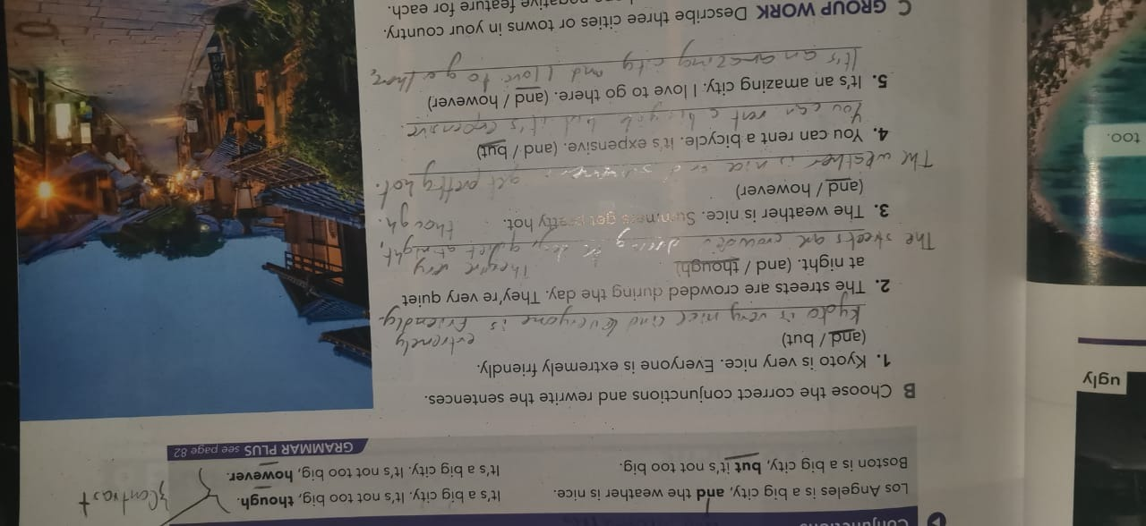
Grammar practice
Workbook pg 3 ex 5
Complete the description of Paris with is or has.

Slide 4
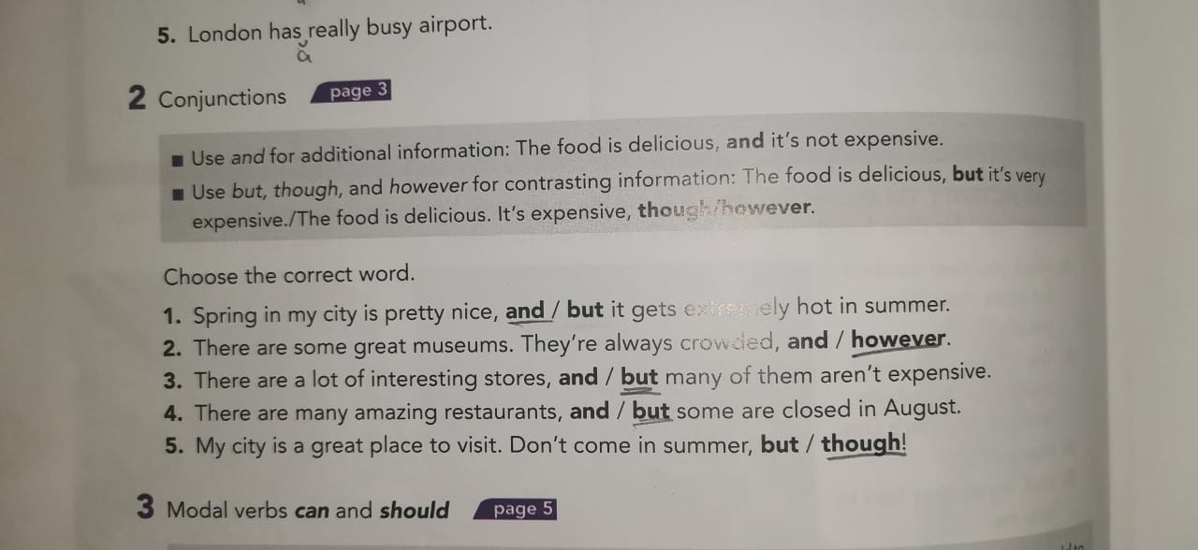
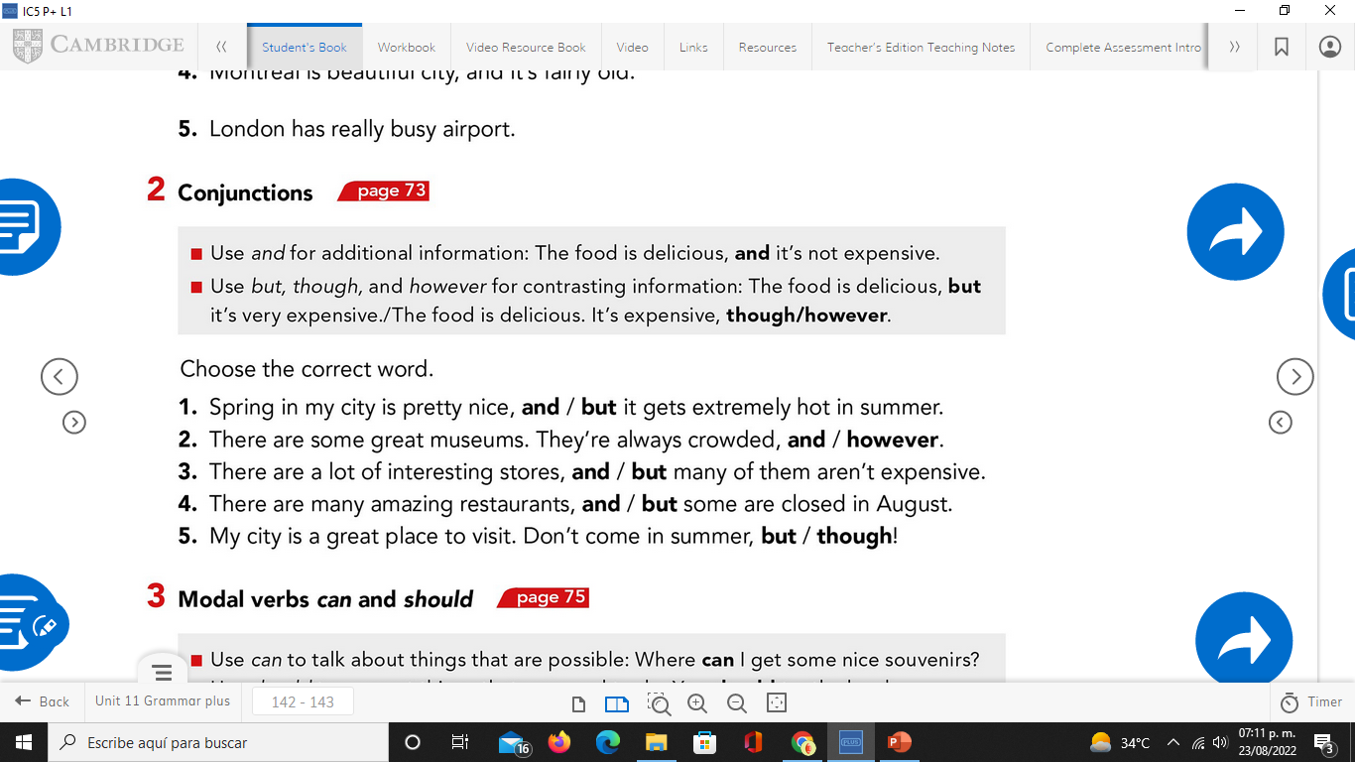
Grammar practice
Studentbook pg 82 ex 2

Slide 5
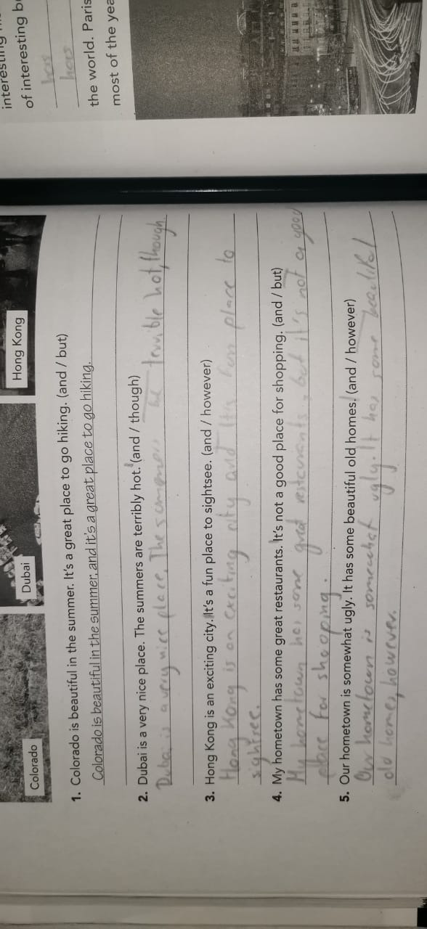
Grammar practice
Studentbook pg 3 ex B
Choose the correct conjuctions and rewrite the sentences.

Slide 6
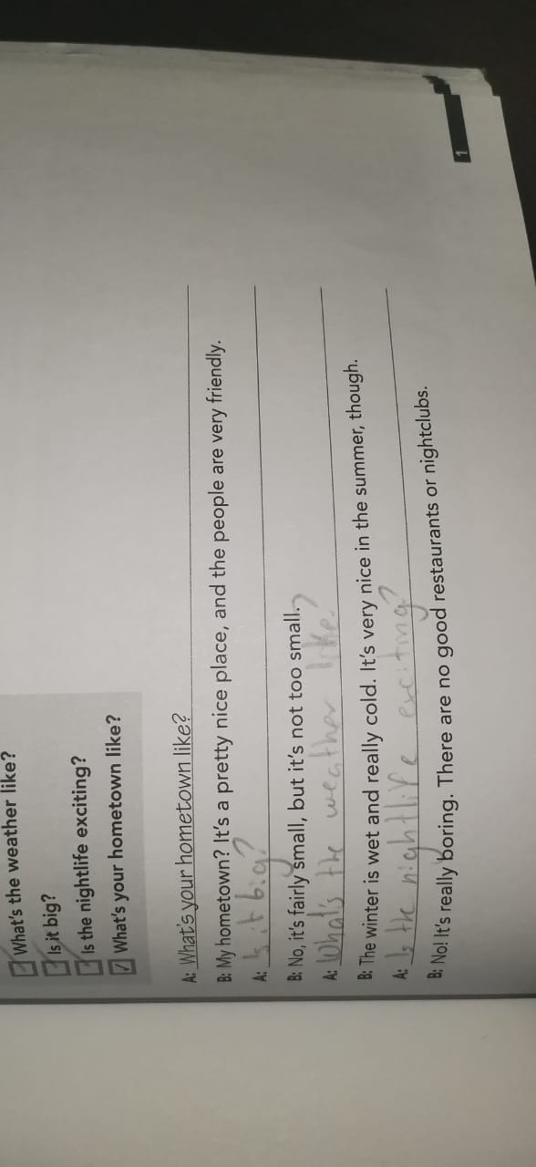
Grammar practice
Workbook pg 1 ex 2
Choose the correct questions to complete this conversation. Circle the conjuctions you find.

Slide 7
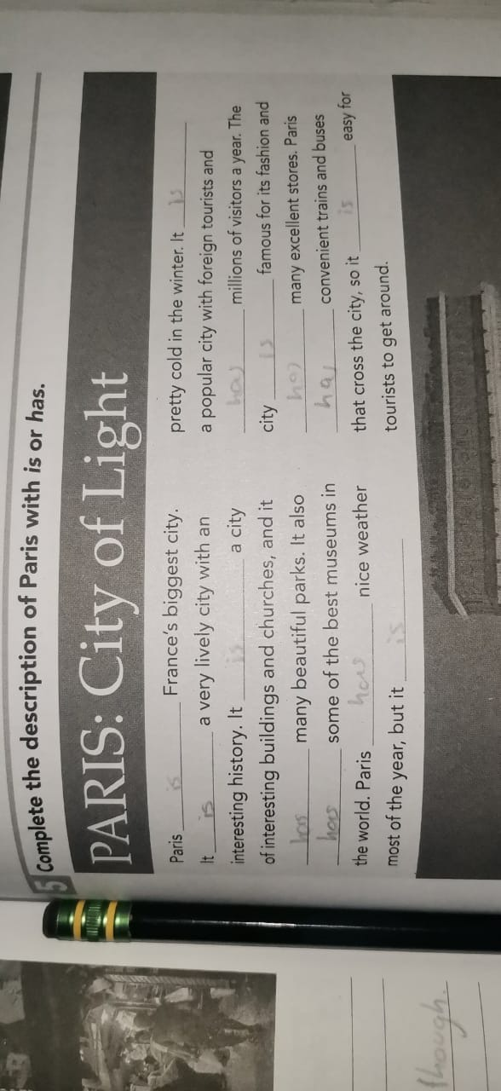
Grammar practice
Workbook pg 2 ex 3
Choose the correct conjuctions and rewrite the sentences.

Slide 8
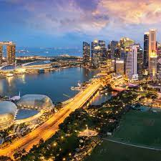
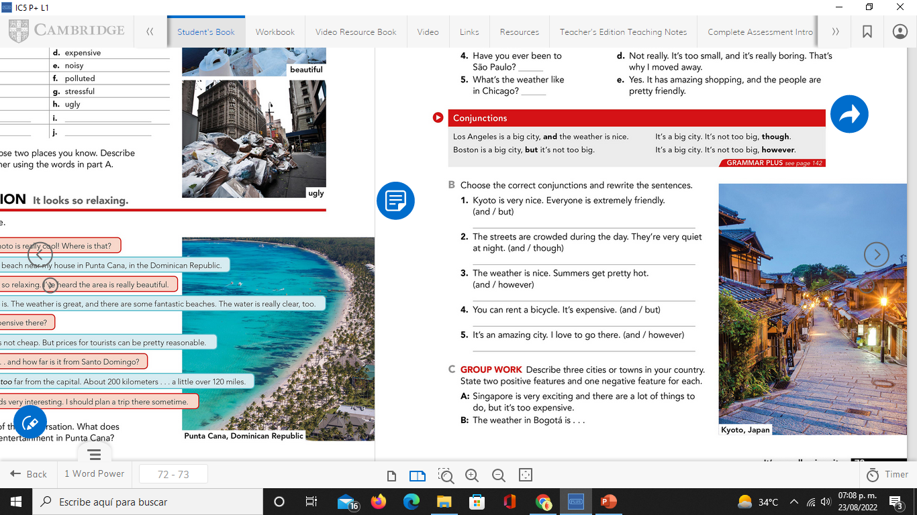
Writing practice
Studentbook pg 3 ex C
Describe one city or town in your country. State two positive features and one negative. (remind to use connectors to add or contrast information)
Example.-
Your description:
_Guadalajara is really beautiful and big city but has too traffic._
_The deportiva is very pretty and has meny games, it’snot very clean, however._
_Puerto Vallarta is a really big and colorful city, it has crime everywhere, thought._
-Insert a picture-

Slide 9
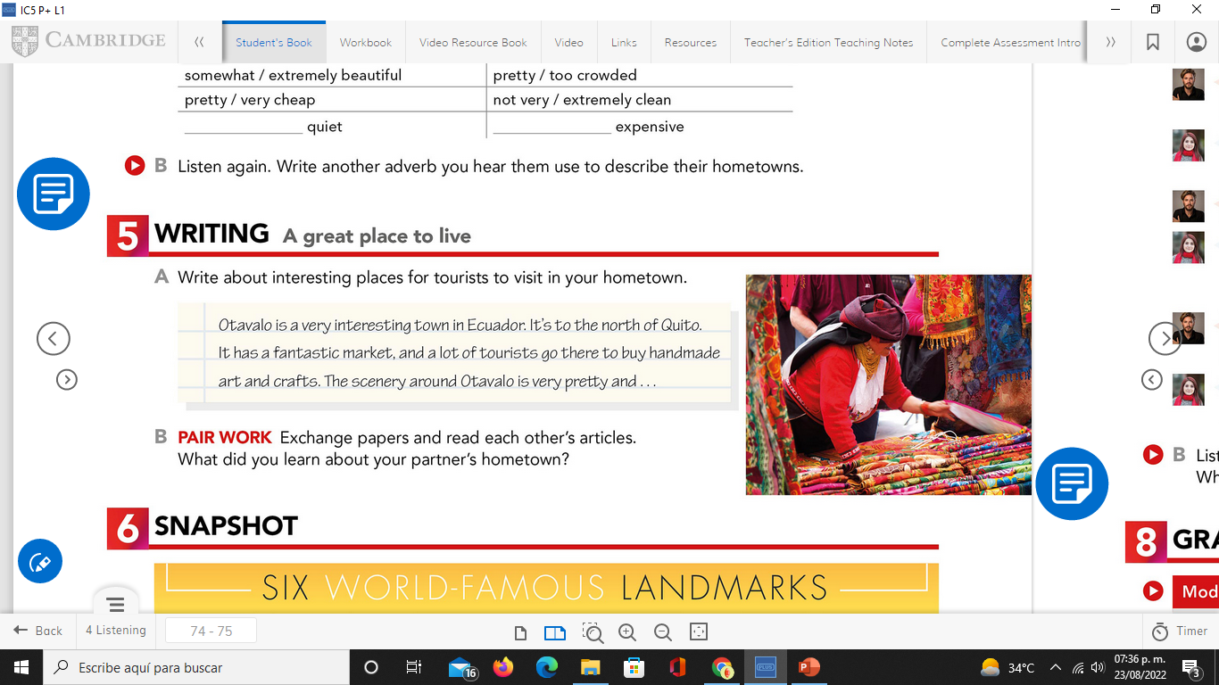
Writing practice “ A great place to live”
Studentbook pg 4 ex 5
Write about interesting places for tourists to visit in your hometown.
Example.-
Your description:
-Insert a picture-
_Saltillo is a small but very pretty city. It has very interesting museums, for example about dinosaurs or catrinas, the center is too big with very striking places as well as restaurants with very tasty food._

